Slide 1
LISTING 1.21 CONTINUING SURGICAL MANAGEMENT

Slide 2
OBJECTIVES
DEFINE CONTINUING SURGICAL MANAGEMENT
DEFINE SOFT TISSUE STRUCTURES
IDENTIFY SOFT TISSUE INJURIES OR ABNORMALITIES
CALCULATE DURATION
DEFINE MAXIMUM MEDICAL BENEFIT
SHOW EXEMPLARY CASES

Slide 3
1.21 SOFT-TISSUE INJURY OR ABNORMALITY UNDER CONTINUING SURGICAL MANAGEMENT
INCLUDES ANY BODY PART (MUSCLE, TENDON, LIGAMENT, SKIN)
EXAMPLES: BURNS, CRUSH INJURIES, CRANIOFACIAL INJURIES, AMPUTATIONS WITH COMPLICATIONS, OPEN FRACTURES WITH SEVERE SOFT-TISSUE INJURY, INFECTION, NON-HEALING DIABETIC FOOT ULCERS
UNDER CONTINUING SURGICAL MANAGEMENT FOR AT LEAST 12 MONTHS AND WITHOUT MAJOR FUNCTIONAL USE OF THE INVOLVED BODY PART
ALL TREATMENT MODALITIES ARE INCLUDED IN DEFINING CONTINUING SURGICAL MANAGEMENT
ENDS WHEN MAXIMUM MEDICAL BENEFIT IS ACHIEVED; 6 MONTHS AFTER LAST SURGERY OR MEDICAL TREATMENT
CONSTRUCT AN RFC WHENCE MAXIMUM MEDICAL BENEFIT ACHIEVED
DOES NOT REQUIRE ONE OF THE FUNCTION-RELATED CRITERION

Slide 4
1.21 Soft tissue injury or abnormality under continuing surgical management (see 1.00L), documented by A, B, and C:
A. Evidence confirms continuing surgical management (see 1.00L) directed toward saving, reconstructing, or replacing the affected part of the body.
AND
B. The surgical management has been, or is expected to be, ongoing for a continuous period of at least 12 months.
AND
C. Maximum medical benefit from therapy (see 1.00O1) has not yet been achieved.

Slide 5
CAN INVOLVE INJURIES OR ABNORMALITIES TO:
ANY BODY PART EXCEPT THE BONY SKELETON (WHY NOT?!)
MUSCLES
TENDONS
LIGAMENTS
SKIN
INTRA-ABDOMINAL AND INTRA-THORACIC STRUCTURES

Slide 6
EXAMPLES
BLUNT TRAUMA/CRUSH INJURIES
PENETRATING TRAUMA (GSW, STAB WOUNDS)
BURNS
ELECTRICAL INJURIES
ISCHEMIC INJURIES
INFECTIONS
NON-HEALING FOOT ULCERS
AMPUTATIONS WITH COMPLICATIONS
OPEN FRACTURES WITH SEVERE SOFT TISSUE INJURY

Slide 7
TREATMENT MODALITIES
ALL TREATMENT MODALITIES ARE INCLUDED IN DEFINING CONTINUING SURGICAL MANAGEMENT
SURGICAL PROCEDURES. NO SPECIFIC NUMBER NEEDED TO MEET LISTING
PHARMACOTHERAPY: MEDICATIONS
INTRA-ARTICULAR STEROID INJECTIONS
PHYSICAL THERAPY: RESTORES FUNCTION
OCCUPATIONAL THERAPY: ADAPT TO DISABILITY AND IMPROVE FUNCTION
INTERVENTIONAL MODALITIES: EPIDURAL STEROID INJECTIONS
WOUND CARE
CASTING
ORTHOTICS AND PROSTHETICS

Slide 8
PYRAMIDAL TREATMENT
BEGIN WITH MOST CONSERVATIVE TREATMENT MODALITIES
CONSERVATIVE TREATMENT DEFINED AS TREATMENT THAT IS LEAST LIKELY TO RESULT IN COMPLICATIONS
TIME IS ELAPSING WITH PROGRESSION TO MORE RADICAL TREATMENT MODALITIES
CALCULATE ESTIMATED TIME FOR POST-OPERATIVE RECOVERY AND THE ATTAINMENT OF MAXIMUM MEDICAL BENEFIT
CONTINUING SURGICAL MANAGEMENT ENDS WHENCE MAXIMUM MEDICAL BENEFIT IS ACHIEVED
DEFINED AS 6 MONTHS FOLLOWING LAST SURGERY OR MEDICAL TREATMENT PER PREAMBLE 1.00O
CONSTRUCT AN RFC WHENCE MAXIMUM MEDICAL BENEFIT IS ACHIEVED

Slide 9
TREATMENT PYRAMID
? MONTHS POST-ONSET
SURGERY
SCS
FACET BLOCKS, RFA
EPIDURAL STEROIDS
ORAL STEROIDS
NSAID, PHYSICAL THERAPY
ONSET
ACTIVITY MODIFICATION

Slide 10
EXAMPLE 1: ROTATOR CUFF TEAR
CONFLUENCE OF 4 TENDONS FROM SCAPULA TO PROXIMAL HUMERUS FORMING A CUFF
TENDON = SOFT TISSUE
SURGERY WHEN FAILED CONSERVATIVE TREATMENT. 3-4 MONTHS POST-INJURY
COMPLICATIONS: RECURRENT TEAR AND ADHESIVE CAPSULITIS (FROZEN SHOULDER)

Slide 11
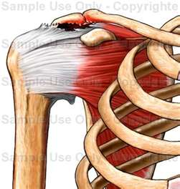
ROTATOR CUFF TEAR
ACROMION
TEAR OF ROTATOR CUFF
(TENDON)

Slide 12
MEETS LISTING 1.21
Initial Title II claim with AOD 2/1/22, DLI in the future, no prior filings; POD = AOD per the FO.
45-year-old man injured his right shoulder on 2/1/22 presenting with pain and the inability to abduct his arm. X-rays were negative for fracture or dislocation and an MRI showed a partial-thickness rotator cuff tear. Initial management involved non-steroidal anti-inflammatory medication and physical therapy. There was no improvement after 3 months, and arthroscopic surgery was undertaken on 5/2/22; rotator cuff tear had progressed to full-thickness. The shoulder was immobilized for 3 weeks allowing for tendon healing, then formal physical therapy was begun. Claimant continued to complain of pain and LOM of the shoulder 3 months following the surgery, and an MRI confirmed a recurrent tear. A second arthroscopic repair was done on 9/3/22. Pain and severe stiffness of the shoulder persisted after 3-months and the claimant was diagnosed with adhesive capsulitis (frozen shoulder). A third surgical procedure was done on 12/5/22 that involved a manipulation under anesthesia (MUA) and arthroscopic lysis of adhesions. Estimated time for post-operative recovery and the achievement of maximum medical benefit is 3-4 months, hence disability is expected to exceed 12 months post-injury.
CONCLUSION: Claimant under continuing surgical management for soft tissue injury to his right shoulder per the criteria of listing 1.21A, B, and C, as defined in preamble 1.00L. Onset is the day of injury.

Slide 13
EXAMPLE 2: DIABETIC FOOT ULCERS
LIMB THREATENING COMPLICATION
DIABETES: SMALL VESSEL DISEASE (MICROANGIOPATHY) + PERIPHERAL NEUROPATHY PREDISPOSES TO INFECTED, NON-HEALING ULCERS.
CAN EQUAL LISTING 4.11B (CHRONIC VENOUS INSUFFICIENCY)
MEET LISTING 1.21A, B, AND C

Slide 14
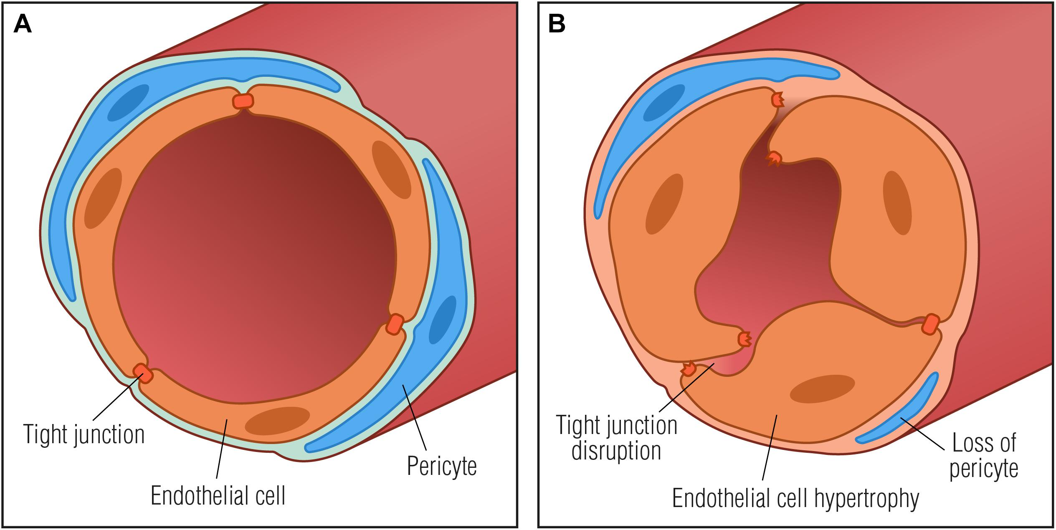
DIABETIC MICROANGIOPATHY

Slide 15
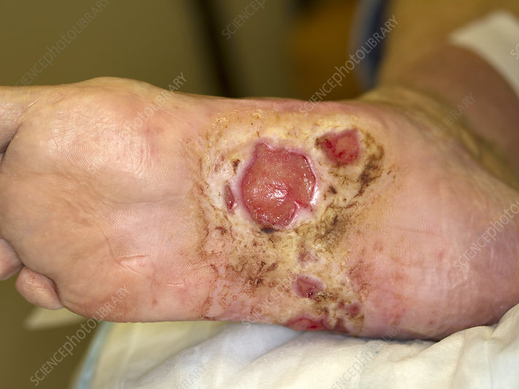
NON-HEALING DIABETIC FOOT ULCER

Slide 17
RECURRENT DIABETIC FOOT ULCERS MEET LISTING 1.21
Initial concurrent claims with AOD 1/1/19, DLI 3/31/21, prior denial 3/3/21; POD = 12/31/18 per the FO.
Claimant is now a 44-year-old diabetic man with a long history of large, infected, non-healing ulcers of both feet, and a severe Charcot arthropathy of his left foot. The following is the chronological history from the prior claim:
Admitted to Harmon Hospital 6/26/19 to 7/24/19 and again from 9/30/19 to 12/1/19 with infected foot ulcerations. Management included wound care and parenteral antibiotics until 11/9/19. It should be noted that the claimant was wheelchair-bound prior and subsequent to these time periods.
Documentation from LV Vascular and Interventional SHH from 8/7/19 to 10/15/19 indicating large non-healing ulcers of both feet requiring ongoing management. Documentation of claimant being wheelchair-bound again noted.
9/27/19: Claimant underwent resection of the metatarsal head of his right 5th toe due to non-healing ulceration and osteomyelitis.
Consultation examination done on 12/18/19 again documents non-healing ulcers of both feet. Examiner opines that the claimant was incapable of performing even sedentary work as standing/walking limited to less than 2 hours in an 8-hour workday.
Claimant underwent major reconstructive surgery with application of an external fixator on 1/17/20; he was re-admitted to the hospital from 1/20/20 to 1/21/20 for pin site care and ongoing wound care on his right foot where he had a Wagner Stage 3 ulcer of his hallux; the fixator was removed on 2/21/20.
Hospitalizations due to chronic infections/complications from current claim in chronological order:
6/19/19 to 6/20/19.
10/5/19 to 10/6/19: Admitted due to bleeding from surgical wound and ongoing wound care.
9/7/20 to 9/21/20.
11/12/20 to 11/17/20 due to osteomyelitis of the left midfoot.
2/22/21: Documentation from Woundtech.
5/20/20 to 6/2/21: Underwent a left BKA. Transferred to inpatient rehabilitation center where he was discharged on 6/17/21.
7/25/19 to 4/6/22: Documentation from Apollo Medical Group.
5/4/22: Admitted to Sunrise Hospital due to right foot wound. Management included wound care and application of wound VAC. Claimant subsequent underwent amputation of his right 4th toe on 6/22/22. He was hospitalized for 3 weeks, thence was transferred to a rehabilitation facility for a month.
CONCLUSION: Claimant has been under continuing surgical management for soft-tissue abnormality and complications involving BLE per the criteria of listing 1.21A, B, and C as defined in preamble 1.00L. Impairment does, therefore, satisfy the criteria to meet the listing. The earliest documentation is from 6/19/19, however, considering the history, the size, and nature of the wounds, reasonable inference can be used to establish a favorable date of onset. Failure to recognize an impairment of listing level severity constitutes error on the face of the evidence which warrants a re-opening of the prior claim.

Slide 18
DIABETIC FOOT ULCERS (1.21 AND 4.11B)
Initial concurrent claims with AOD 1/7/21, DLI 3/31/20, prior denials due to IE; POD = 1/31/18 per the FO.
Claimant is now a 51-year-old man with diabetic peripheral neuropathy and a long history of infected, non-healing ulcerations of both feet. The MER documents the following hospital admissions and surgical procedures in chronological order:
3/3/18 to 3/5/18 due to infected, non-healing ulcer of left foot treated with surgical debridement and intravenous antibiotics.
1/19/19 to 1/23/19 admitted due to persistent non-healing foot ulcers treated with surgical debridements and intravenous antibiotics.
1/29/20 admitted to ED with a one-year history of chronic ulceration of left foot.
6/28/20 admitted for irrigation and surgical debridement of both feet.
1/16/21 to 1/21/21 admitted due to infected foot ulcer and osteomyelitis of left foot. Treated with surgical debridement and intravenous antibiotics.
1/22/21 to 2/24/21 admitted for surgical debridement and intravenous antibiotics.
6/12/21 admitted for surgical debridement and amputation of 2nd toe left foot.
5/6/22 to 5/12/22 admitted with infected ulcers of both feet; underwent amputation of right 4th toe at MTPJ level.
9/18/22 admitted with infected ulcerations; underwent surgical procedure on 9/23/22.
10/11/22 admitted for surgical debridement of infected ulcer plantar aspect of left foot.
1/19/23 admitted for surgical debridement and arthroplasty of left third toe.
CONCLUSION: Claimant has been under continuing surgical management for soft tissue abnormality of both lower extremities (infected non-healing foot ulcers) per the criteria of listing 1.21A, B, and C, as defined in preamble 1.00L. He has not achieved maximum medical benefit per 1.00O. Impairment does, therefore, meet listing. The medical onset date can reasonably be inferred as of the POD (1/31/18). Prognosis is poor.

Slide 19
EXAMPLE 3: TRAUMATIC AMPUTATION OF HAND MEETS LISTING 1.21
Initial Title II claim with AOD 01/05/23, DLI in the future, no prior filings.
20-year-old man involved in an MCA on 01/05/23 sustaining a near complete traumatic amputation of his dominant right hand between the proximal and distal carpal rows. Initial surgical management included bony stabilization, revascularization of the hand, repair of tendons, nerves, and ligaments,, and application of a spanning external fixator. The fixator was subsequently removed, and he underwent partial amputation of the thumb, debridement of the palmar aspect of the hand, and application of BTM skin substitute on 01/29/23 as detailed in the operative report. He has subsequently undergone the following surgical procedures:
02/16/23: Excisional debridement of open wound, STSG, and application of wound VAC.
03/08/23: Free-flap coverage of large palmer wound using latissimus dorsi due to skin graft failure. Claimant is currently undergoing occupational therapy and splinting and will require additional reconstructive surgical procedures and extensive rehabilitation before he regains any functional use of his right hand. Disability is, therefore, expected to exceed 12 months post-injury.
CONCLUSION: Claimant under continuing surgical management for severe soft tissue and bony injuries to his right hand per the criteria of listing 1.21A, B, and C, as defined in preamble 1.00L. Onset is the day of injury.

Slide 20
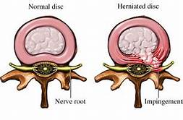
EXAMPLE 4: HERNIATED NUCLEUS PULPOSUS (HNP)
NUCLEUS PULPOSUS
ANNULUS FIBROSUS
NERVE ROOT
NORMAL DISC
HERNIATED DISC
(COMPRESSING NERVE ROOT)
(INTERVERTEBRAL DISC IS A FIBROCARTILAGENOUS STRUCTURE)

Slide 21
HNP OF THE LSS EQUALS LISTING 1.21
DAY 1: 51-YEAR-OLD MAN PRESENTING WITH LBP AFTER INJURING HIS BACK AT WORK. MRI SHOWS AN HNP AT L5-S1
3 MONTHS POST-INJURY: SYMPTOMS HAVE FAILED TO RESPOND TO CONSERVATIVE MANAGEMENT, INCLUDING PHARMACOTHERAPY, FORMAL PHYSICAL THERAPY, CHIROPRACTIC MANIPULATIONS, AND ACUPUNCTURE
LESI’S X 3 AT WEEKLY INTERVALS WITHOUT BENEFIT
DISKECTOMY WITHOUT FUSION AT 6 MONTHS POST-INJURY WITH PERSISTENT PAIN
DECOMPRESSION AND FUSION AT 9 MONTHS POST-INJURY. ESTIMATED TIME FOR POST-OPERATIVE RECOVERY AND THE ACHIEVEMENT OF MAXIMUM MEDICAL BENEFIT IS 6 MONTHS, HENCE DISABILITY IS EXPECTED TO EXCEED 12 MONTHS POST ONSET.
CLAIMANT UNDER CONTINUING SURGICAL MANAGEMENT FOR HIS BACK INJURY WITH THE EXPECTATION THAT DISABILITY WILL LAST OVER 12 MONTHS POST-ONSET. IMPAIRMENT IS MOST CLOSELY ANALOGOUS TO LISTING 1.21 AND IS FOUND MEDICALLY EQUIVALENT. THE ONLY DISTINGUISHING FACTOR IS THAT INJURY WAS TO FIBROCARTILAGENOUS STRUCTURES AS OPPOSED TO SOFT-TISSUE.

Slide 22
RESPONSE FROM OMP
(OFFICE OF MANAGEMENT AND BUDGET)
An injury to fibrocartilagenous structures, such as intervertebral discs, that requires continuing surgical management does not have to be evaluated under 1.15. It could be evaluated under 1.21, because fibrocartilagenous structures are, as the name implies, made of cartilage and white fibrous material. They are not part of the bony skeleton. This type of cartilage is made up of collagen, which is also a component of skin and fibrocartilage is flexible, like skin. It’s somewhat similar to a ligament, which we could also consider under 1.21. While it may not “meet” 1.21, as long as all requirements of 1.21 and 1.00L AND 1.00O are met - except replacing “soft tissue” with “fibrocartilagenous structures” - the condition would certainly equal LISTING 1.21.

Slide 23
EXAMPLE 5: BURNS
FIRST DEGREE: SUPERFICIAL SKIN BURN.
EXAMPLE = SUNBURN
SECOND DEGREE: PARTIAL THICKNESS SKIN
BURN
THIRD DEGREE: FULL THICKNESS SKIN BURN

Slide 24
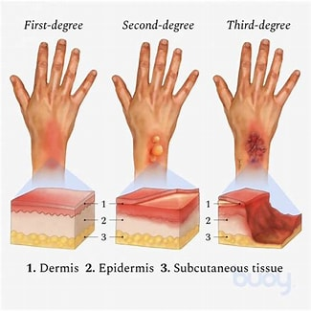
FIRST DEGREE SECOND DEGREE THIRD DEGREE
1
1
2
2
3
3
1 = EPIDERMIS 2 = DERMIS 3 = SUBCUTANEOUS TISSUE

Slide 25
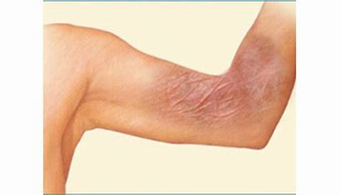
SCARRING AND JOINT CONTRACTURE FOLLOWING BURN INJURY

Slide 26
MEETS LISTING 1.21
25-year-old man S/P suicide attempt via self-immolation sustaining second and third degree burns to his face, torso, and BUE, including his hands. He was admitted to SHMC from 4/10/23 to 6/15/23 where he underwent multiple surgical procedures that included debridements and STSG. He underwent additional surgical procedures on 6/26/23 and 7/3/23. He is currently receiving local wound care, formal physical therapy, and dynamic splinting. Claimant will require additional surgical procedures whence the wounds have completely healed that will include release of contractures to his hands, followed by formal physical therapy, occupational therapy, and dynamic splinting. Disability will, therefore, exceed 12 months post-onset.
CONCLUSION: Claimant under continuing surgical management for thermal soft tissue injuries to his face, torso and hands per the criteria of listing 1.21A, B, and C, as defined in preamble 1.00L. Onset is the day of injury.

Slide 27
EXAMPLE 6: HIDRADENITIS SUPPURATIVA
SKIN CONDITION CAUSING PAINFUL LUMPS TO FORM UNDER THE SKIN
USUALLY DEVELOP IN AREAS WHERE SKIN RUBS TOGETHER (ARMPITS, GROIN, BUTTOCKS, BREASTS)
CAUSES SINUS TRACTS AND FISTULAE WHICH CAN BREAK OUT AND DRAIN PUS
TREATMENT IS MULTI-MODAL AND CAN INCLUDE TOPICAL ANTIBIOTICS, ORAL ANTIBIOTICS, AND SURGERY
CONSIDER LISTING 1.21 (CONTINUING SURGICAL MANAGEMENT)

Slide 28
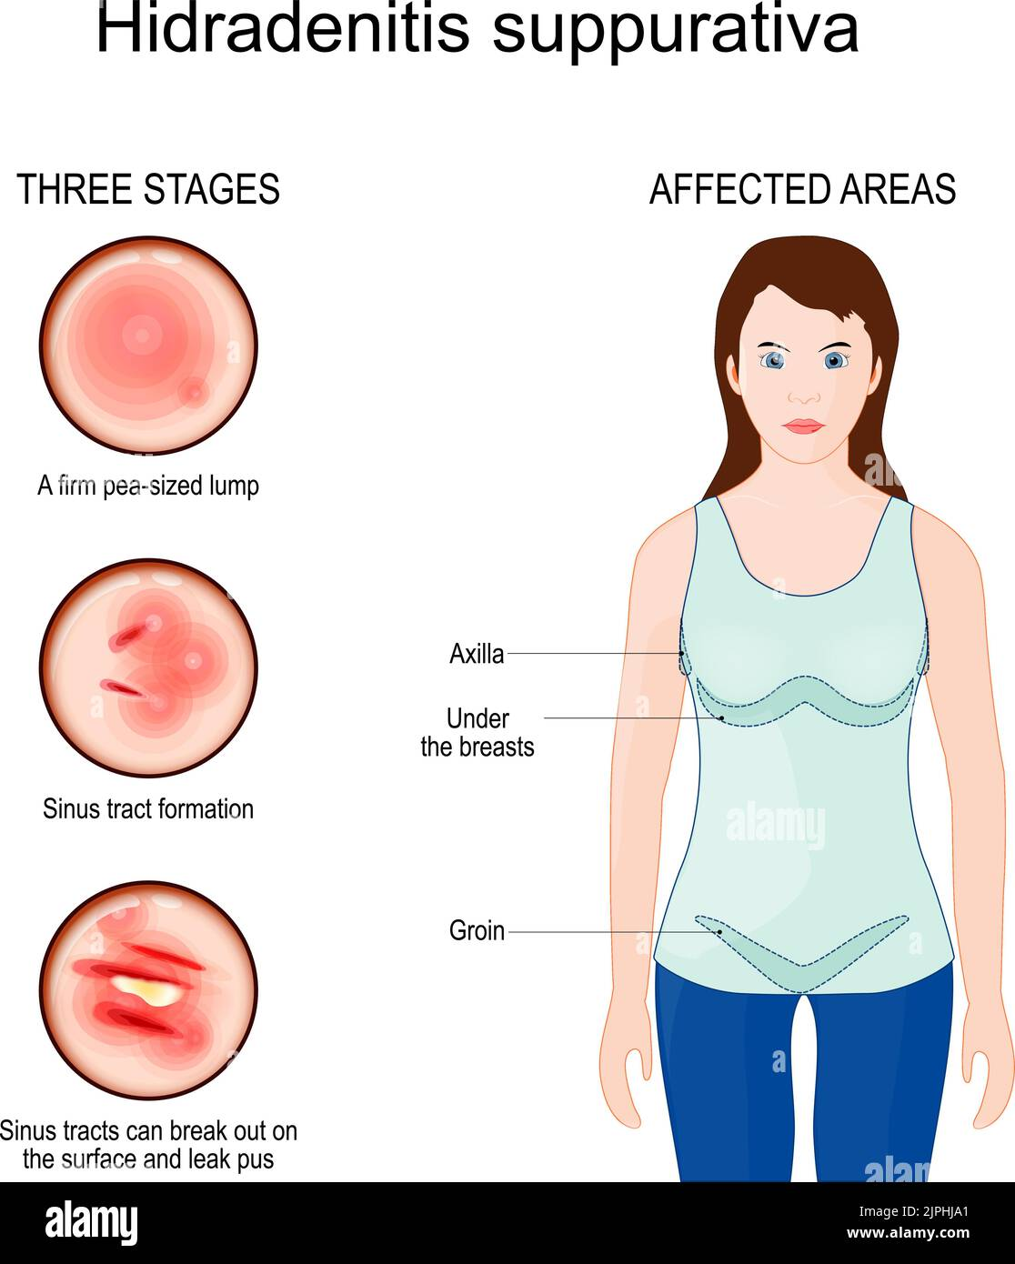
STAGES AND SITES OF INVOLVEMENT
THREE STAGES
AFFECTED AREAS
FIRM PEA SIZED LUMP
AXILLA
UNDER BREASTS
SINUS TRACT FORMATION
GROIN
SINUS TRACTS BREAK OUT AND DRAIN PUS

Slide 29
HURLEY STAGES
HURLEY STAGE I: A SINGLE OR MULTIPLE BUMPS WITH NO SINUS TRACTS
HURLEY STAGE II: MULTIPLE BUMPS WITH SOME SINUS TRACTS AND SCARRING
HURLAY STAGE III: MULTIPLE BUMPS WITH MANY SINUS TRACTS AND SCARS INVOLVING AN ENTIRE AREA OF THE BODY

Slide 30
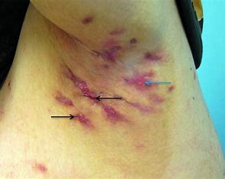
HURLEY STAGE III OF AXILLA

Slide 31
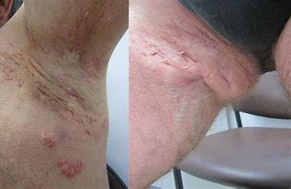
HURLEY STAGE III OF AXILLA AND INNER THIGH

Slide 32
HIDRADENITIS SUPPURATIVA MEETS LISTING 1.21
19-year-old man with the following impairments:
1. Hidradenitis suppurativa.
2. Extreme morbid obesity: BMI > 50.
3. OSA on CPAP.
Claimant was evaluated at the Skin Docs on 3/6/24 presenting with at least a 3-month history of recurrent growths involving both axillae and thighs. Pertinent findings on physical examination include acneiform nodules and fistulae formations and draining sinuses distributed on both axillae and thighs, Hurley Stage III, single or multiple, widely separated recurrent abscesses with sinus tract formation and scarring. Management has included surgery, topical and oral steroids, and oral antibiotics.
CONCLUSION: Claimant with severe and recurrent soft tissue abnormality with extensive involvement of both axillae and thighs under continuing medical and surgical management with the expectation that disability will last at least 12 months until maximum medical benefit is achieved. The impairment does, therefore, satisfy the criteria of listing 1.21A, B, and C, as defined in preamble 1.00L.

