Slide 1
National Association of
Disability Examiners National Training Conference
August 2, 2022 from 1:00pm-2:00pm Functional Limitations of Low Vision
Stephanie Bissonette, Director of Children Services
Vermont Association for the Blind & Visually Impaired (VABVI),
Teacher of the Visually Impaired and
Certified Orientation & Mobility Specialist

Slide 2
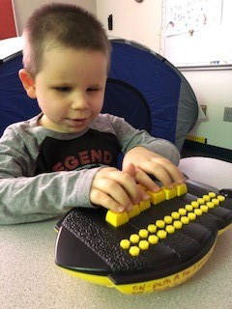

Today’s Agenda:
How states typically help individuals with a Visual
Impairment
Functional Impacts of Visual Impairment
Functional Limitations Secondary to Visual
Impairment (VI)
Q & A time

Slide 3
Who are the 4 major service providers that work directly with individuals with visual impairments?
All of the following 4 job descriptions require college degrees…
Teacher of the Visually Impaired (TVI) works with children ages birth to high school graduation and licensed by the state Department of Education.
Certified Orientation & Mobility Specialist (COMS) works with children ages 2 and older and individuals throughout adulthood and is certified by a professional organization known as ACVREP or the Association for the Academy of Certification of Vision Rehabilitation & Education Professionals
Certified Assistive Technology Instructional Specialist (CATIS) for individuals with a visual impairment (clarify the distinction very different than your typical technology specialist) works with children at age 3 and older and individuals throughout adulthood and certified by ACVREP.
Vision Rehabilitation Therapist (VRT) works with transition students, ages 14 and older, and individuals throughout adulthood and certified by ACVREP.
BTW: Our agency, VABVI, also employs a volunteer coordinator who recruits and manages volunteers for our personalized transportation program, since Vermont is so rural and traveling to the grocery store and doctor is a huge obstacle.

Slide 4

We are the certified Braille experts too…

Slide 5
Jargon buster, when to use Blind vs Visually Impaired? Use the term visually impaired because it encompasses both the totally blind and those with low vision.
I am aware that many of you come from out of state, so our agency, VABVI, is just one example of the variety of services. Each state operates different by a variety of entities. The bigger the state the more entities there will be.
Since Vermont is the 2nd least populated state we have two agencies, VABVI and DBVI, providing all services. VABVI is a nonprofit organization and DBVI is part of Vocational Rehabilitation/Hire Ability. We collaborate daily to create smooth transition of services.
Review VABVI website https://www.vabvi.org/ and referral process on next slide.

Slide 6
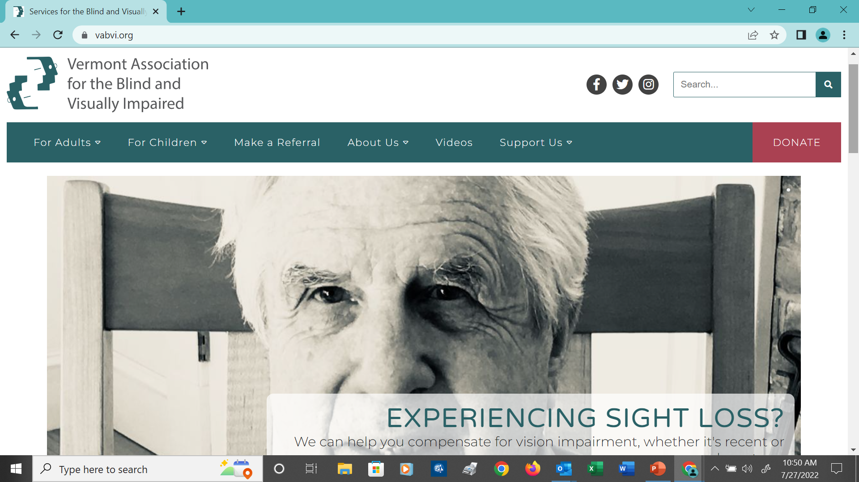

Slide 7
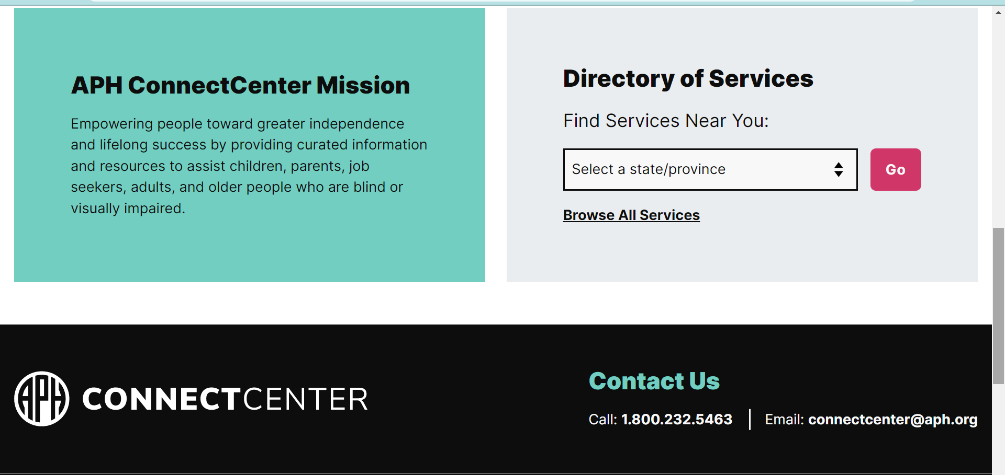
You can google “APH Connect Center” for a national list of services by state. APH = American Printing House for the Blind:

Slide 8
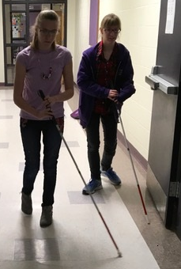
How we determine eligibility for children
For children, most states/organizations require an eye report for proof.
Most states follow the Special Education Rules and regulations from
their DOE which include these 4 bullets:
  Visual acuity of 20/70 or worse in the better eye
  Visual field loss of 20% or less
  A progressive eye condition
  And as of May 2017, OSEP (Office of Sp Ed Programs) distributed a memo regarding “Eligibility Determination for Children Suspected of Having a Visual Impairment Including Blindness under the Individuals with Disabilities Education Act.” = more of a functional definition.
Take referral information
Obtain signatures for authorization to share information and signature to acknowledge HIPPA regulations
Most referrals come from school staff, then families and 10% from doctors.

Slide 9
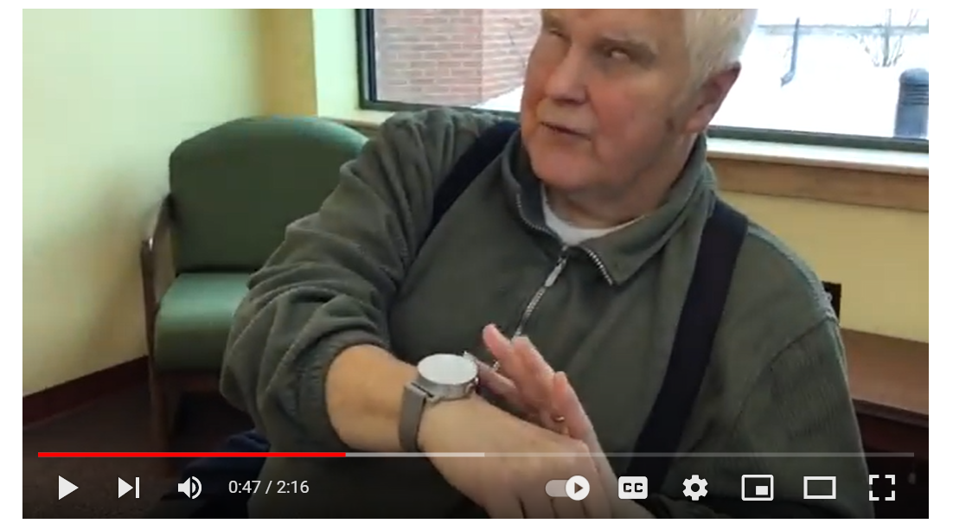
How we determine eligibility for adults …
Is based on a functional definition…
Typically, they no longer meet the driving requirements or are struggling with daily tasks
Most referrals come from their self or family, others come from council on aging, senior centers, social workers and 20% come from doctors
Take referral information
Obtain signatures for authorization to share information and signature to acknowledge HIPPA regulations
Obtain a copy of an eye report

Slide 10
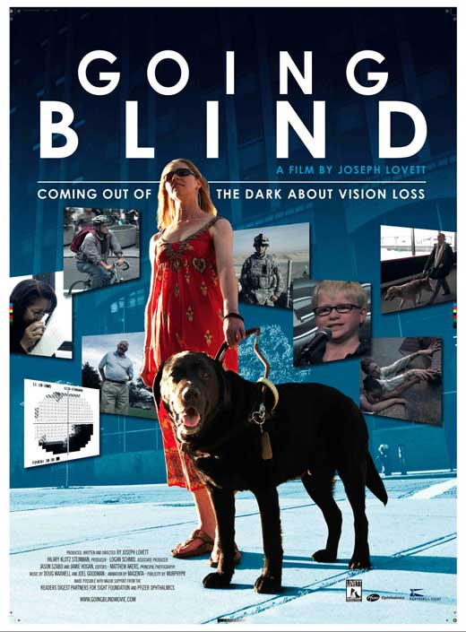
Why don’t more referrals come from doctors?
The answer is two-fold:
They either are unaware of services from a TVI, COMS, CATIS and VRT
OR
They stay in their lane, referring to medical models only,
not educational or rehabilitation models.
Our VABVI staff was able to visit most every optometrist and
ophthalmologist in the state if VT to describe our services
and how to make a referral. That’s more difficult in other states.
We have tried to be invited to the annual local optometrist conference
We do not have an optometry or ophthalmology college in Vermont, so option one worked
best for Vermont.
Describe plot of this awesome 2010 documentary
GOING BLIND: Coming Out of the Darkness About Vision Loss.

Slide 11
How and where are services delivered?
“Itinerant” services may occur at the home or school. The staff travels from client to client, seeing as many as 4 or 5 clients per day.
For adults, every state provides services differently some itinerant and are some center based.
For the majority of kids, they are mainstreamed, while a very small percentage are at schools for the blind. In New England the only school for the blind is Perkins, therefore their population is less academic and includes mostly students with challenging needs. Other states have different rules and see more academic students.
Our professional organization the Association for the Education and Rehabilitation (AER) for the blind and visually impaired keeps us connected on a national level.
I can connect with all 50 states through list serves from the American Printing House (APH) Trustees and the Council of Schools and Services for the Blind (COSB).

Slide 12
Functional Impacts of VI: People remember 80% of what they see and 20% of what they hear.
Congenitally Visually Impaired (born that way)
  Incidental learning gaps due to lack of vision
  A sighted baby is motivated to move to the toy they see
  As a baby you hear pots and pans but you don’t get motivated to crawl, because you can sit and continue to listen
Adventitiously Visually Impaired (lose their sight and they have a visual memory)
  Have visual memory in place dealing with grief adjustment to VI, like loss of loved one
  Functional impact of relearning how to do things without vision such as putting toothpaste on your toothbrush. Lots of adaptive ways directly into mouth
  It seems insurmountable but once they’re taught an alternative way the burden is lifted.

Slide 13
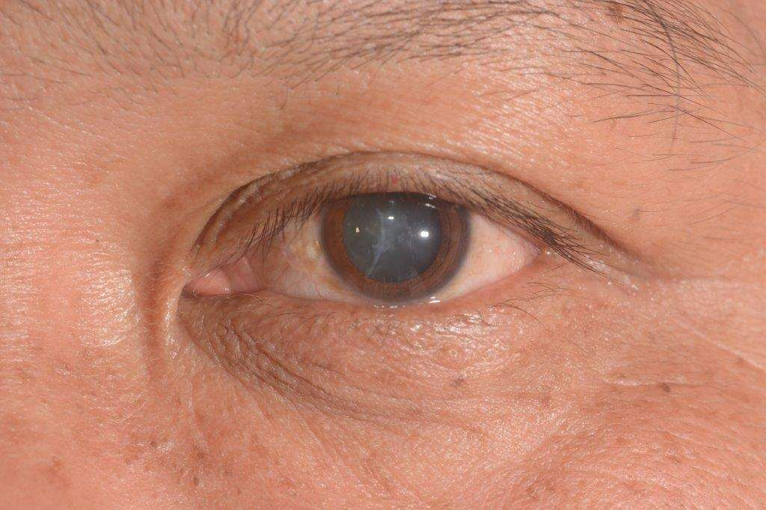
List of the top 3 visual impairments for adults and children differ…
List of the top 3 visual impairments for adults are (SEE GOGGLES):
Ages 30-55 = diabetic retinopathy
Ages 60+ glaucoma, cataracts AND age related macular degeneration
List of top 3 VI for children are:
Cortical Visual Impairment (CVI)
Retinopathy of Prematurity (ROP)
Optic Nerve Hypoplasia (ONH)

Slide 14
Defining CVI because it’s the leading cause of VI in children from https://www.nei.nih.gov
“Cerebral visual impairment (sometimes called cortical visual impairment or CVI) is a disorder caused by damage to the parts of the brain that process vision. It's most common in babies and young children, but can continue into adulthood.”
Since it’s a fairly new diagnosis in the past 20 years, you will start seeing adults with this. It did not exist 37 years ago when I started as a TVI.
“A child with CVI has vision problems that are caused by their brain that can’t be explained by a problem with their eyes. Normally, the eyes send electrical signals to the brain, and the brain turns those signals into the images you see. If you have CVI, your brain has trouble processing and understanding these signals.”
“CVI is a leading cause of vision loss among kids in the United States. For some children with CVI, vision gets better over time , but everybody is different. If your child has CVI, make sure that they get early intervention and therapy, educational support, and other special services to help them develop and learn.”
Sample of solutions: If a student with CVI is having trouble finding Waldo in a Where in the World is Waldo picture, then we simplify the picture by reducing clutter and the student is more successful. Same applies to the environment, reduce the ckutter often provides more success.
Vision can manifest differently due to stress, fatigue, environment.

Slide 15
Joe (adult), a case in point… show this 2 minute video… https://www.youtube.com/watch?v=lK-6eK5Mxd4
Joe (engineer) thought he was doomed, but he was able to work another 10 years after he received services from a VRT, CATIS and COMS
A lot of people think they can’t its a matter of learning how to do it differently
A lot of people choose to quit working but once they learn the adaptive skills they can keep working.
There is HELP!

Slide 16
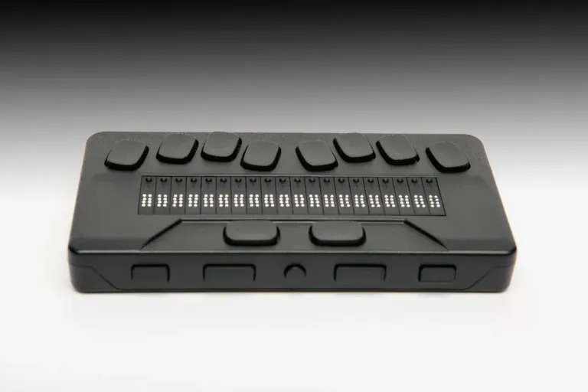
A Few Tricks of the Trade…
What is JAWS & Zoomtext?
Sometimes schools assume a TVI is not needed because they are naïve, they don’t know what they don’t know.
Toothpaste on tongue, liquid level indicator to pour hot coffee, talking book library BARD free, accessibility built into Apple phones, bump dots, wooden stick, long potholders and so on)
Picture of the new free NLS eReader for downloading books only…students have access to more sophisticated braille laptop computers that will do almost everything your computer will do, but they need specialized teachers to show them how to use it.

Slide 17
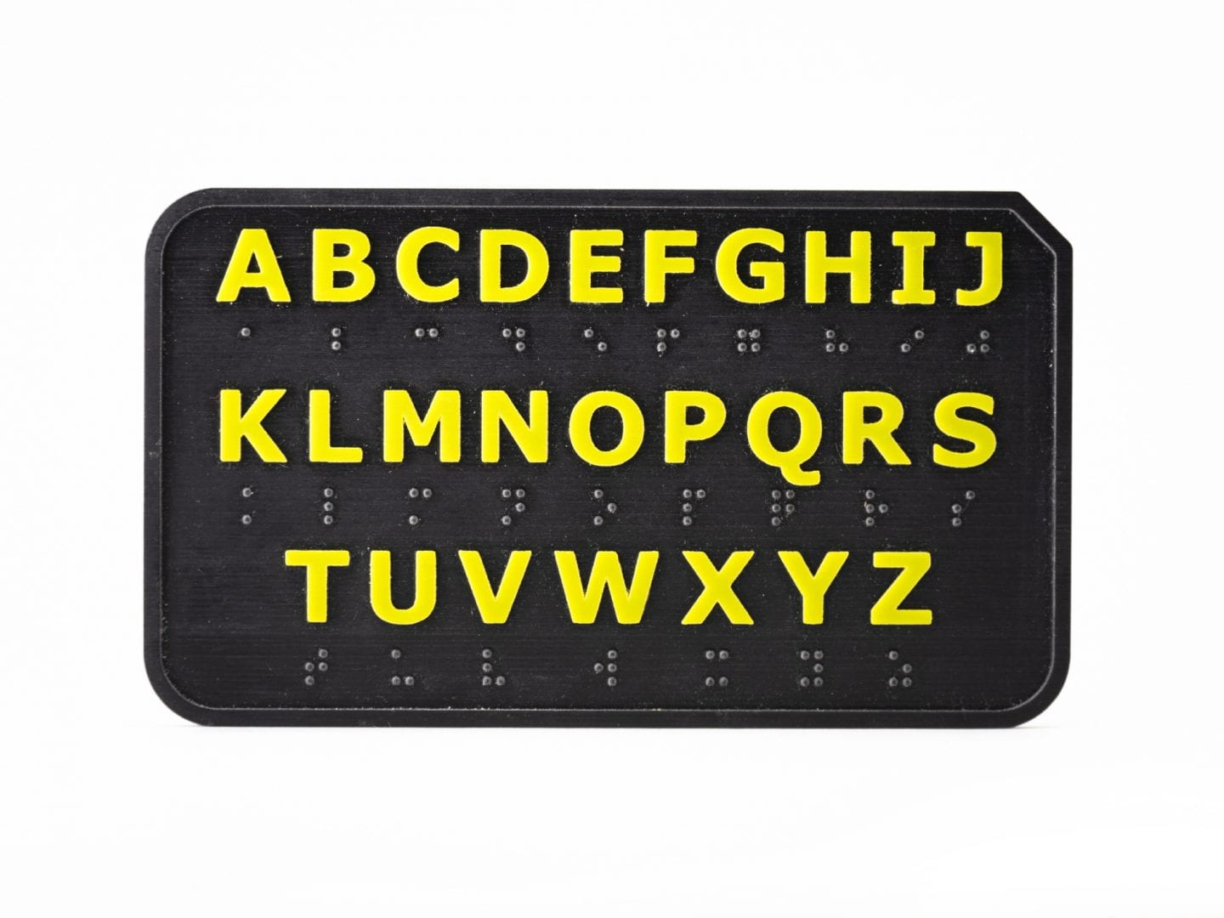
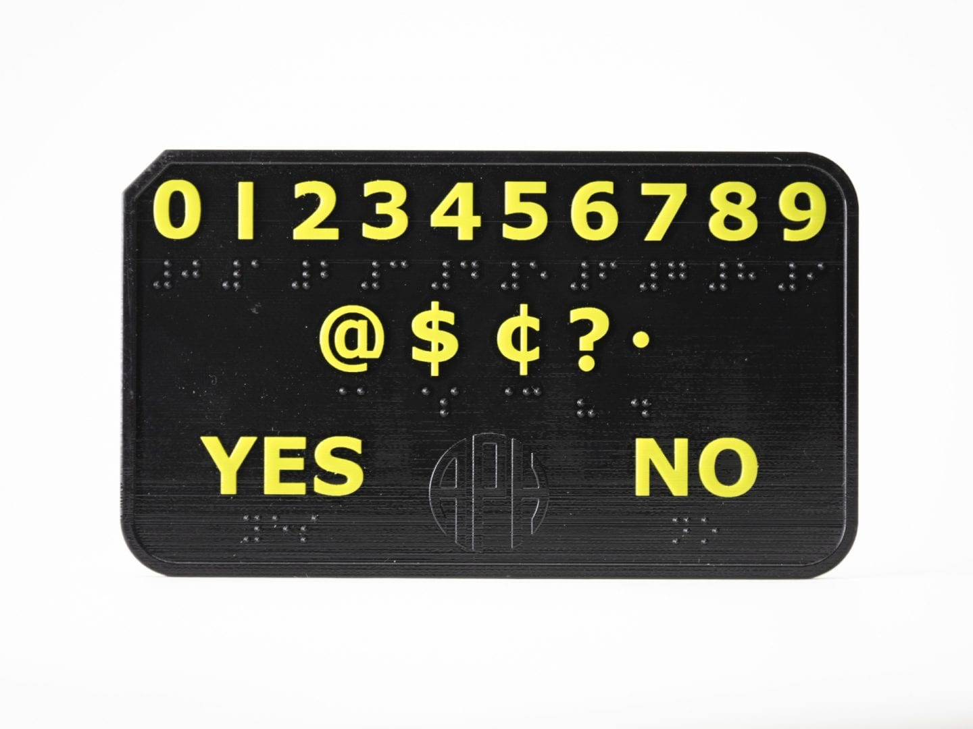
Random example of a two-sided Deafblind pocket communicator (tactile and visual) when you are with someone face to face:

Slide 18
What areas of life are affected by a visual impairment?
Best defined by the 9 areas of the “Expanded Core Curriculum:”
    Compensatory (such as direct Braille instruction, making science accessible if you can’t see in the microscope and social studies accessible when maps are challenging to read, making music and art accessible…)
    Orientation & Mobility (for future non-drivers, including cane and transit instruction)
    Socialization (how do you find or make a friend when you can’t see them?)
    Daily Living Skills (independence with daily routines)
    Recreation/leisure (making PE accessible and encouraging more exercise at home)
    Career Education (need to reduce 70% unemployment rate)
    Assistive Technology (try using a computer w/o looking at the screen and most jobs require computer skills)
    Sensory Skills (maximizing your other senses)
    Self-Determination (controlling your own life)

Slide 19

Functional Limitations Secondary to
Visual Impairment
For the variety of students we work with, at least 60% have
additional disability.
50% of people over the age of 75 have a combined VI and hearing loss.
As you age its common for multiple senses to decrease.
Your sense of smell is not as strong, neuropathy occurs (poor sense of touch) and your hearing ability decreases often after age 75 yrs of age).
Therefore, learning safety tricks is that much more important.
Clients are using wheelchairs, walkers, and additional ambulatory devices.
CVI leading cause of VI multiple impairments amongst children b/c western medicine is saving more children at birth = more complications.
As students with CVI approach adult life they often need supported employment because they have secondary impairments. You’ll see more of these students in adult life.
Picture of Haben Girma, the first deafblind individual to graduate from Harvard Law School and motivational speaker. Her book HABEN is a great non-fiction read.

Slide 20
FYI # 1 of 3:
FOR KIDS: there is the 504 Plan or IEP Team = TVI, COMS, CATIS, OT, PT, SLP, DFHH and/or some sort of inclusionary specialist. Services differ from state to state.
Funding for children services differs from state to state.
FOR ADULTS: Federal funding is given to every state for adults, depending on population. Who runs it depends on model of the state.
1. Vocational Track via the IPE = Individual Plan of Employment for ages 18+
2. Or the Independent Living Plan (ILP) for those not on a vocational track.
3. Older individuals with blindness access services via a blindness grant (formerly known as Chapter 2) and these services are managed through organizations (not a medical model).
4. The Vermont Division f/t Blind is part of Voc Rehab (and in Vermont Voc Rehab is now known as Hire Ability). Typical of VT to change the name…. For children an IFSP is known as a One Plan.

Slide 21
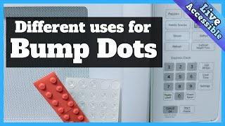
FYI #2 of 3:
Over 55 and not on a vocational track then every state receives a grant based on population for some services and possibly equipment but not always equipment (VT with a minimal population receives $250,000 for older blindness population. VABVI must raise money to offset costs of services, b/c the real cost is 1.5 million (VABVI provides up to $125 worth of equipment if they cannot afford it. NYC organization provides $100 worth of equipment.
Every state is different.
Bump Dots for your microwave costs $5, but a braille computer costs $5,000.
MA is a bigger state providing different types of services in different parts of state, therefore funding is divided by multiple organizations MA Commission f/t Blind, Carroll Center, Lowell Assoc f/t Blind, Perkins, MABVI...
There are a variety of evaluations we can provide (think of the 9 ECC areas we talked about) to determine the problem areas and the solutions, such as a Learning Media Assessment to identify primary and secondary learning modes.

Slide 22
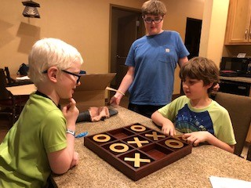
FYI #3 of 3:
Clients don’t know what they don’t know until they
receive rehab services.
If they are applying for SS at early stages of VI they will probably less capable of doing things on their own.
Some students are labeled as hysterically blind b/c they just haven’t been properly diagnosed yet.
My high school student, age 17, academically on par, has been losing his sight for 3 years and still not “official” diagnosis.
An adult friend was incorrectly diagnosed as a child with macular degeneration and was recently diagnosed with Atypical Retinitis Pigmentosa.
Bottom line: Visual diagnosis’ can be complicated.

Slide 23

Veterans Administration:
Independently funded for veterans (well funded).
All services and equipment provide at no costs.
Encourage clients to access blindness services through VA for best services.
VA has blind regional centers (if needed).
Often have a secondary disability
If they have hearing loss in addition to the VI, there is often another way to do it.

Slide 24
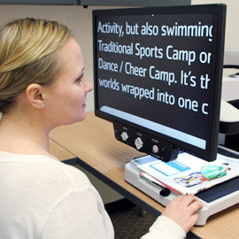
For the psychological consultants in the audience:
Many clients are UNable to access visual information on psychological
evaluations.
Inkblots are useless to them.
Use part of tests that are not visual.
Very few tests are available in braille or large print, most are not.
Consult with the TVI for children or the VRT working with adults regarding accessibility testing options.
If client has low vision, then they should have access to a CCTV (see picture).
Very old resource from the Journal of Blindness and Visual Impairment
Answering the Questions of the Psychologist Assessing the Visually Handicapped Child
Dr. John L. Morse, Ed.D.
First Published October 1, 1975 Research Article
https://journals.sagepub.com/doi/abs/10.1177/0145482X7506900804

Slide 25

What questions do you have for me?

