Slide 1
Social Security Administration
Office of the Inspector General
NATIONAL ASSOCIATION OF
DISABILITY EXAMINERS
Cooperative Disability Investigations
Presenters:
Donald Jefferson
Acting Assistant Inspector General, Investigations
Conor Washington
Special Agent in Charge, Cooperative Disability Investigations Division

Slide 2
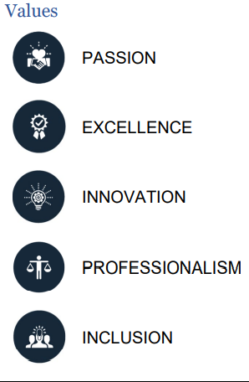
SSA OIG Overview
VALUES
Office of the Chief Strategy Officer
Office of Investigations
Office of Resource Management
Office of the Counsel to the Inspector General
Office of Audit
Office of Information Technology

Slide 3
Cooperative Disability Investigations
Key anti-fraud initiative that pools resources to combat fraud in Social Security Administration's Title II and Title XVI disability programs, and related federal and state programs.
CDI units obtain evidence of material fact to resolve questions of fraud
CDI partners are:
  Social Security Administration
  Office of the Inspector General
  Disability Determination Services
  Law Enforcement Agency
DDS
SSA
OIG
LEA PARTNER

Slide 4
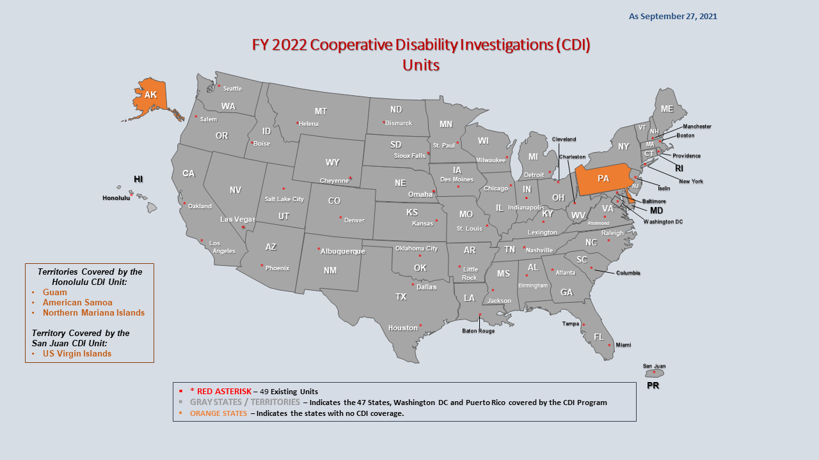
Coverage & Expansion
49 units, covering 47 states, District of Columbia, Puerto Rico, Guam, American Samoa, Northern Mariana Islands, and U.S. Virgin Islands
Expanding to PA, DE, and AK

Slide 5
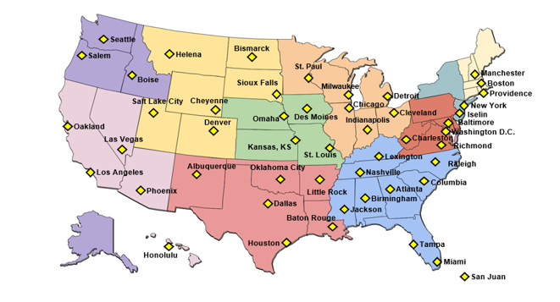
Monetary Accomplishments
FY 2021:
$86 million SSA’s disability programs
$76.5 million to non-SSA programs
Inception to FY 2021: $7.7 billion
$4.3 billion SSA’s disability programs
$3.4 billion Federal and State programs

Slide 6
Roles & Responsibilities
CDI Team Member | Roles and Responsibilities
OIG Special Agent (team leader) | Provides investigative oversight, including prosecution and Civil Monetary Penalties
SSA Program Specialist | Provides technical support for claims development, policy issues, and liaison to SSA
DDS Disability Examiner | Provides technical support for disability related development, makes assessment on referred cases to CDI, and primary liaison to DDS offices
State or local law enforcement partner | Provides investigative support, such as suspect and witness interviews, surveillance, and enforcement operations.

Slide 7

Types of Disability Fraud
  Feigning impairments, false statements
  Concealing medical improvement
  Concealing work
  Inconsistent statements/facts
  Third party facilitators
  Unreported workers’ compensation benefits

Slide 8

Investigative Outcomes
  Criminal prosecution
  Civil judgments
  Administrative sanctions
  Denial of claim
  Cessation of disability
  Adverse reopening
  Approval of claim

Slide 9

Investigative Process: Potential Steps
  Referral received and assessed to determine if investigation is warranted.
  OIG determines if case meets guidelines.
  If investigation reveals fraud, outcomes include:
        Criminal prosecution (OIG), or
        Administrative actions (SSA).

Slide 10
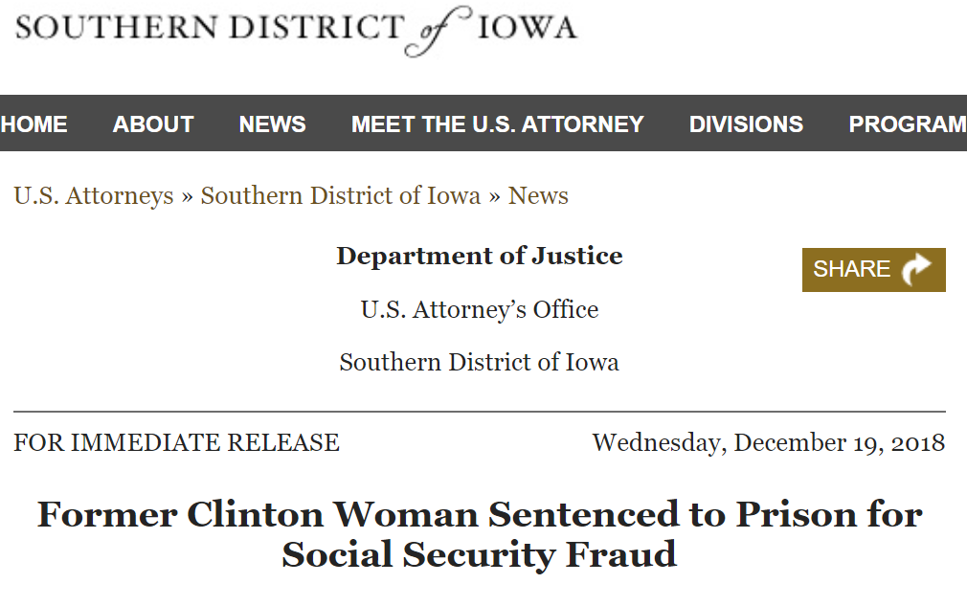
Case #1: Iowa Woman
  40-year-old woman
  Title XVI and Title II disability applicant
  Referral from Iowa DDS
  Alleged inconsistencies between her claimed disability and the medical evidence on record.
  Alleged disability from PTSD, anxiety, depression, headaches, traumatic brain injury, fractured ankle, broken arm and complications from being hit by a car

Slide 11
Functional Report
  Functional information on record stated that she required assistance and reminders for daily functions.
  She reported inability to remember to eat, cook or take medications without assistance; unable to leave the house alone.
  Degree of cognitive limitations alleged not supported in the context of normal brain imaging.
  Additionally, presented herself to SSA as not married, however, record indicates that she was. Relevant SSI issue for determining technical eligibility.

Slide 12

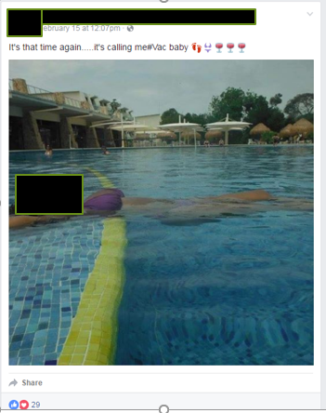


Evidence: Social Media
“Me telling them I’m married is like telling them to not give me anything. I’m not with him. It’s just a piece of paper. We are not financially responsible for each other. I raise my son by my own damn self.”
– Subject during CDI interview
In social media posts, Subject refers to “him” as her “husband.”
She took multiple trips with him in 2016, and, in January 2017, they went to Las Vegas and Venice Beach, CA.
“I can’t go anywhere. I have not been anywhere this year.”
– Subject during CDI interview.

Slide 13
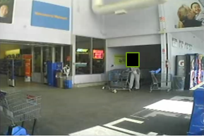
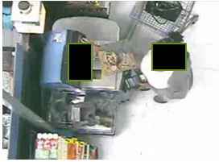
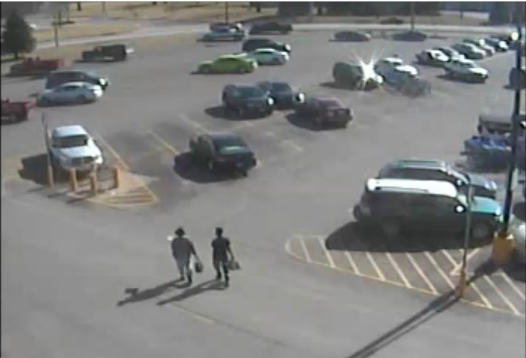
Evidence: Surveillance
Video surveillance shows Subject shopping and using a debit card

Slide 14
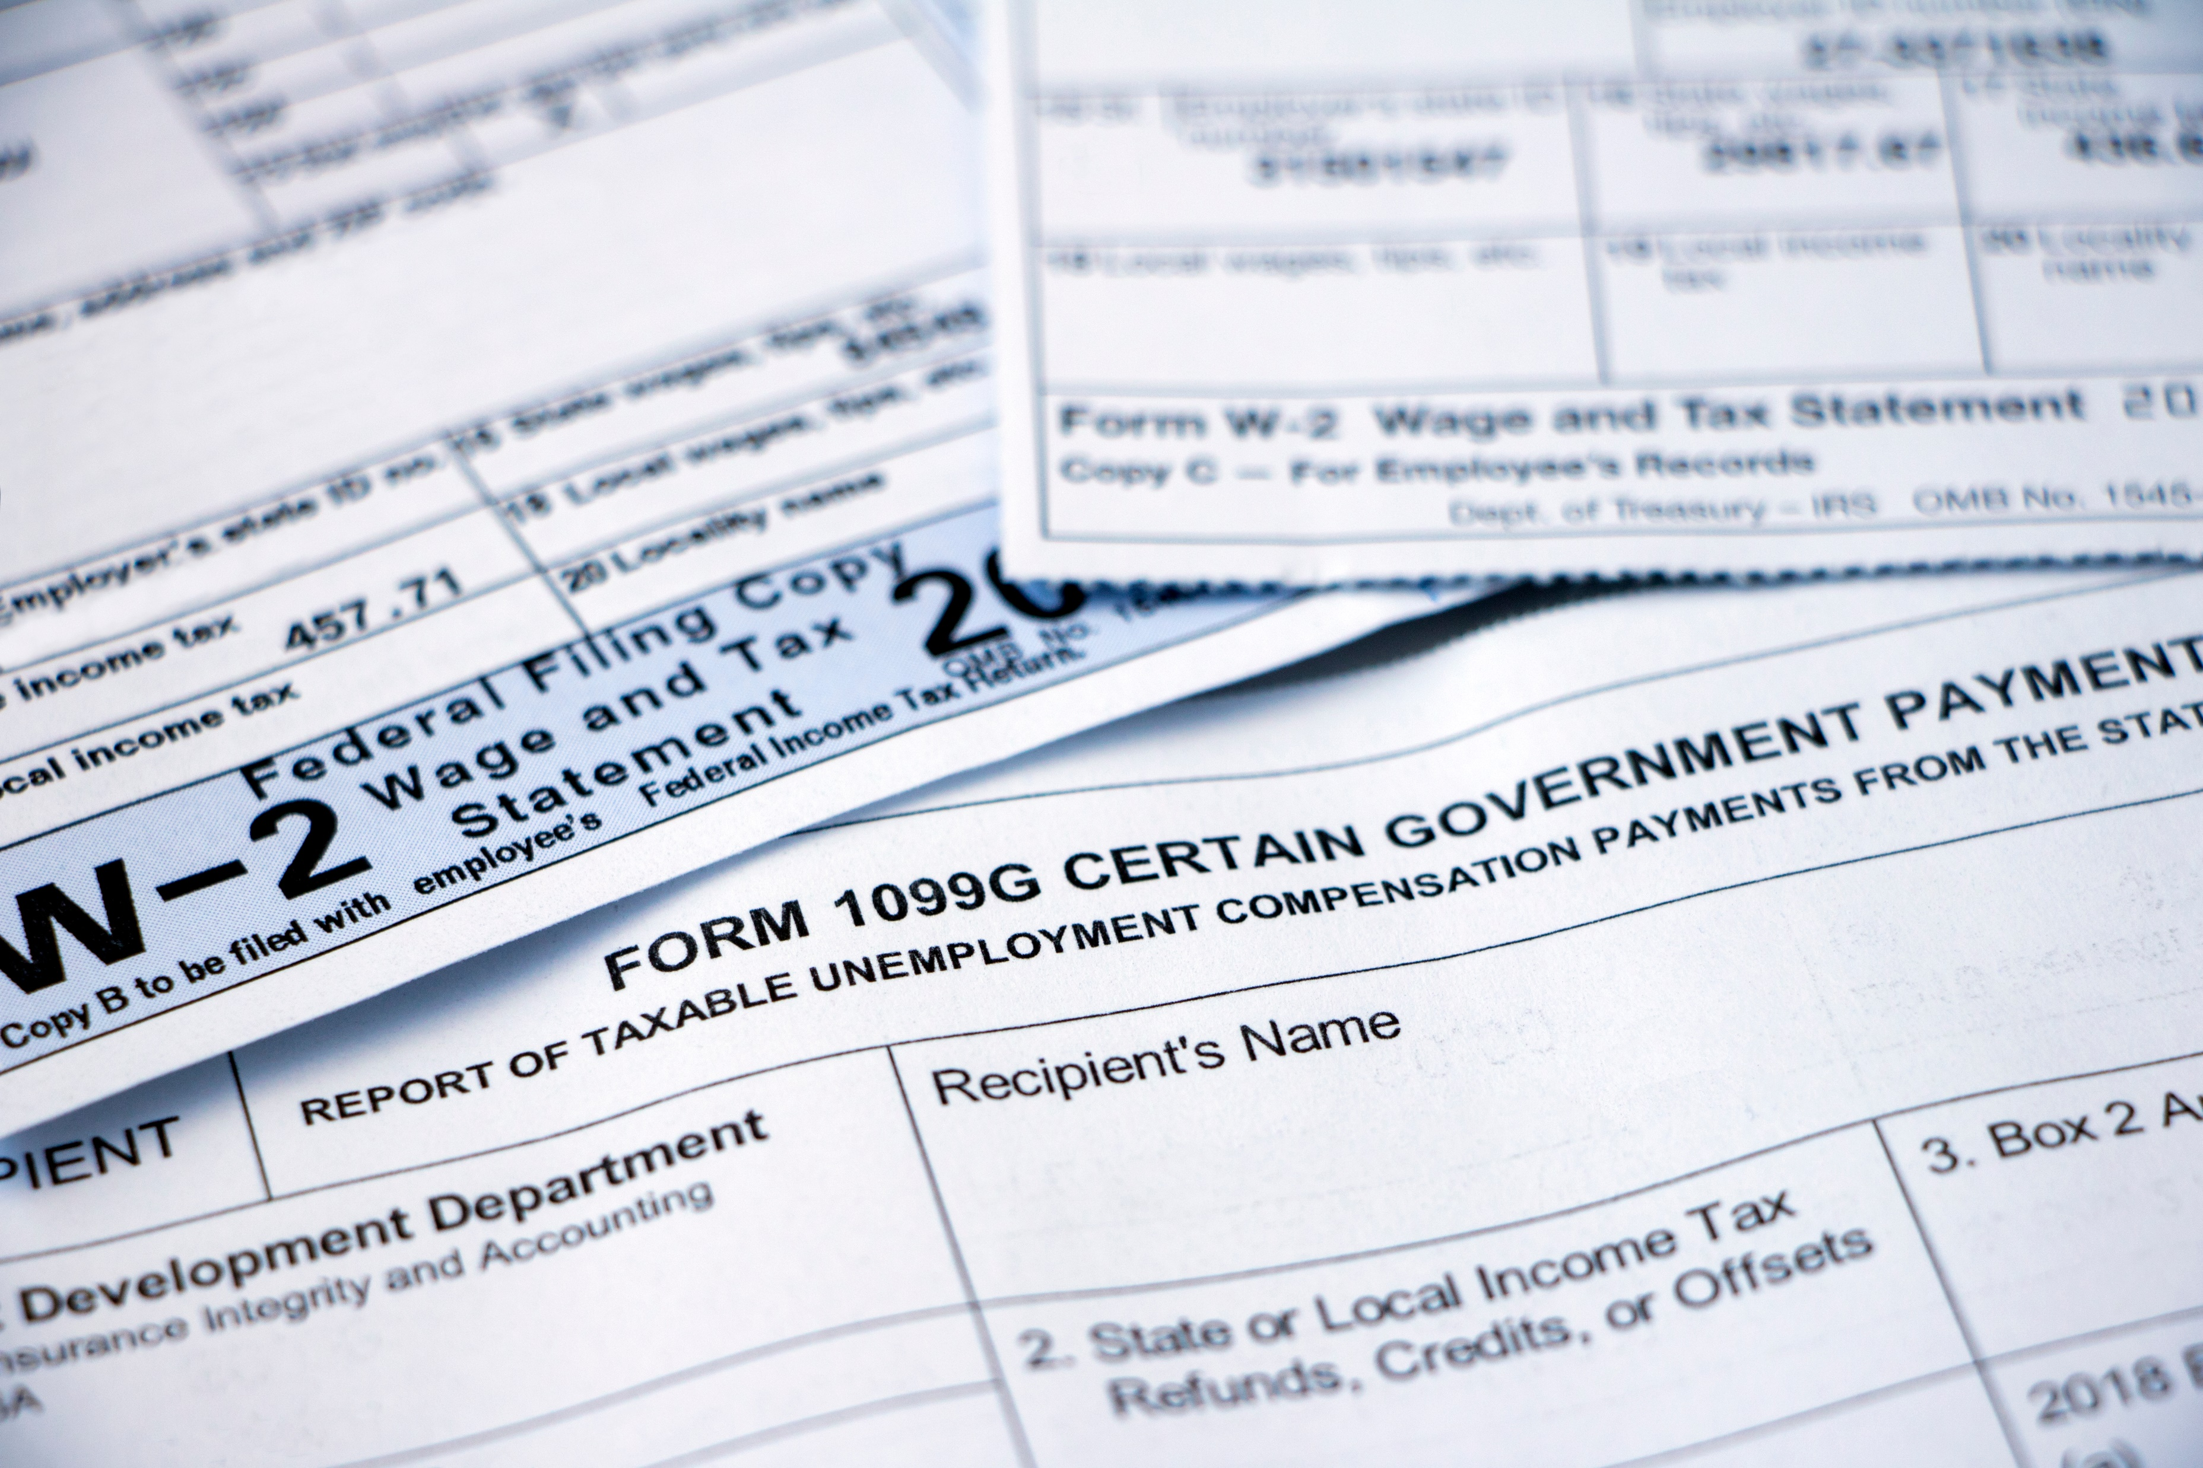
Employment Records
IG subpoenas issued to obtain employment records.
Work history following her alleged disability onset date included:
  Child Care Provider
  Veteran’s Affairs Coordinator
  Open-source records: owned and operated a hair styling business

Slide 15

Medical Records
Claimed Traumatic Brain Injury but no medical evidence to support it
Alleged limitations:
  Unable to live unassisted, inconsistent with jobs she held
  Ability to function independently (social media postings of vacations/outings)

Slide 16
Witness/Subject Interviews
Witness 1 - “She never had any problems understanding or comprehending the nature of each meeting.”
Witness 2 - “She never appeared inhibited in any way.”
Witness 3 - "I don't see any sign of a TBI or cognitive loss and I really don't think so on the PTSD or personality disorder."
Subject - “Why should I tell you something that’s gonna stop me from getting something I need.”

Slide 17

Judicial Actions: Indictment & Arrest
Case presented to the United States Attorney’s Office
Accepted for criminal prosecution.
Indictment: February 13, 2018
  False Statements (Title 18 USC 1001)
  False Statements of Material Fact to Determine Benefits (Title 42 USC 1383a(a)(2)).
Warrant issued, arrested February 27, 2018

Slide 18
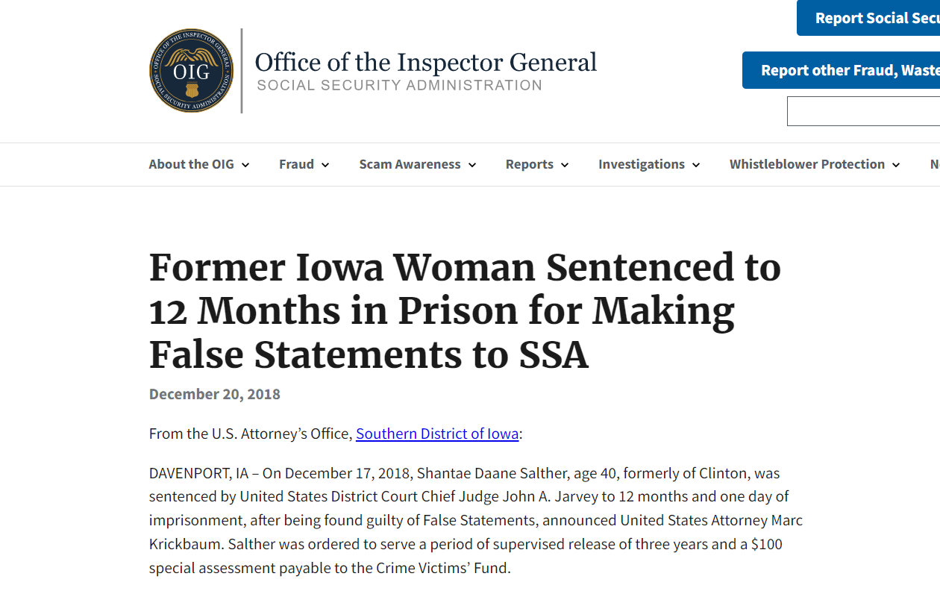
Judicial Actions: Trial & Sentence
Four-day jury trial
Guilty: False Statements
Not guilty: False Statements of Material Fact Used to Determine Benefits
Sentencing: December 18, 2018
  12 months’ and one-day incarceration, 3 years’ supervised release

Slide 19
Case #2: Attorney to Criminal
1996: Began law career
2000: Devised check scheme
Subsequently convicted and lost her law license.
2005: Convicted additional violations; sentenced to probation.
Eventually became teacher after lying about felony conviction.
2007: Self-terminated, after School District discovered conviction.
October 2006 - October 2008: Absconded from probation supervision
2008: Arrested on felony forgery charges.
Convicted and placed on probation.

Slide 20
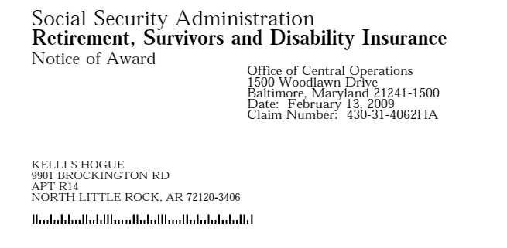
Benefits Awarded
September 2008: Applied for disability benefits
  Claiming impairments: bipolar disorder, PTSD disorder, anxiety, and thyroid problems.
February 2009: Benefits awarded.
Hired as legal assistant at a Law Firm.
March 2009: Opened business bank accounts; received up to $800/wk.
Late 2010: Bookkeeper for Runyan Sewer District. Earned $750/wk.
May 2012: Embezzling begins. Writing company checks to herself.
October 2018: Embezzlement discovered. She was terminated.
Fraud was subsequently reported to the U.S. Secret Service.

Slide 21
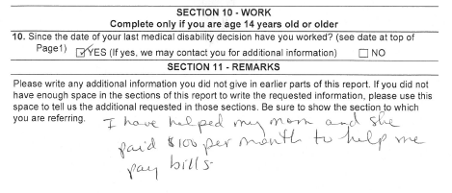
False Statements
February 2019: Advised attorney settle “quickly and quietly”.
Followed up with a threatening email to expose attorney for unethical behavior.
April 2019: CDI Unit gets referral from U.S. Secret Service.
CDI unit immediately opened case for SSA fraud
Subject completed a Continuing Disability Review Report minimizing the work she has conducted.
“..helped my mom and she paid $100 month to help me pay bills.”
Notes:
In February 2019, she sent a batch of emails to her attorney advising she wanted any charges dropped against her and that she wanted the case settled “quickly and quietly”.
She followed up with an email warning her attorney that she was thinking about reporting his illegal and unethical practices and threatened to expose his “extracurricular sex activities” to various judges and attorneys.
In April 2019, the Little Rock CDI Unit received a referral from the U.S. Secret Service after an analyst discovered her SSA funds being deposited along with her earned income.
The CDI Unit immediately opened a case for the SSA fraud investigation, as well as the embezzlement violations.
In this same month, she completed a Continuing Disability Review Report minimizing the work she has conducted.

Slide 22
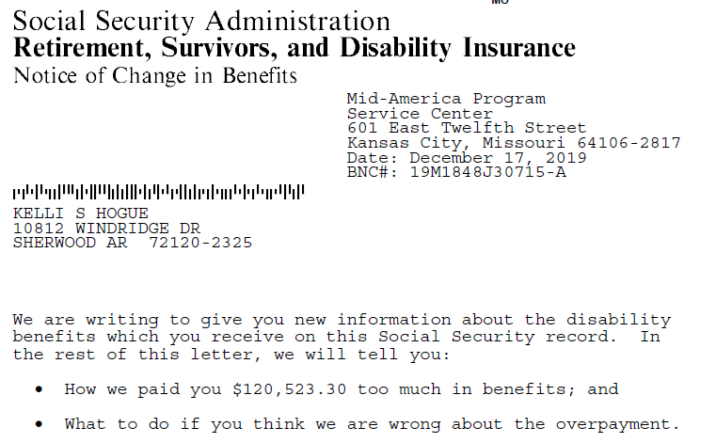
Undisputed Earnings
June 2019: Little Rock CDIU interviewed the subject; she provided more false statements about her work.
Investigation found she had SGA from approval date to when she stopped in 2018.
SSA overpayment $120,523
Investigation determined fraud loss to the Runyan Sewer District $669,599
She stated in writing that she did not dispute the earnings.
The SSA issued a notice to her.
Notes:
SSA issued a notice to her outlining the overpayment amount and detailing all her earnings from the Law Firm and Runyan Sewer District. She responded in written correspondence that she did not dispute the earnings figures.

Slide 23
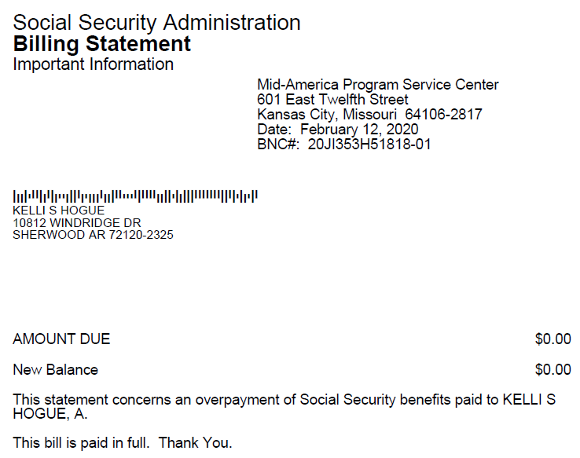
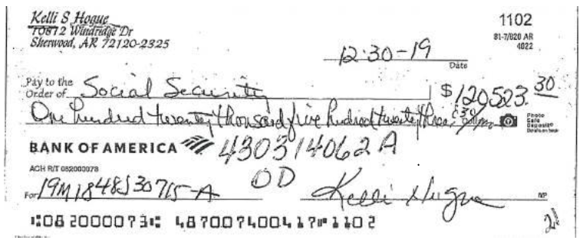
Indictment, Plea, Restitution
October 2019: Indicted in the Eastern District of Arkansas
  Six counts of Title 18, U.S.C. 1344 – Bank Fraud,
  One count of Title 18, U.S.C. 641 – Theft of Government Funds,
  One count of Title 18, U.S.C. 1001 – False Statement to the U.S. Government
December 2019: Paid SSA $120,523 with a personal check
August 2021: Pleaded guilty to Bank Fraud and Theft of Government Funds.
October 2021: Paid sewer district business, in full, $669,599
Notes:
On October 3, 2019, she was federally indicted in the Eastern District of Arkansas and was charged with violating six (6) counts of Title 18, U.S.C. 1344 – Bank Fraud, one (1) count of Title 18, U.S.C. 641 – Theft of Government Funds, and one (1) count of Title 18, U.S.C. 1001 – False Statement to the U.S.

Slide 24
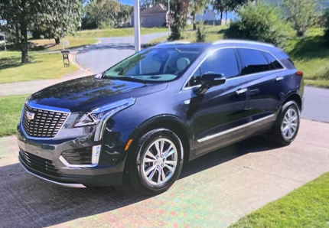
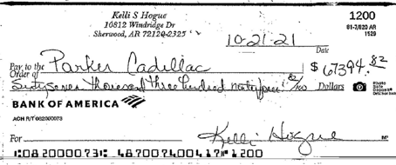
Mounting Evidence
Purchased new 2022 Cadillac SUV for $67,394
January 2022: Submitted character reference letters to the court for leniency.
Further investigation:
Committed Income Tax Fraud 2019 - 2021
Received $3.9 million from U.S. Treasury
Bank records reveal dirty money tied to 8 accounts
October 2019: Purchased residence for $169,470 with the dirty funds.
Purchased residence for her mother for $121,307
In

Slide 25


Bond Revoked
February 2022: Revocation hearing, as a result of the forged character letters
Bond revoked
Remanded into the custody of the U.S. Marshals.
March 2022: Sentenced to 96 months (8 Years).
Notes:
As a result of the forged character letters, a revocation hearing was held on February 10, 2022.
Her bond was revoked and she was remanded into the custody of the U.S. Marshals.

Slide 26
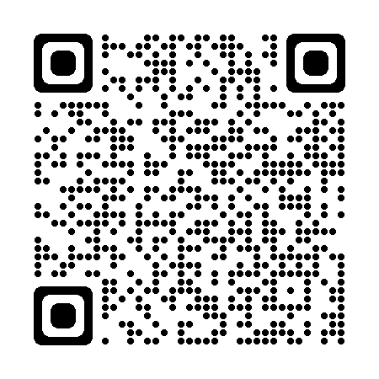
Visit: OIG.SSA.GOV
Report Fraud

Slide 27

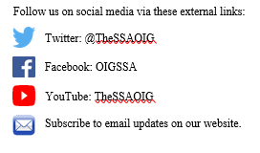
Questions and Thank You! !
SOCIAL SECURITY ADMINISTRATION
OFFICE OF THE INSPECTOR GENERAL
OIG.SSA.GOV

