Slide 1
SSI/SSDI Outreach, Access, and Recovery (SOAR): Opportunities for Collaboration
Substance Abuse and Mental Health Services Administration
(SAMHSA) SOAR Technical Assistance Center
Policy Research Associates, Inc.
National Association of Disability Examiners
August 2022

Slide 2
Disclaimer
The views, opinions, and content expressed in this presentation do not necessarily reflect the views, opinions, or policies of the Center for Mental Health Services (CMHS), the Substance Abuse and Mental Health Services Administration (SAMHSA), or the U.S. Department of Health and Human Services (HHS).
Notes:
Local Lead Note:
The SAMHSA SOAR TA Center asks that you keep this disclaimer in your presentation.

Slide 3




About Me
Assistant Director of the SAMHSA SOAR Technical Assistance Center at Policy Research Associates
Live in Delmar, New York (outside of Albany)
Worked for the SOAR TA Center for 10 years
Serve as the liaison to the state of: CO, CT, DE, IL, MT, NY, PA, and VA
Expert in the Social Security Disability Application Process, Work Incentives, and Growing the SOAR initiative!
Subject Matter Expert: SOAR and American Indian and Alaska Natives and SOAR Implementation in Rural Areas

Slide 4
Quick Poll (Show of Hands)
How many attendees are familiar with SOAR?
Does your DDS have a designated SOAR contact?

Slide 5
What is SOAR?
A model for assisting eligible individuals to apply for Social Security Administration (SSA) disability benefits
For individuals who are experiencing or at risk of homelessness and have a serious mental illness, co-occurring substance use disorder, or other physical disabilities
Sponsored by SAMHSA in collaboration with the Social Security Administration (SSA) since 2005
All 50 states and Washington, DC currently participate

Slide 6
SOAR Across the Lifespan
Children
Birth to age 18
Eligible for SSI only
How does the child’s functioning compare to a child of the same age who does not have impairments
Youth and Young Adults
Age 18-24
Eligible for SSI and/or SSDI (Disabled Adult Child)
Application evaluated under the adult definition of disability
Redetermination
Youth aging out of foster care
Adults
Age 18+
Eligible for SSI and/or SSDI
Is the applicant able to work and earn at a substantial gainful level?
Notes:
Redetermination: https://www.ssa.gov/ssi/text-redets-ussi.htm

Slide 7
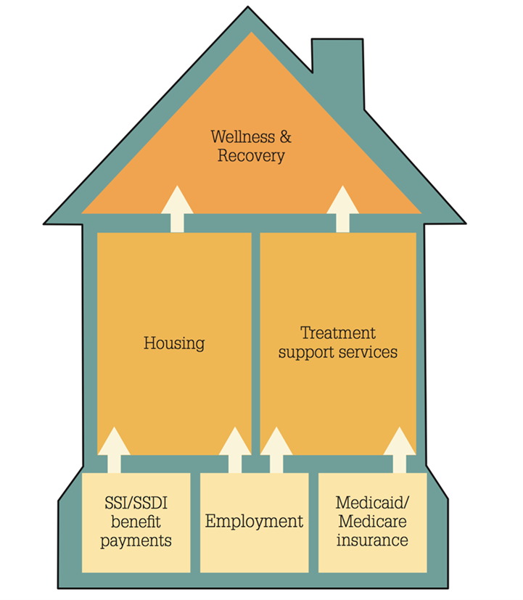
A Foundation for Recovery and Resiliency
More Than Income
SSI/SSDI: One Brick in Foundation
Access to more robust health care and housing
Increased education and employment opportunities
Decrease in incarcerations and hospitalizations
Ability to maximize income

Slide 8
How do States and Communities Benefit?
SSI and Medicaid bring federal dollars into states, localities, and community programs:
Health providers can recoup cost of uncompensated care.
States and localities can recoup the cost of public assistance.
Cash benefits and back payments received by individuals is spent in the local community (2021: $564 million*).
* https://soarworks.samhsa.gov/article/soar-outcomes-and-impact

Slide 9
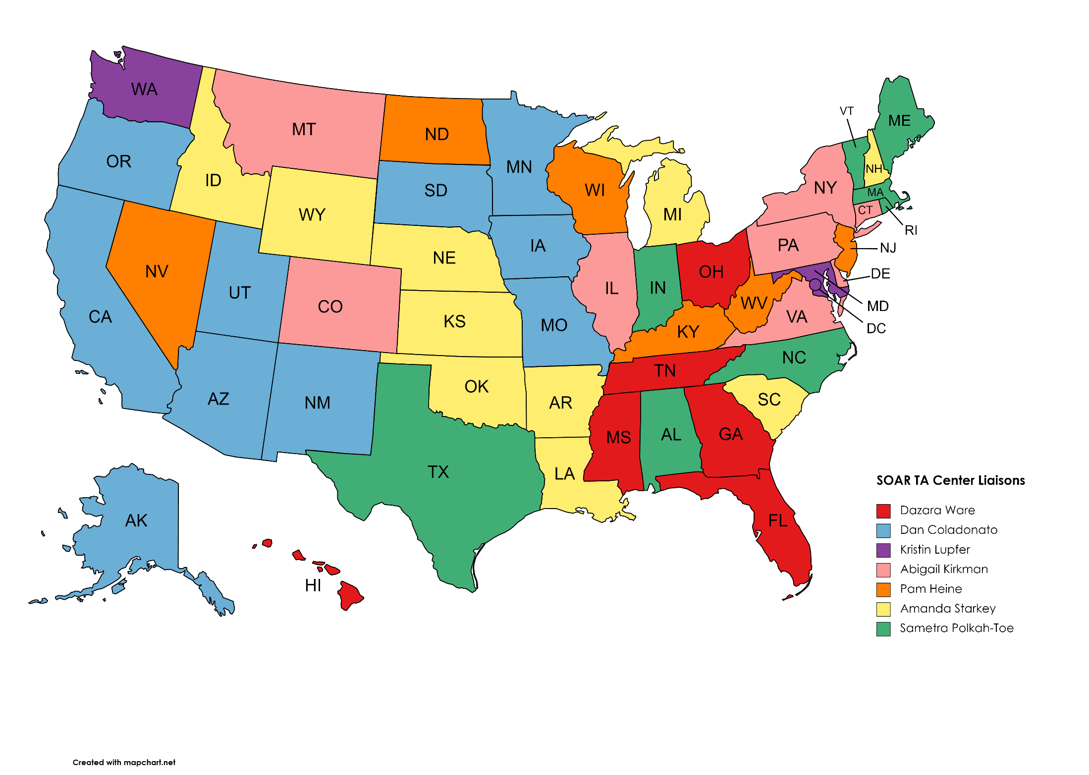
The SAMHSA SOAR TA Center is funded by SAMSHA and has existed since 2009.
Connect with your SAMHSA SOAR TA Center liaison!
What is the SAMHSA SOAR TA Center?
Funded by SAMHSA
Founded in 2009
Provides support at all levels of SOAR implementation
Designates state-specific liaisons dedicated to supporting SOAR growth and success!
Works collaboratively with our national partners
Contact Us: https://soarworks.samhsa.gov/contact
State Directory: https://soarworks.samhsa.gov/state-directory

Slide 10
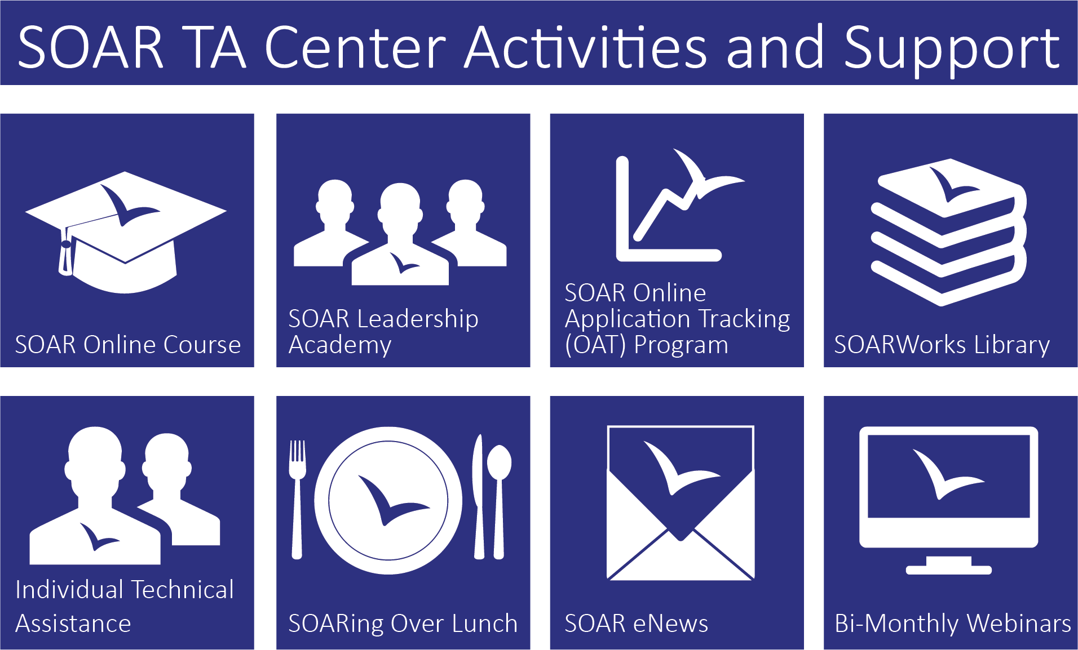
Support We Provide

Slide 11
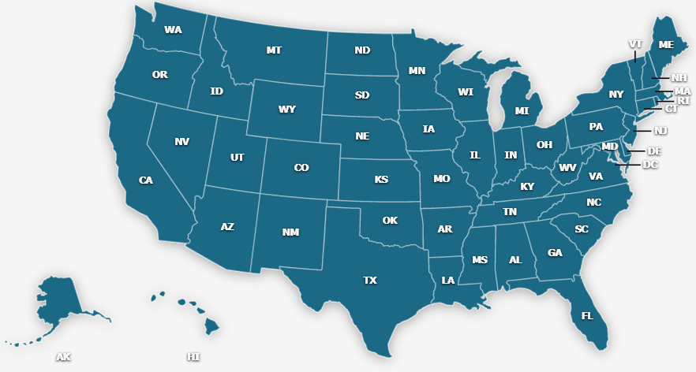
SOAR in Your State
All states participate in SOAR in some capacity
Most states have a SOAR State Team Lead as well as SOAR Local Leads that work to implement and support SOAR
Collaboration with local and regional SSA and DDS offices is the goal!
State Directory | SOAR Works! (samhsa.gov)

Slide 12
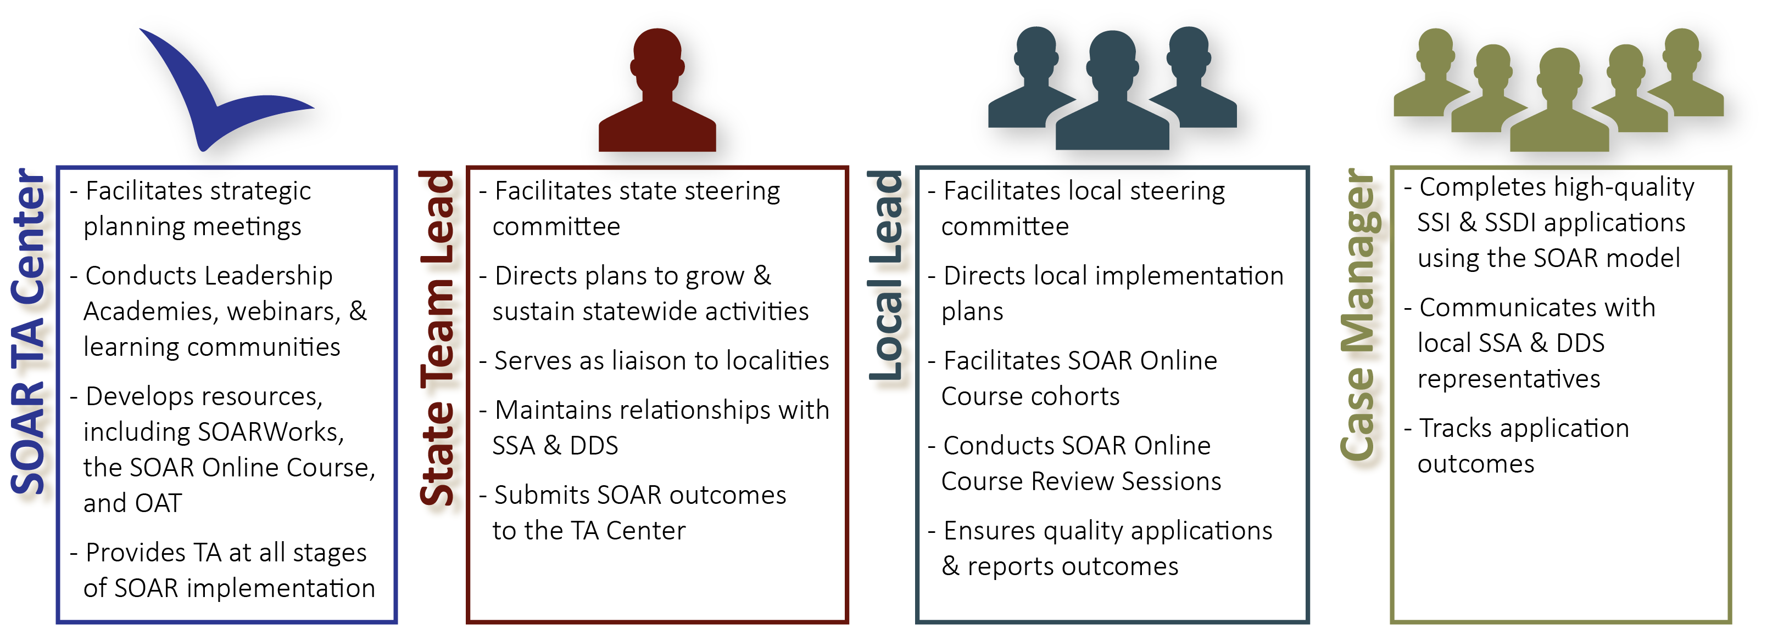
SOAR Leadership Structure
*OAT: Online Application Tracking Program
*DDS: Disability Determination Services
*TA: Technical Assistance
Notes:
Be sure to mention that case managers might have an agency lead that uses OAT and helps supervise multiple case managers
All these players are ambassadors for SOAR Initiative – united in ending homelessness for individuals with disabling conditions

Slide 13
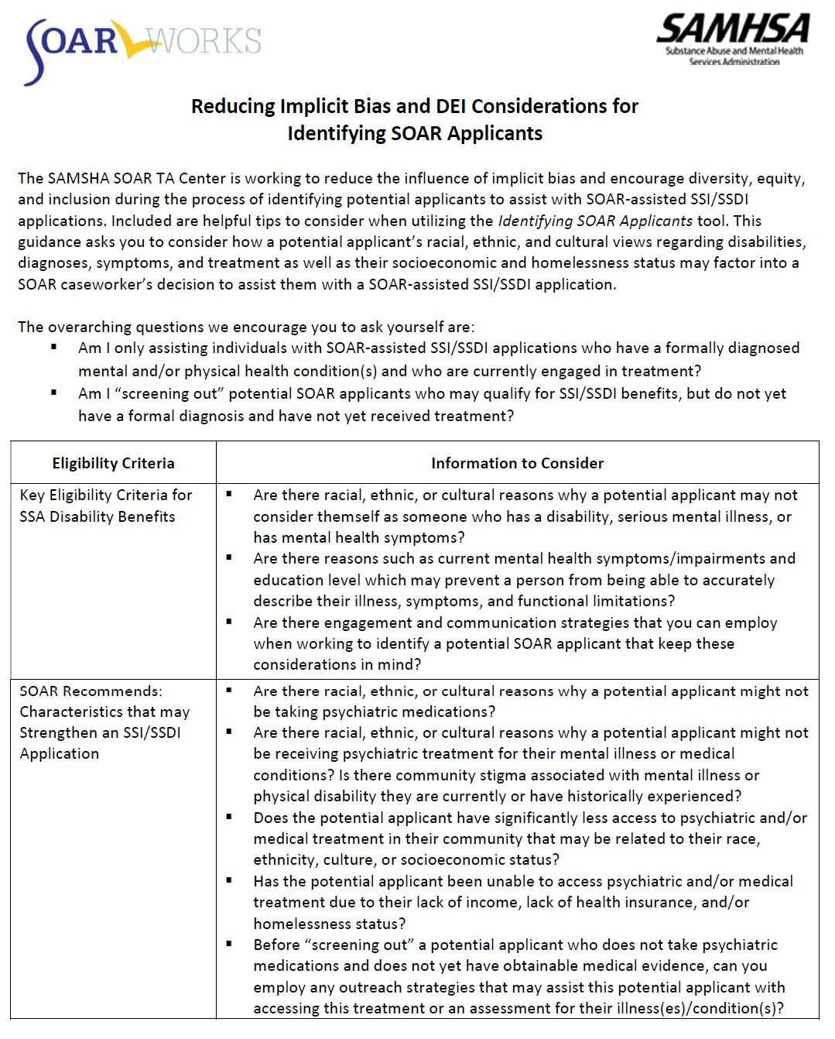
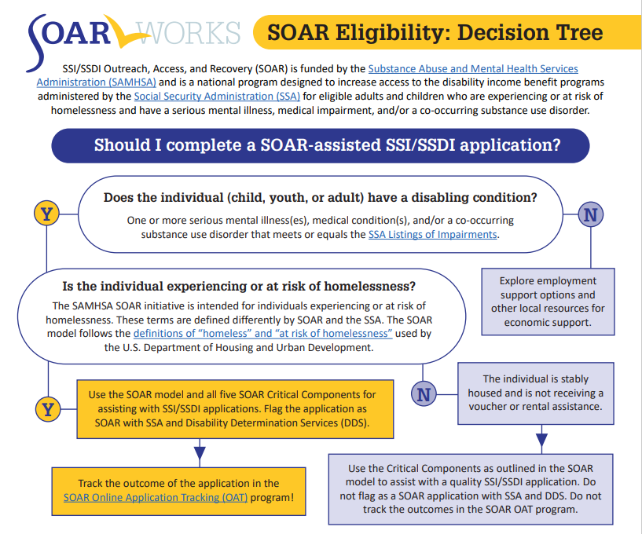
Who is a SOAR Applicant?
We want to ensure that ALL eligible applicants are served appropriately.

Slide 14
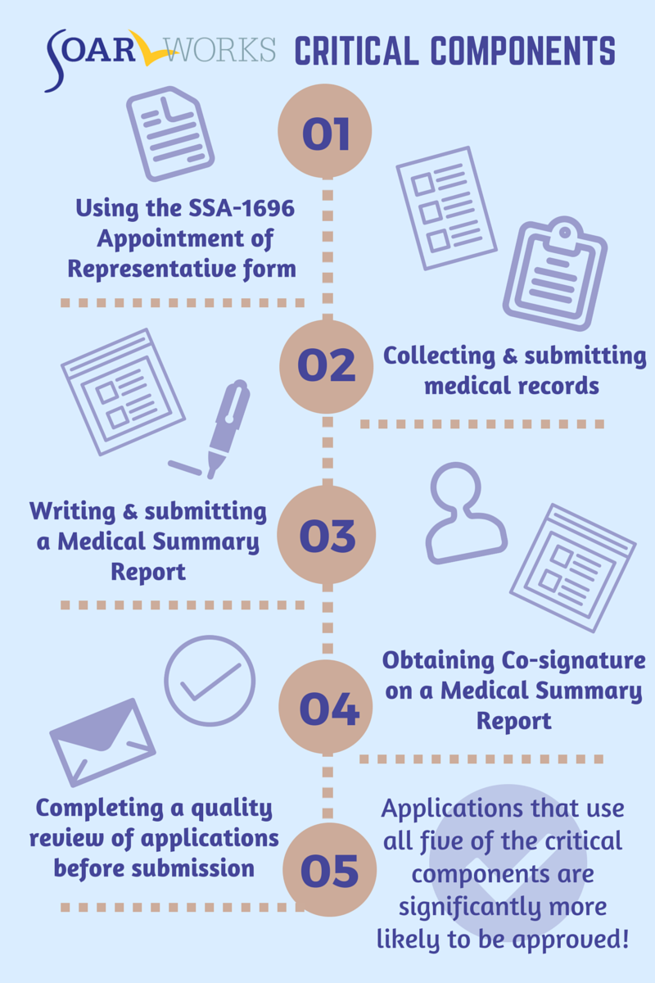

What Makes SOAR Unique?
SOAR-trained case workers are the heroes!

Slide 15
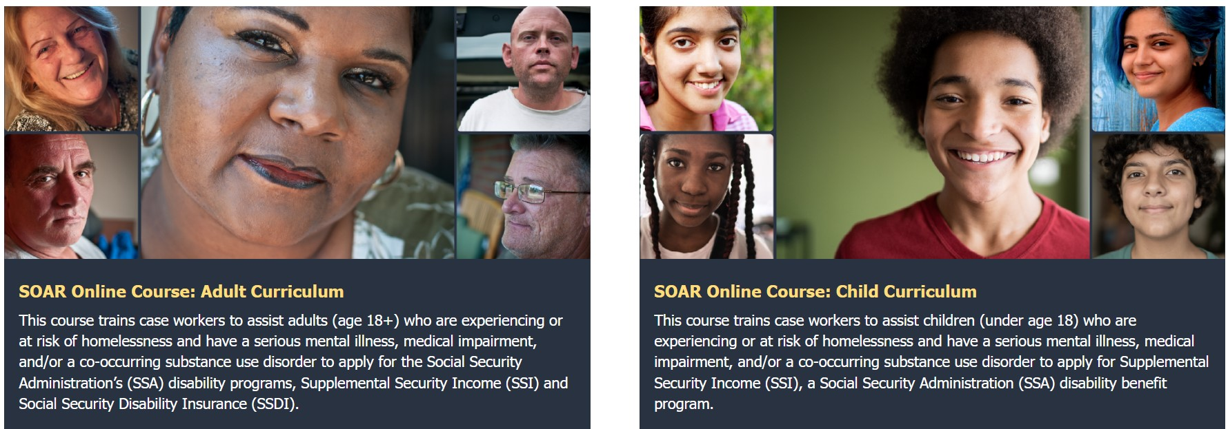
The SOAR Online Course
Standardized training provided across all geographic areas
SOAR Leaders can coordinate follow-up training and support
Course is FREE, web-based, and self-guided
20 CEUs from National Association of Social Workers (NASW)

Slide 16
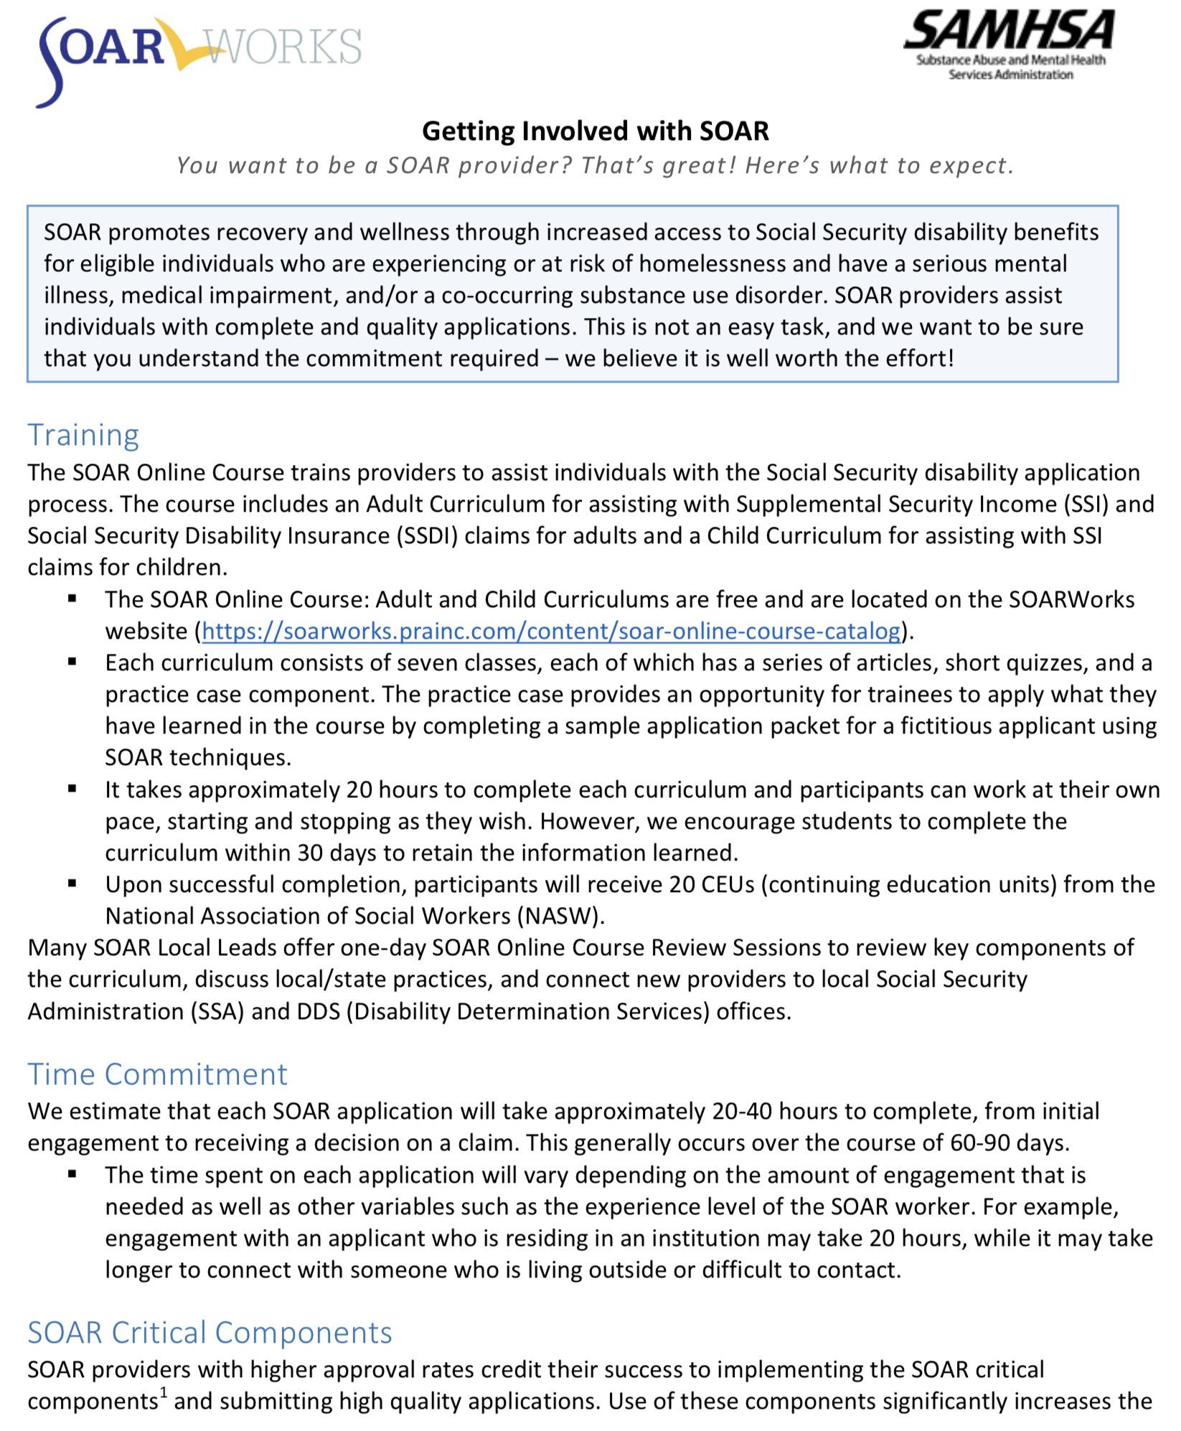
The Training and Becoming Involved
Emphasis on being able to commit time to complete and submit quality applications
20-40 hours per complete application
Completing all SOAR critical components
Tracking outcomes

Slide 17
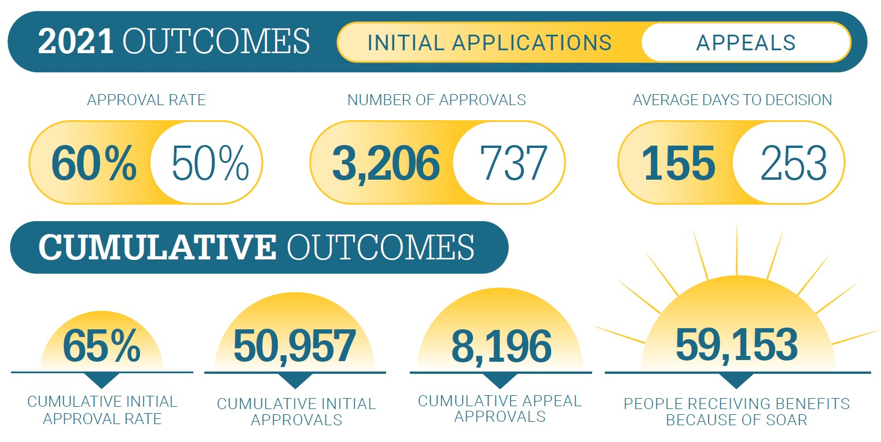
SOAR Works!
*National SOAR outcomes as of June 30, 2021
https://soarworks.samhsa.gov/article/soar-outcomes-and-impact

Slide 18
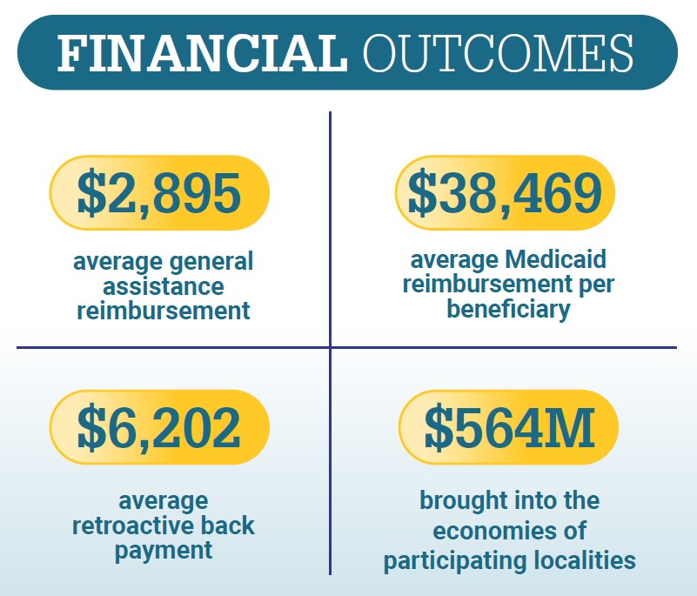
2021 Financial Outcomes

Slide 19
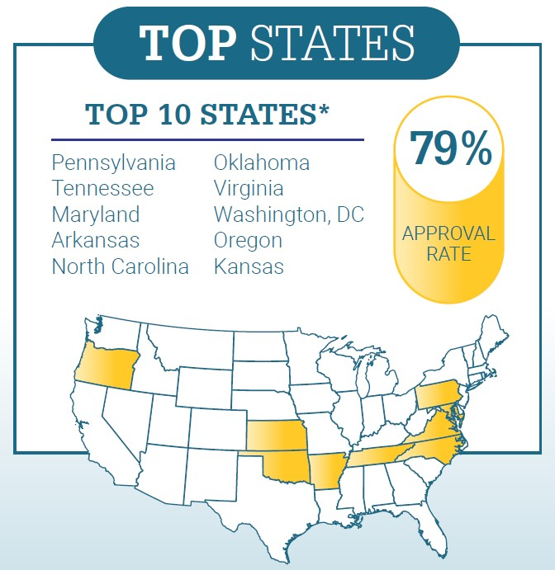
SOAR Super Stars!
*Inclusion: Highest cumulative approval rates on initial application for states with at least 350 cumulative decisions, at least 24 decisions in 2021 (2 per month), and a 2021 approval rate above the national average.
Combined, these states had 22,510 decisions

Slide 20
The Medical Summary Report
Unique and Critical Components of SOAR

Slide 21
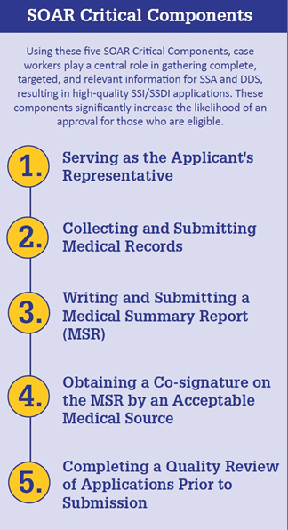

The SOAR Critical Components
As the applicant’s representative a SOAR-trained case worker works collaboratively with the applicant to submit a complete SSI/SSDI application:
  Regular communication with the applicant
  Extensive engagement process
  Clearly link the applicant’s diagnoses to their functional limitation
  Case worker will communicate regularly with SSA and DDS, and provide additional information when needed

Slide 22
Medical Summary Report (MSR)
The MSR is a letter which describes the individual and their limitations in functioning
  Supports medical records submitted
  Provides a clear link between an applicant’s conditions and functional limitations
  Often takes place of the SSA-3373 Function Report
  Is medical evidence when co-signed by an Acceptable Medical Source
  Can be sent directly to the DDS examiner or hand delivered to SSA
Answers the question: “Can the person work and earn SGA?”
Submitted as part of the completed application
Notes:
Medical Summary Report (MSR)
The Medical Summary Report (MSR) is a letter written by the case manager and submitted as part of the SOAR application packet. The skills you practiced in writing functional descriptions will be put to use in your MSR letter. View sample MSRs here: https://soarworks.samhsa.gov/article/sample-medical-summary-reports
In some states or specific Field Offices, SSA and DDS have agreed, as part of the SOAR Process, that the MSR can take the place of the SSA-3373: Function Report (found here: https://www.ssa.gov/forms/ssa-3373-bk.pdf)
Even if the SSA-3373 is required, the MSR is included as part of the SOAR packet as additional evidence to support the claim. (For more information, read “About the Function Report: SSA-3373”: https://soarworks.samhsa.gov/article/about-function-report-ssa-3373).
Reminder: SGA is Substantial Gainful Activity- $1,350/month (2022)

Slide 23
Medical Summary Report Resources
We have many tools for gathering information needed to write the MSR
We advocate for asking open-ended questions
  Tell me about …
  How often …
  When was the last time …
Interviewing focuses on functional limitations related to the applicant’s diagnoses
  Context of questions – SGA
  Distinguish between access and ability
Using the SSA Blue Book
Notes:
Medical Summary Report Interview Guide
As you utilize the MSR Interview Guide to ask questions, you can record answers in the MSR Template.
SOAR-trained providers are able to gather a thorough history in a respectful manner, which in turn helps DDS understand the impact and duration of a person’s impairment and the effect of their illness(es) on work ability and functioning.
How questions are asked can be critical to obtaining the appropriate information. The interviewing process can also uncover sensitive topics like past and current trauma that need to be approached with care
Interviewers who feel uncomfortable or ill-equipped to explore certain topics should not do so.
Instead, they should seek assistance from someone who is more clinically skilled, more able to assess responses, and more confident in ensuring that the person feels safe from self-harm and/or emotional distress when the interview ends.
How Do I Ask?
Your challenge is to gather the greatest amount of information while remaining respectful and compassionate.
Remember to talk with the person about their strengths and their struggles
Keep your questions simple and direct without being judgmental
Consider using the sample questions throughout the MSR Interview Guide
Make note of the person’s non-verbal as well as verbal responses
Open-ended Questions
Open-ended questions encourage responses that are descriptive and rich with information.
Avoid yes/no questions, such as “Can you _____?” Most people answer “yes” because they want to be seen in the best light
Examples: “Why did you leave the last job you had?” “When you do _____, how do you feel?”
Context of Questions
Remember that our goal is to obtain information that is directly related to how an individual’s disabling conditions limits his/her ability to function and maintain employment at Substantial Gainful levels.
Ability or Access?
It is important to distinguish between ability and access. DDS evaluates the extent to which the applicant’s illness impairs their ability to function, rather than impairments in functioning due to lack of access to facilities.
This is especially important for people who are experiencing homelessness
Does someone not cook because they can’t manage cooking or because they don’t have a stove?
How you ask the question can help clarify this issue
Examples “What do you like to cook?” “When was the last time you did?” “If you had a kitchen would you cook? Why or why not?”

Slide 24
Components of the MSR
Reference Section
Introduction
Personal History (Personal, Educational, Legal)
Occupational History
Substance Use History
Physical Health History
Psychiatric History
Functional Information
Summary
Contact Information
Notes:
**You’ll review each of these sections on the following slides.

Slide 25
How We Advocate the MSR Be Used
As medical evidence when signed by an Acceptable Medical Source
(When applicable) in lieu of the Adult Function Report (SSA-3373)
As a key piece of collateral information
An indication of a complete application!

Slide 26
Collaboration between SOAR and DDS
Collaboration is Key

Slide 27








Community Collaborations
Notes:
SOAR cannot and does not function in a vacuum. We rely heavily on our community partners.
First and foremost, the Social Security Administration (SSA) is an essential collaborator. SSA is the federal agency that administers SSI and SSDI. Because SSA is federal, their eligibility rules are the same in every state. SSA makes the non-medical decision on the claim.
Every state has a Disability Determination Services (DDS) that works in partnership with SSA to make the medical or disability determination. The DDS is often an unknown player in the process, but with SOAR they are absolutely key.
Medical and treatment providers are also extremely important. You will need access to assessments, evaluations and the corresponding medical records that support the claim.
Involving partners from criminal justice organizations, Veterans Affairs, employment programs, housing providers and others helps to ensure that individuals served by SOAR are receiving comprehensive services and supports and that your SOAR program is not operating in a silo.

Slide 28
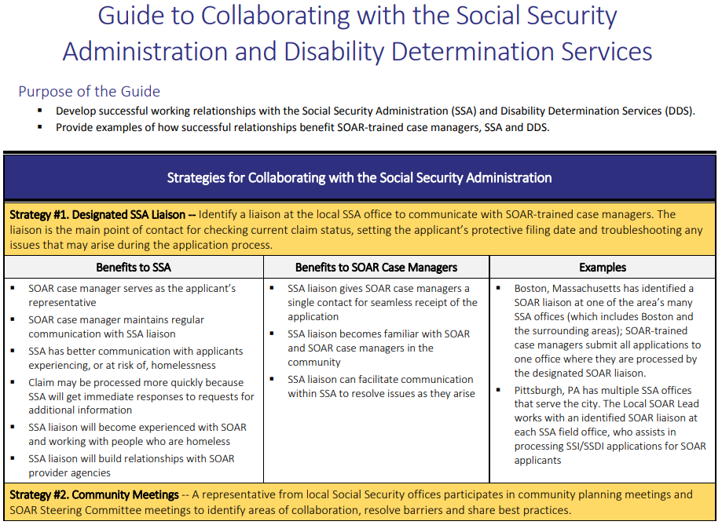
Collaboration is Key!
SSA + DDS Collaboration Guide -072017 FINAL.pdf (samhsa.gov)

Slide 29
Successful Collaboration: Virginia
SSA and DDS created SOAR Regional Representatives to assist with:
  Tracking SOAR claims
  Assigning SOAR claims, and
  Communicating with SOAR representatives around SOAR claim status and needs
DDS created SOAR Units
  DDS SOAR analysts were designated in all four regions of the state
  DDS SOAR analysts are seasoned DDS employees who are familiar with working with the SOAR populations (i.e., individuals experiencing or at risk of homelessness, live with serious mental illness, are exiting public institutions)
SSA and DDS regional representatives attend monthly regional SOAR meetings, and openly communicate with SOAR case workers, Local Leads, and the SOAR State Team Lead

Slide 30
Successful Collaboration: South Carolina
The South Carolina DDS/SOAR process was developed by SSA, DDS, and the SOAR State Team Lead
There are dedicated DDS examiners at each regional DDS office
State DDS Senior Psychologist rates all SOAR Applications
State DDS tracks all SOAR Applications
  Shares Application Data with State Team Lead
  Assists State Team Lead with outcome reporting
Provides training and technical assistance to both DDS examiners and SOAR case worker re: how to submit complete and quality applications

Slide 31
Successful Collaboration: New Mexico
The New Mexico DDS has a designated SOAR point of contact who is very accessible and involved with SOAR statewide
Several DDS adjudicators have been designated to review SOAR claims, they receive additional training or have experience processing applications for applicants who are experiencing or at risk of homelessness
Communicates regularly with the SOAR State Team Lead and Local Leads, as well as SOAR case workers
DDS regularly attends the statewide SOAR Steering Committee meetings

Slide 32
Successful Collaboration: Texas
Centralized state DDS examiner
Designated unit that handles all SOAR applications
  Applicants are labeled SOAR in the remarks section and transferred to the unit
The SOAR State Team Lead/TA Center liaison provide DDS with a list of SOAR-trained providers to ensure that applications labeled as SOAR are coming from SOAR-trained case workers

Slide 33
Successful Collaboration: Illinois
The Illinois DDS does not (yet) have a decided unit or examiners
Created a designated e-mail address for SOAR providers to reach out with questions or barriers they’re experiencing; the case workers also work directly with the adjudicator assigned to their claim
DDS representative attends the quarterly statewide SOAR Steering Committee and is very accessible

Slide 34
Successful Collaboration: Nebraska
SOAR Leadership in Nebraska asked DDS for feedback on SOAR-assisted applications:
  Time limited
  Each SOAR application received a brief survey where examiners indicated if the critical components were included
  Area for notes/comments on how to strengthen the application

Slide 35


Questions?
Question & Answer
Open Discussion

Slide 36
Connect with me!
Abigail Kirkman
Assistant Director
SAMHSA SOAR Technical Assistance Center
at Policy Research Associates, Inc.
akirkman@prainc.com
(518) 439-7415, EXT: 5226

Slide 37
Thank You
https://soarworks.prainc.com
soar@prainc.com

