Slide 1
COVID 19 - LONG HAUL
A TWENTY FIRST CENTURY POST-VIRAL SYNDROME
J. Scott Pritchard, Do
Lead medical consultant
DDS - Oregon

Slide 2
What is COVID – 19?
Novel (Co)rona (Vi)rus – (ID) in 2019
SARS-CoV– 2 - a family of Coronavirus typically present with upper respiratory symptoms including sore throat, sinus infections, mild cough to severe PNA and respiratory failure. Coronavirus is a large family of viruses that infect specifically humans or animals. They are named for their corona-like(crown) appearance.
CoV – 1 &2 are pathogenic and cause
Severe Acute Respiratory Syndromes.

Slide 3
Symptoms - onset
2 – 14 days after exposure to virus
- fever or chills
- cough
- shortness of breath
- fatigue
- myalgias
- sore throat.
- congestion or runny nose

Slide 4
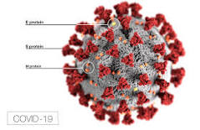
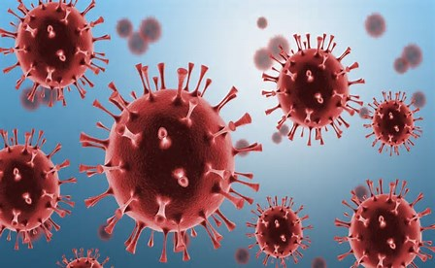

Slide 5
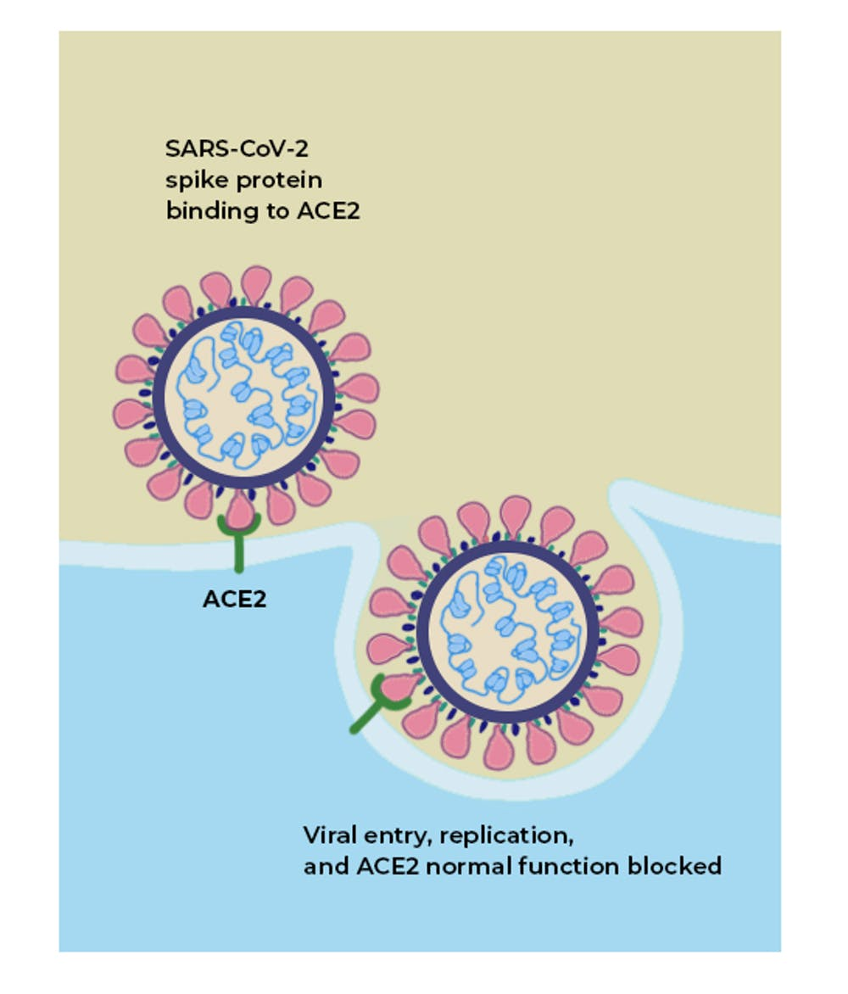

Slide 6
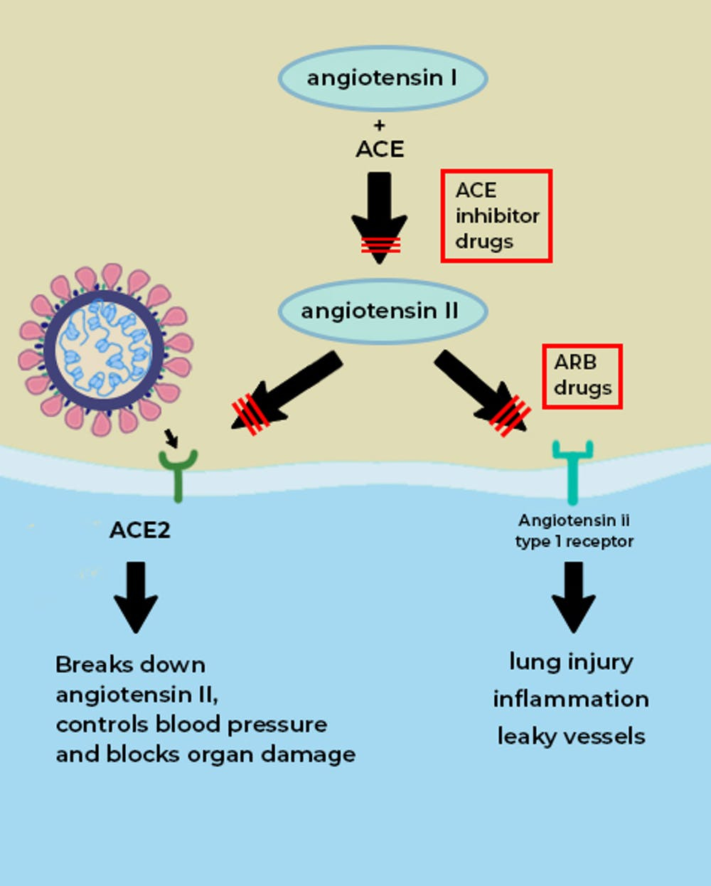

Slide 7
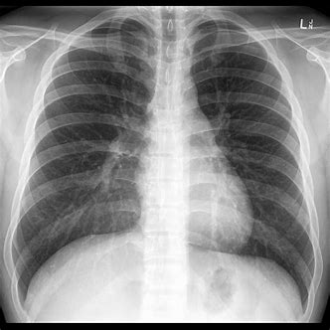
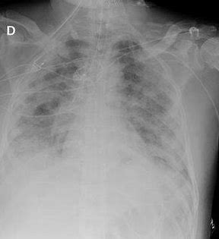

Slide 8
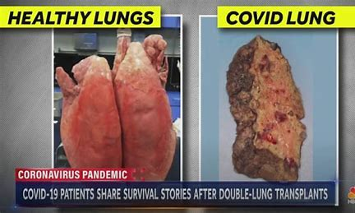

Slide 9
What is Long COVID?
- CDC definition – a range of new, recurrent or ongoing health problems people can experience four or more weeks after initial SARS – CoV- 2 infection.
- NICE – UK – symptomatic individuals from 4 – 12 weeks.
Post COVID syndrome – 12 weeks after acute infection.
- Long COVID is now a condition protected by the
Americans with Disability Act(ADA)

Slide 10
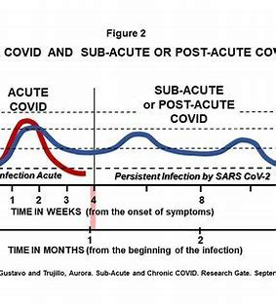

Slide 11
Who is likely to get long COVID ?
The true frequency and severity is unknown
- occurs with mild acute illness or even those that were asymptomatic
- All ages – Most common – age 35 – 69 women > men
The risk factors and biological associations are not well understood
- SARS – CoV – 2, EBV viremia, autoantibodies,
T2DM, reactivation of other viruses, CAD
- > 5 symptoms during acute infection or severity of infection

Slide 12
Pathophysiology –
- persistent virus or viral remnants causing chronic inflammation.
- autoimmunity – an acute respiratory infection(s) can induce autoimmunity in some. This difficult to reduce.
- dysregulated gut microbiome, dysbiosis and latent reactivation of viruses such as
Epstein-Barr(ME/CFS). SSR 14-1p.
- persistent viral replication
- residual organ damage from acute infection
- post-hospital or ICU syndromes
- mitochondrial disease impact

Slide 13
Characteristic Symptoms –
- Post-exertional malaise/fatigue
- pain with breathing
- brain fog
- palpitations/tachycardia
- sleep disruption
- GI problems
- Depression
- anosmia
- headache
- nerve abnormalities
- myalgias
- hair loss

Slide 14
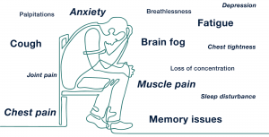

Slide 15
Epidemiology –
COVID -19
US – 80 million infected. 1 million deaths
World – 500 million infected. 6 million deaths
Long COVID prevalence – 10 – 30% of COVID cases
US – 8 – 24 million
World – 50 – 150 million
Relative small number of COVID infections worldwide
(7.9 billion) with significant public health impact.
1918 – H1N1 pandemic – Spanish flu –
500 million infected.
50 million deaths(~675000 – US)

Slide 16
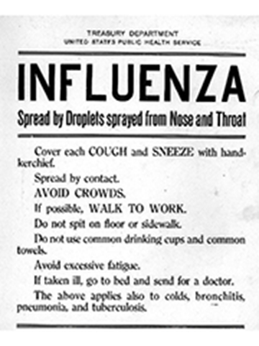

Slide 17
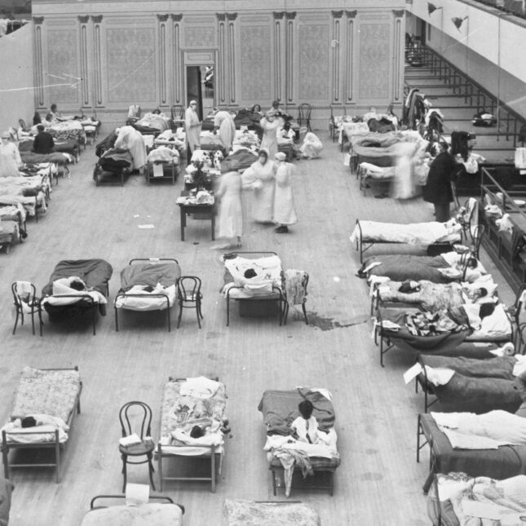

Slide 18
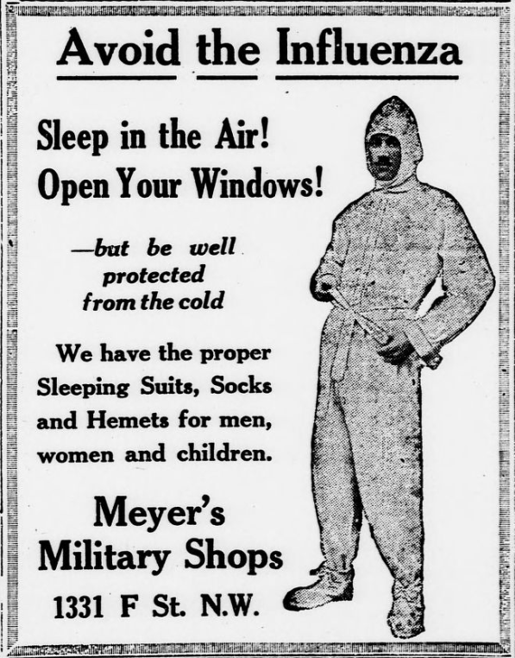

Slide 19
COVID Vaccination –
- The risk of long haul COVID is 50% less in individuals who are fully vaccinated
- Side effects are typically more pronounced and last longer than the general population.
- After vaccination –
- Most report no change in symptoms
- Minority of those receiving the vaccine improve
- Smaller minority get worse

Slide 20
Post-exertional malaise (PEM)
- Hallmark symptoms of syndrome
- increased or mental exertion on a “good day” followed by severe exhaustion or worsening requiring several days/weeks to recover
- disabling exhaustion out or proportion to the effort exerted
- triggered by physical activity(bathing, stress, cognitive activities
- onset delayed by 12 to 72 hours. Severity unpredictable.
- Not fatigue – feeling of weariness, tiredness or lack of energy
- individuals can meet criteria for CFS

Slide 21
Cognitive Impairment(brain fog) primary cognitive symptoms
- word retrieval
- working memory
- reasoning
- problem solving
- attention
- executive functioning
- spatial planning. presentation similar to post-concussion syndrome

Slide 22
Dysautonomia –
- dysfunction of the autonomic nervous system.
- POTS(Postural Orthostatic Tachycardia Syndrome)
- lightheadedness, chest pain, dyspnea, shaking
- heart increases > 30 beats per minute or >
120 beats per minute within the first 10 minutes of standing(tilt table test).
- individuals with long haul COVID often have symptoms suggestive of dysautonomia.

Slide 23
Small Fiber Neuropathy(SFN)
- small unmyelinated C fibers and thinly myelinated A-delta fibers.
- mediate pain, thermal sensation, autonomic
- burning, prickling, shooting/aching pain
- autonomic – dizzy when standing, abnormal sweating, palpitations, dry mouth and urinary dysfunction

Slide 24
Mast cell activation syndrome irregular mast cell activation w/episodic symptoms
- hives and flushing
- non-pitting and angioedema
- nausea, vomiting, diarrhea and abdominal pain
- conjunctivitis, runny nose, sore throat
- wheezing
- palpitations and anxiety
- hypotension
- headache and brain fog

Slide 25
Mitochondrial Dysfunction –
SARS CoV -2 RNA targets the mitochondrial matrix and disrupts normal function.
- decreased energy production
- decreased anti-viral signaling and immune response
- hijacked for viral replication
- increases inflammatory responses
- impairs the ability to support immune response
- loss of mitochondrial integrity and death

Slide 26
Symptoms are intermittent in nature.
- Symptoms tend to cluster during periods of improvement or worsening.
- worsening of symptoms typically occur after periods of PEM(post-exertional malaise) and stress.
(malaise – feeling uncomfortable, ill or lack of energy that can’t be explained).
Often very difficult to discern the complex of overlapping symptoms from other impairments.

Slide 27
SSA - Emergency message – 21032
Evaluating cases with coronavirus disease 2019.
Establishing an Impairment –
- A report of a + viral test for SARS-CoV – 2.
- A diagnostic test with findings consistent with COVID – 19. E.g. chest XR w/lung abnormalities
- A diagnosis of COVID-19 with signs consistent with
COVID – 19. E.g. fever, cough
A + antibody test does not establish COVID-19 as an impairment. A + test could reflect other infections w/Coronavirus or a prior vaccination

Slide 28
Definition of disability – must be established
COVID – 19 may meet the durational requirements
- Long-term effects of COVID-19
- One or more new impairments secondary to COVID
- Worsening of existing impairments.
COVID-19 as a stand alone impairment cannot meet a listing. It potentially can equal a listing as an unlisted impairment(primarily secondary to other body systems affected).

Slide 29
We cannot medically equal listing 3.14.
COVID – 19 causes acute respiratory failure.
It cannot be substituted for a chronic respiratory impairment.
(3.14 “Respiratory failure resulting from any underlying chronic respiratory disorder except CF”).
-Prophylactic restrictions or limitations intended to limit exposure to COVID -19 cannot be included in the RFC. E.g. recommendation a clt telework as they are at high risk for COVID – 19
-EOD may be established before or after onset of a
COVID – 19 infection
Diaries – do not apply criteria mechanically. Use judgment to establish a longer or shorter diary for review based upon the severity of impairment/restrictiveness of RFC.

Slide 30
Claimant Story
Prior to getting COVID – 19, April 2020, the clt reported working 50 hours per week and enjoyed traveling.
Now she is feels like she is wearing a “lead” weight around her body, after doing household chores she suffers profound exhaustion for days and her heart races on occasion.
She has trouble finding words, staying focused, multi- tasking and is mentally exhausted going to the store.
She has undergone an extensive workup by a cardiologist and pulmonologist. She was told her symptoms were anxiety based and told “think happy thoughts”.

Slide 31
She is unable to work, feels like a burden on her daughter an dismissed by the medical community.
She doesn’t understand what is wrong with her, is scared that she might die and contemplates whether life is worth living.
Does she have Long COVID syndrome?
What is your decision based upon the evidence and guidance of EM 21032?

Slide 32
Thank you for your kind attention!

