Slide 1
Cognitive Factors .in Adjudicating
Disability Claims
Presenter: Mark Berkowitz, Psy.D.
Denver Regional Medical Advisor

Slide 2
What is intelligence?
Not homogeneous – Musical vs. Mathematical vs. Comic vs. Business Geniuses?
How valuable is psychological testing in predicting future success?
  (Mensa has some very dysfunctional people)
One definition – The global ability to act purposefully, think rationally, and deal effectively with one's environment. Utilize what one has learned.

Slide 3


In assessing disability claims
REMEMBER: Regardless of alleged or apparent functional limitations,
must be traceable back to a MDI,
  established by an acceptable medical source

Slide 4

About AMS ...
Physician or licensed psychologist
Licensed psychologist: some States require a master's degree; some a doctorate.
School psychologist is an AMS for establishing:
  Borderline intellectual functioning
  Learning disability
  Intellectual disability (formerly called mental retardation)

Slide 5

Evidence may provide answers and raise questions simultaneously
“Judge a man by his questions, not by his answers.” --Voltaire
When file has testing or other forms of cognitive assessment (e.g. MSE), ask,
What does this tell me about the claimant, and what else do I need to explore?

Slide 6

Psych testing should be used to:
1. Answer questions within the limits of the test;
2. Raise questions for further investigation; and
3. Offer guidance for interventions.

Slide 7
IQ is a testing benchmark
Ask yourself: are findings consistent with longitudinal functioning and past test results?
IQ scores at/after age 16 are valid/stable, barring some factor that might suggest a change.
DI 24515.055A: “IQs obtained from tests having the desirable qualities described above tend to stabilize by the age of 16.”
  Age 16 is not a hard cut-off
  In a specific case, there may be reasons to use an earlier score. Needs strong rationale!

Slide 8
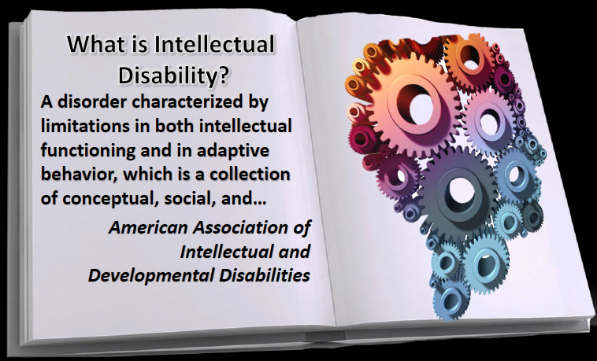
Why is information about adaptive functioning important?
IQ scores do NOT tell us if someone demonstrates deficits in adaptive functioning initially manifested during the developmental period.
See the June 2016 Disability Topics VOD

Slide 9
IQ score ranges
Superior-Above 120
High Average-111-120
Average-90-110
Low Average-80-89
Borderline-70-79
Mental Retardation-Below 70
Scaled Subtest Scores range from 1-19

Slide 10

Examiner Tips--1
Look at the range of subtest scores.
Consider two different claimants with FSIQ scores of 70.
One has subtest scores all approximately in the range of 3-6;
The other in the range of 1-10.
What does this possibly tell us?

Slide 11

Examiner Tips--2
Low IQ scores but also a DIB claim:
Does this suggest conflict; that the IQ scores imply lower functioning than demonstrated functioning?
Do we need to investigate work to determine of special considerations were present?
Work doesn't have to be SGA to get insured.
CE buyer beware!
Notes:
Buyer beware → CE BIF diagnosis

Slide 12

Examiner Tips--3
Listing 11.07A. Cerebral palsy with IQ of 70 or less.
No requirement for intellectual disability or that all of the IQ scores are at or around that level.
Change is coming! Sept 29, 2016—IQ will not be in the 11.07 listing.

Slide 13
Examiner Tips--4
11.04 CVA—Usually defer for 3 months, but
DI 25505.035C.5 says:
Evaluate evidence of any residual impairment(s) at more than 3 months following a CVA, unless the claimant demonstrates an unusually rapid recovery.
Do not medically defer the claim when an allowance is appropriate if the evidence clearly indicates little or no chance of recovery.

Slide 14
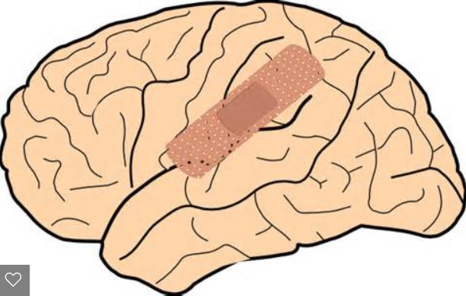

Examiner Tips--5
Listing 12.02 … presence of a specific organic factor etiologically related to the abnormal mental state and loss of previously acquired functional abilities.
Therefore BIF and LD do not meet 12.02.

Slide 15

Examiner Tips--6
Listing 12.02 (and aspects of 11.18, cerebral trauma)
We cannot deny someone within the first six months of a traumatic brain injury.
We can allow within 6 months, if appropriate.
If not allowed before 6 months, must have "evidence" at least 6 months post-injury.

Slide 16
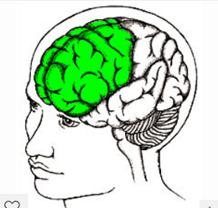
Examiner Tips--7
Frontal lobe injuries: Often they will score higher on standardized testing due to the make-up of the testing.
May actually function- much lower and often MER and family collaterals will tip you off to this.

Slide 17
Classic Signs of
Frontal Lobe Impairment
Categories
Cognitive
Emotional
Behavioral

Slide 18

Cognitive
Short attention span
Poor concentration
Poor working memory
Poor short term memory
Difficulty in planning and reasoning

Slide 19
Emotional
Difficulty in inhibiting emotions, anger, excitement, sadness etc.
Mood lability
Depression, possibly due to above.
Occasionally, difficulty in understanding others' points of view, leading to anger and frustration.

Slide 20
Behavioral
Nature of purposeful behavior
Perseveration behavior
Inappropriate aggression
Inappropriate sexual behavior
Inappropriate humor and telling of pointless and boring stories

Slide 21
Pet Peeves--1
No history, few significant findings ... Defaulting to simple repetitive tasks MRFC.

Slide 22

Pet Peeves--2
PRTF B4 criteria: Episodes of decompensation
3 episodes,(marked) within 1 year, or an average of once every 4 months.
  Within one year of adjudication, not several years ago.
2 weeks or longer
  We may use judgment for more frequent/shorter duration or less frequent/longer duration.

Slide 23

Pet Peeves--3
Unnecessary CEs or unnecessary tests in CE:
Too many tests that are expensive and not helpful;
IQ test is purchased when an IQ test at/after age 16 is in file.
WISC can be administered up to age 17; program only requires "valid testing.”

Slide 24

Pet Peeves--4
Giving too much weight to very limiting MSS from CE when
those conclusions rely mostly on claimant self-report of history and
there is a lack of objective evidence in the exam, little/no MER, or little/no longitudinal history.

Slide 25

Pet Peeves--5
Adopting a first-time CE psychiatric diagnosis of a major mental impairment based mostly on self-report with little, if any, objective signs or psychiatric history, to meet 12.05C

Slide 26

Questions? Discussion?

Slide 27

Need a CE?
Claimant alleges “anxiety,” or says “I feel depressed.”
These words may be normal response to life and physical challenges.
They may not mean a separate psychiatric impairment.
Do not necessarily require significant development

Slide 28

“Alleged” or “discovered” mental impairment
Check sources and medications – Psychiatrically relevant? Requested and received?
If no psych sources and primary issues appear to be physical, review MER for useful information
  MSE, signs, symptoms, function
  Response to psych meds prescribed by non-mental health professionals

Slide 29

“Alleged” or “discovered” mental impairment (--cont.)
Review ADLs and 3rd party collaterals for possible psychiatrically based limitations
Review FO observations
Review claimant’s statements, including why he or she stopped working.

Slide 30

“Alleged” or “discovered” mental impairment (--cont.)
If there is psychiatric-related MER, but more information is needed:
Recontact sources
Ask for specific information
If the MDI is established, other medical and non-medical source may provided sufficient information to establish severity.

Slide 31
Potential mental impairment
(DI 24505.030)
DO NOT DEVELOP evidence for a potential mental or physical impairment when:
No treatment recommended or received for a condition;
No medical evidence of an MDI; and
No limitations in basic work activities (or functional limitations for children).

Slide 32

Before purchasing a CE
Consider whether the evidence, including any diagnostic tests or procedures already performed, is available from the claimant’s medical sources before deciding to purchase a CE

Slide 33

Before requesting a CE
If the evidence in the folder is insufficient, has the DDS documented attempts to get necessary supplemental medical evidence from MER sources?
Is there a material conflict, inconsistency, or ambiguity in the evidence that DDS cannot resolve by re-contacting the claimant, his or her medical source(s), or other appropriate source(s)?
  Can a CE resolve the conflict?

Slide 34
Static impairment
Generally will not need to purchase a CE to resolve severity unless there is no longitudinal history or medical evidence describing the severity of the impairment at any time.

Slide 35
CDRs
CEs are not needed for many CDRs. Do not order a CE:
If the CPD impairment(s) met a listing and will always meet it (e.g., listing 14.08).
For most MINE or MINE-equivalent cases.
To “establish” an MDI that is established in existing evidence (e.g. in CPD folder).
An MDI established at CPD need not be established again. Medical evidence from other medical sources can document current severity.

