Slide 1

NADE Meeting
Nancy Berryhill
Deputy Commissioner for Operations
August 15, 2016

Slide 2
Agenda
FY 2016 Budget
FY 2017 Budget Forecast
Bipartisan Budget Act 2015
  SDM and Colorado Pilot
DCPS
SSA Express
Customer Service Station
my SSA
iSSNRC
Click to Chat

Slide 3
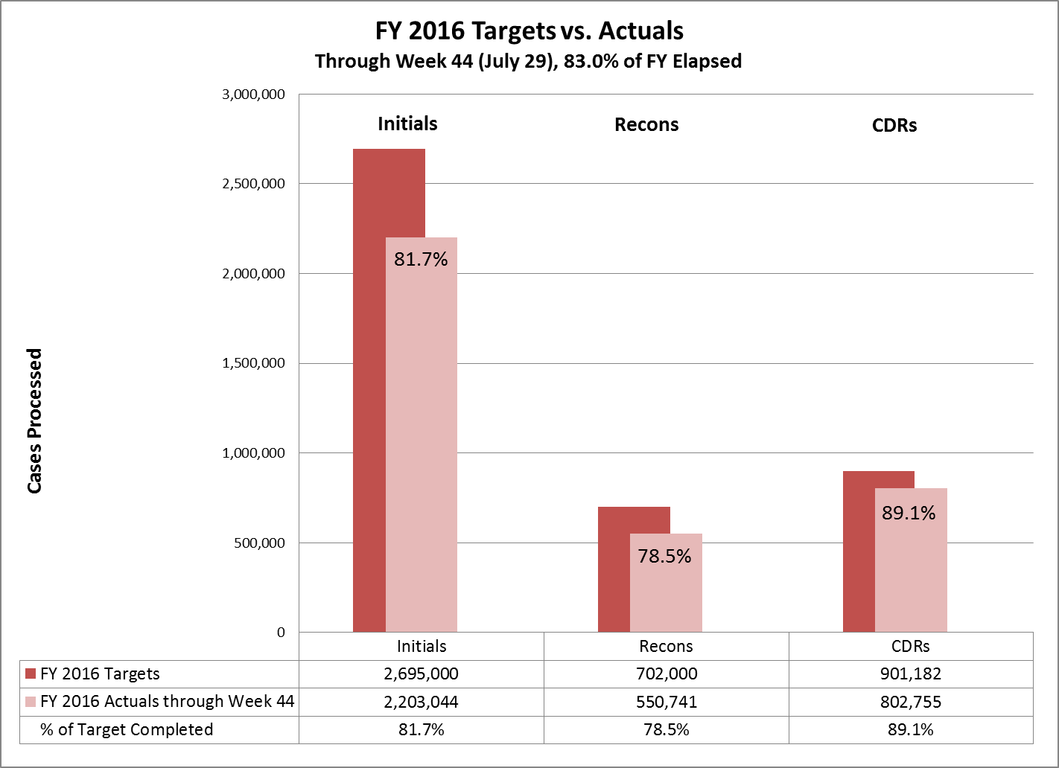
Notes:
We began FY 2016 with high targets of initial, reconsiderations, and CDRs claims to clear. We knew we would be facing a demanding year.
The national target for total workload clearances in the DDSs and the federal units included:
2.695 million Initial cases
702,000 Reconsideration cases
850,000 CDRs cases
As of August 5, (week 45), we are at 84.9% completion of the fiscal year.
With only a quarter left of FY 16, nationally you have processed:
83.7% of the initial claims goal
80.3% of the reconsiderations goal
91.0% of the CDR goal
FY 2016's CDR goal is the highest CDR goal since 2002, and we are on target to meet this goal.
The agency's goal is to become current with this workload by FY 2019, if not earlier.

Slide 4
FY 2017 Budget Forecast
Possible Continuing Resolution
Operating under a Hiring Freeze in FY 2017
  FY 2016 1:1 Hiring plus 400 Additional Hires
Notes:
Looking at the after effects of FY 2016, I am sure many of you are thinking what FY 2017 has in store for us. What will it look like?
Our discussions with the Office of Budget lead us to believe that the FY17 budget will be challenging.
It is likely that we will start FY 2017 under a Continuing Resolution– This means last year’s funding, but we know that things go up.
CR effectively leaves us with fewer resources to do our work after we pay for growth in our fixed costs.
We have gone back to zero base budgeting, which is keep the lights on and the doors open.
We worked very fast this year to get as many hires as we could.
We expect to be in total hiring freeze with little to no overtime beginning Oct. 1, 2016.
The immediate effects on the public of a CR include:
longer processing times for initial disability claims and hearings;
service deterioration in field offices and on our National 800 Number; and
delays in resolving post-entitlement issues.
Both our IT and physical infrastructures would also be at risk.
In anticipation of future budget constraints, we have looked for every possible cut we can take to reduce our costs for next year.
The ACOSS is doing everything she can to prevent furloughs next year, including implementing the current hiring freeze, planning for the possibility of a future hiring freeze, and limiting overtime to extremely low levels.
We need sustained, adequate funding – funding well over and above the growth in our fixed costs of approximately $350 million – in order to tackle our challenges and provide the level of service the public expects.
Full funding of the FY 2017 President’s Budget would get us back on track and help us rebound from funding constraints this year. The President’s Budget would ensure that we can begin to reduce hearings wait times, provide better service in our field offices and on our National 800 Number, save billions of taxpayer dollars through program integrity work, and address our IT modernization needs.
We had to make some tough decisions on hiring. As you are aware, the agency is operating under a hiring freeze; however we kept the DDS at the one for one plus an additional 400 above attrition hires.
Workload targets are fluid at this time, currently the FY17 President’s Budget is showing a CDR goal of 1,100,000, however, it can change.
As you know, workload targets only become firm after we have a budget, which is not likely until at least the second quarter of the fiscal year.
We know this is often difficult as it usually results in mid-year shift of workloads.
We always appreciate your patience and flexibility with this process.

Slide 5
Single Decision Maker
Prototype
SDM II
Notes:
SDM History & Colorado Pilot
In 1996, ten operating sites were involved in Phase I SDM test.
In October 1999, during Phase II, was rolled out in ten additional sites. At the same time, SDM authority was extended in the Phase II states as a stand-alone process.
At present, the states currently processing initial disability cases under SDM authority are:
Prototype: Alaska, Alabama, California (Los Angeles and Glendale), Colorado, Louisiana, Michigan, Missouri, New Hampshire, New York and Pennsylvania.
Phase II SDM: Florida, Guam, Kansas, Kentucky, Maine, North Carolina, Nevada, Vermont, Washington, and West Virginia.
In November of 2010, the final rules for the regulation allowing State Disability Examiners (DEs) to make fully favorable determinations in certain QDD or CAL cases without the approval of a State agency medical (MC) or psychological (PC) consultant went into effect. This new process applied only to certain QDD and CAL initial and CAL reconsideration cases nationwide.
Provision 832- Elimination of SDM, eliminates the DDS ability to utilize Single Decision Maker (SDM) authority. It requires a medical doctor sign off on all physical cases and a qualified psychiatrist or psychologist sign off on mental cases. Implement on November 2, 2016
Provision 832 - Single Decision Maker (SDM) Elimination
Eliminates the DDS ability to utilize SDM authority, which is used to expedite case processing and ensure medical consultant resources are dedicated to the more complex workloads.
In preparation for this elimination we are working closely with those impacted DDSs to ensure they have sufficient staffing, system functionality, and other indirect needs to make this change successful.
We appreciate the work of Colorado DDS to implement a pilot that can help inform and develop strategies to minimize any service impact.

Slide 6
CO DDS SDM Pilot Findings
Decreased Productivity
Increased Processing Time
Increased consultative examination rates
Notes:
Shortly after the January meeting, the CO DDS was proactive and agreed to pilot the elimination of SDM to help us access and develop strategies to minimize any service impact. I want to take this opportunity to thank the Colorado DDS for being proactive piloting SDM elimination. As result of the pilot, we learned several things.
The Colorado DDS moved forward with their pilot with a staggered approach. They found the following impacts:
Decreased productivity—took longer to clear cases because of the requirement all cases required medical consultant review
Increased processing time—longer to clear cases, more time because of required medical reviews
Increased consultative examination rates –medical consultants requested more information before preparing medical assessments

Slide 7
Disability Case Processing System (DCPS) Progress
Through Line Milestone
  The ability to take a simple case through the system, following the simplest possible path.
  Completed at the end of March 2016
Staff continue to make demonstrable progress in the development of what we now refer to DCPS2 Release 1
Working hard to get working code into the hands of the Early Adopter sites (Delaware, Maine and Ohio) by the end of calendar year 2016
DCPS remains one of the agency’s top priorities
Notes:
When the Acting Commissioner last spoke to you in March, the focus for DCPS development was on finishing the “through-line” functionality-- the ability to take a simple case through the system, following the simplest possible path.
We successfully completed that milestone at the end of March, and since that time, we have continued to make demonstrable progress in the development of what we now refer to DCPS2 Release 1.
During the recent DDS All Administrators meeting, DDS administrators, Regional Commissioners, disability center directors and others had the opportunity to view an end-to-end demo of the DCPS functionality developed to date. The demo included functionality such as organizational setup, case receipt, evidence requests and the newly incorporated case analysis features.
The feedback from that demo was very positive, and many of the administrators were impressed with the large amount of progress that we have made in just 8 months of development. Several administrators expressed interest in possibly being part of the next round of early adopters.
The DCPS development team continues to push towards having a product ready for use in our three early adopter states (Delaware, Maine and Ohio) by the end of calendar year 2016.
DCPS is one of the agency’s top priorities, and despite the uncertain budget picture for FY 2017, we will continue to do all that we can to ensure that DCPS has the resources and support that it needs to be successful.
We are aware that Micropact has reached out to the DDSs to offer a modern product. Micropact did reach out to SSA as well. We are in the process of looking at the product to determine viability. In the meantime we are 100% dedicated to delivering DCPS. We will provide the DDS community regular updates as we progress through this issue.”

Slide 8
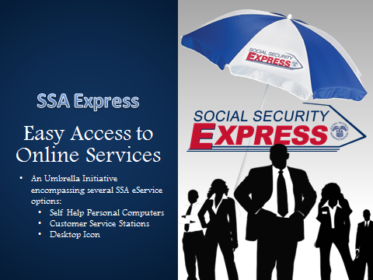
Notes:
Social Security Express is an umbrella initiative encompassing several SSA eService options:
Self Help Personal Computers (SHPC)
Customer Service Stations (CSS)
Desktop Icon
Each of these projects under Social Security Express serves to help transition customers traditional face to face service (FO interviews and N8NN calls) to self-service
All of these projects feature streamlined access to various SSA eServices behind ssa.gov in a similar “Big Button” format for customers
These projects are customizable based on site preferences and they can offer quick or full service options
Quick service (My SSA and Retirement Estimator)
CSS only offers quick service option because it’s a standup kiosk
Full service (Quick service options and the ability to file and appeal for benefits)
These projects are mixture of external and internal solutions for our customers
External: Icon and CSS are available at 3rd party community and other government locations
Internal: SHPCs and 1 CSS are available in our FOs

Slide 9

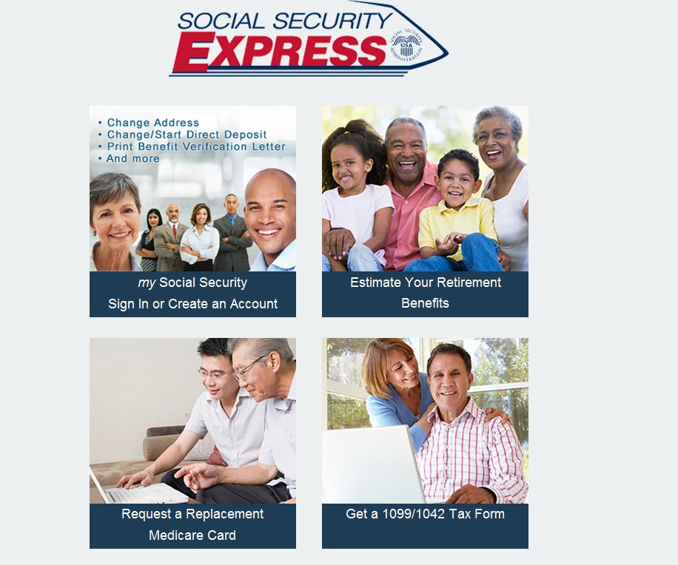
Social Security Express Desktop Icon
Easy Access to Online Services
Streamlined Menu
Easy Installation
Over 750 partners in VAs, Senior Centers, Libraries, Tribal Sites, Social Services, Govt Agencies
Notes:
Icon project began in Fall 2013- the idea is to provide and easy way for people to conduct business online, in a convenient location
Third Party (non-SSA) partners (e.g. VAs, HHS’, libraries, retirement homes, etc.)
Business and installation processes redesigned in June 2015, which spring boarded us from 170 partners at that time and made installation to a desktop computer simple and easy
Drag/ drop method of installation – takes less than a minute
As of August, 2016 we have over 750 active partners across the country
More than 75 of these partners have the Icon on their website

Slide 10
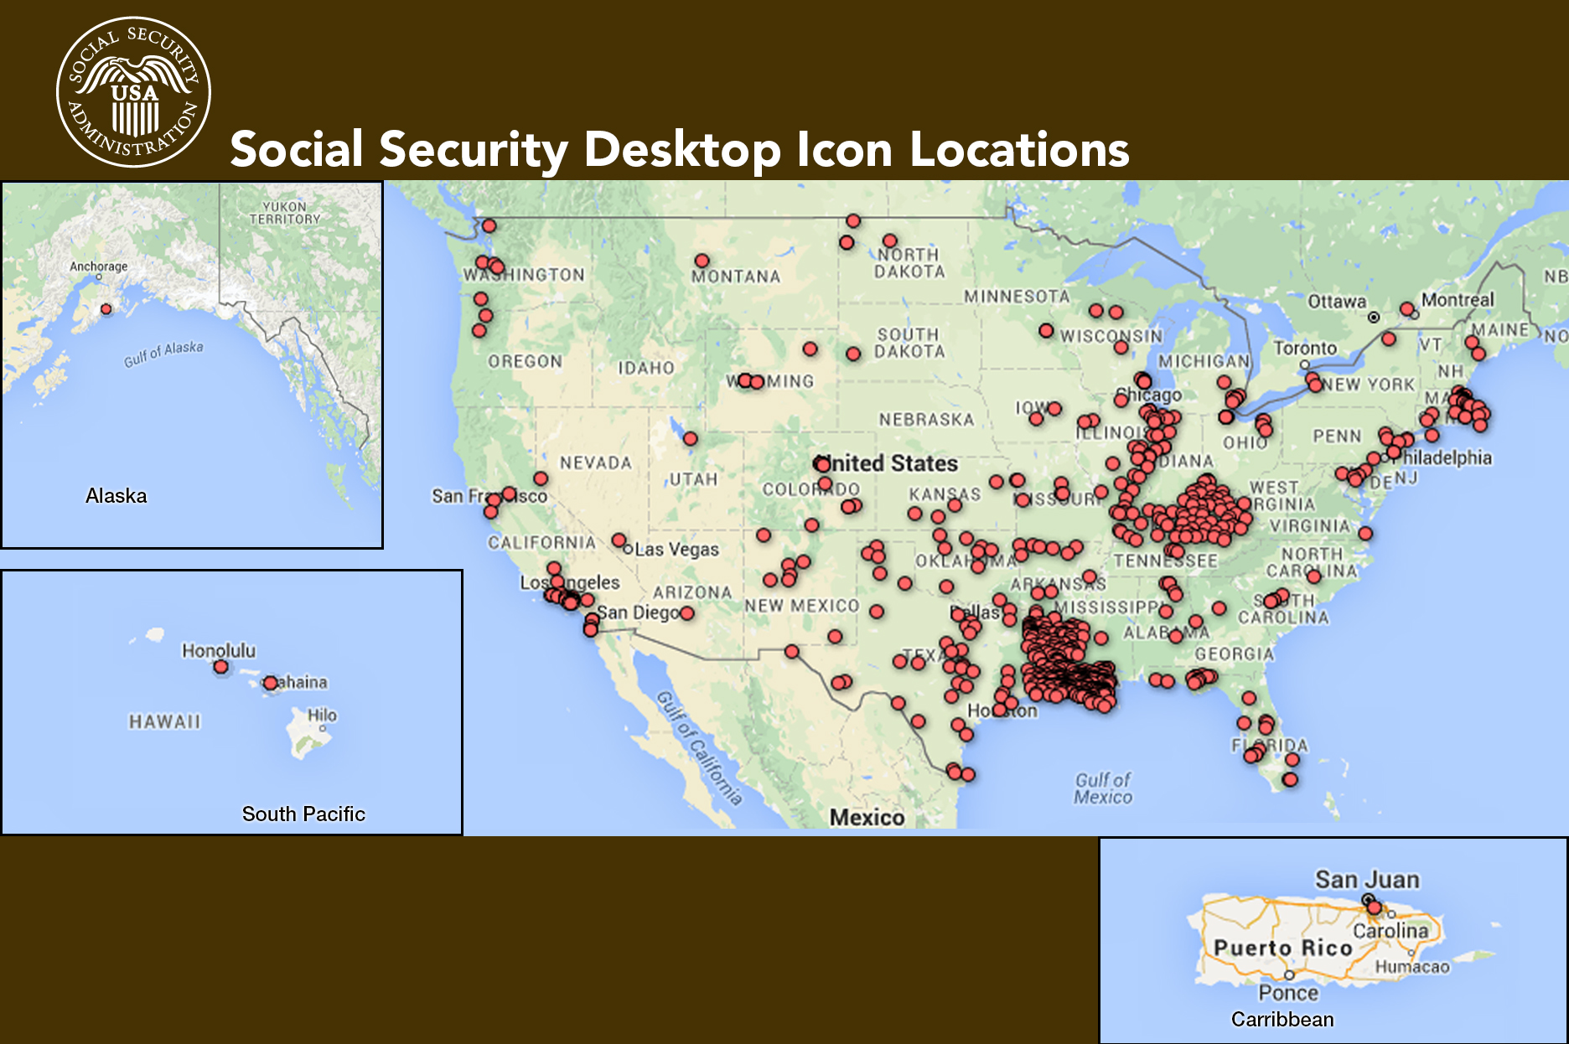
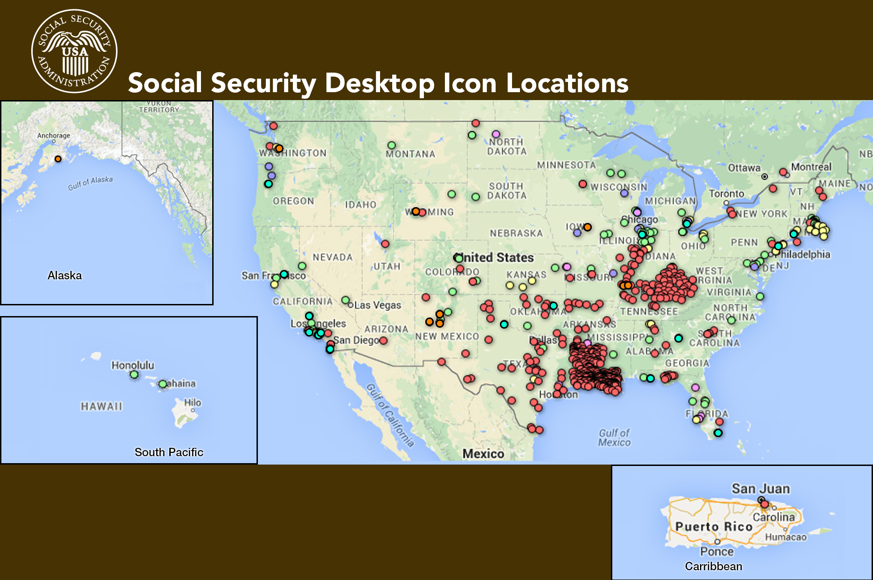
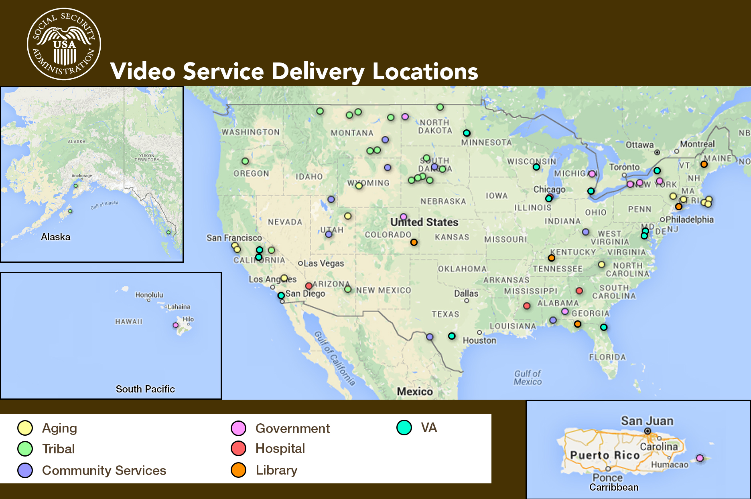
Health Centers
Government
Social Security
Library
VA
Tribal
Notes:
This chart provides a visual representation of where the Icons are installed and the type of Icon partners we have
In September 2015, The IRS added our Icon at all 37 IRS Taxpayer Assistance Centers across the country on over 100 of their kiosks
We are constantly promoting the Icon to 3rd party organizations like the National Council on Aging, HHS, and the DC Mayor’s office to expand our partner base

Slide 11
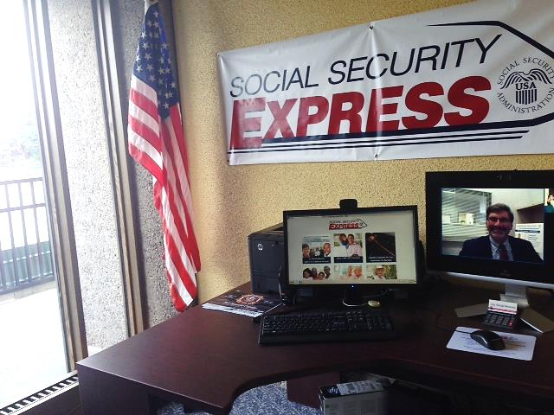
Wisconsin King Veterans Home
Notes:
-This is a 700 bed facility for elderly and disabled veterans. By appointment, or every Thursday by walk in, the veterans at King can visit the Video Service Delivery (VSD) unit there to talk with a live SSA representative (screen on the right), and use the Desktop Icon for online services (screen on the left).
This is the best of both worlds- accessing our online services but a video option for face to face interaction

Slide 12
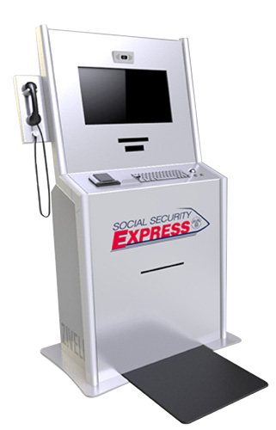
SSA Express Customer Service Stations (CSS)
Proof of Concept (POC) began Summer 2014
6 partner locations and 1 field office
CSS Features:
  Video Teleconferencing
  Access to Online Services
  Retractable Printer
  Security Mat
  ID Scanner
Notes:
We are testing out Customer Service Stations, in community locations
The Customer Service Stations provide our customers a streamlined menu to our online services, while providing video support with a live SSA agent in case the customer needs additional assistance.
Video chat support from a small cadre of N8NN agents in the PHI Region/ Wabash building answer calls Mon – Fri 9:00am – 5:30pm EST
During video calls, SSA agents use a set of Remote Xpert tools to better help the customers
ID Scanner
Two-way screen sharing
Remote Printing
Signature Tablet
Video Volume Control
We have seven Customer Services Stations installed (six external locations and one SSA field office)
We will evaluate the Proof of Concept through February 2017 before determining if we will expand to a pilot phase to additional locations
The external sites receive promotional materials, easel back posters with our branded SSA Express logo to promote the services

Slide 13
Social Security Express Customer Service Station (CSS)
Privacy Handset
Video Enabled
Touchscreen
Monitor
Document ID
Scanner
Retractable
Printer
Signature
Pen and Pad
Security Mat
Keyboard/
Mouse
Notes:
The features of our Customer Service Stations ensure security.
When customers step on the security mat it begins their session
When customers step off the mat, it ends the session after a 10 second countdown
The printer will retract any unclaimed printed material after 15 seconds into a secured/ locked bin inside the CSS
SSA employees periodically check these bins and destroy any PII in these bins
The handset does not dial out and doesn’t feature speakerphone
Acceptable IDs are:
Driver’s Licenses
State IDs
Passports
Military IDs
More
There is not an on screen keyboard, customers must use the physical keyboard for typing

Slide 14
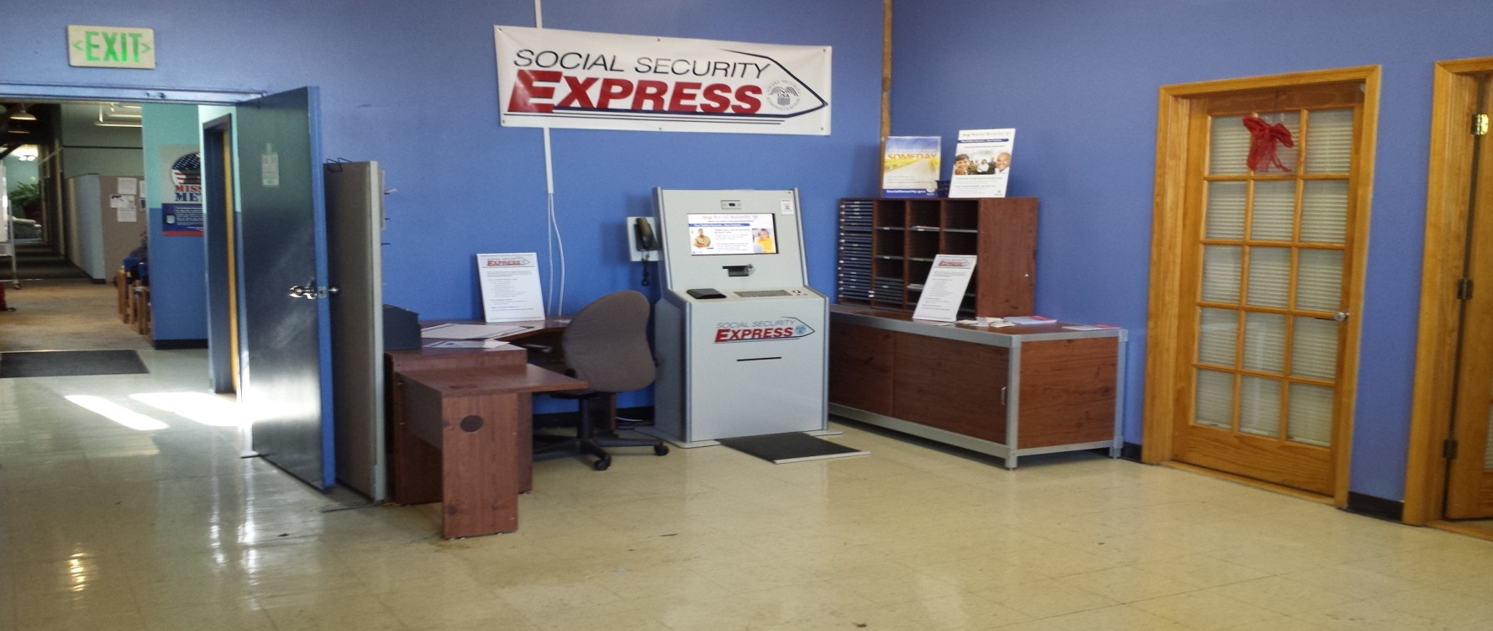
Maryland Center for Veteran’s
Education and Training (MCVET)
Insert slide 15 and 16 from other presentation
Notes:
Here is a picture of our Customer Service Station in the Maryland Center for Veteran's Education and Training (MCVET) in in Baltimore City
MCVET is a non-profit organization that provides homeless veterans and other veterans in need with comprehensive services that enable them to rejoin communities as productive citizens. Onsite, they house up to 250 homeless veterans every year from all around the country.
In addition to housing, MCVET offers mental and substance abuse counseling, health care services (mental and physical), as well as, educational and employment services through the Maryland State Department of Vocational Rehabilitation.
Social Security Administration collaborated with MCVET and launched a Customer Service Station on September 29, 2014

Slide 15
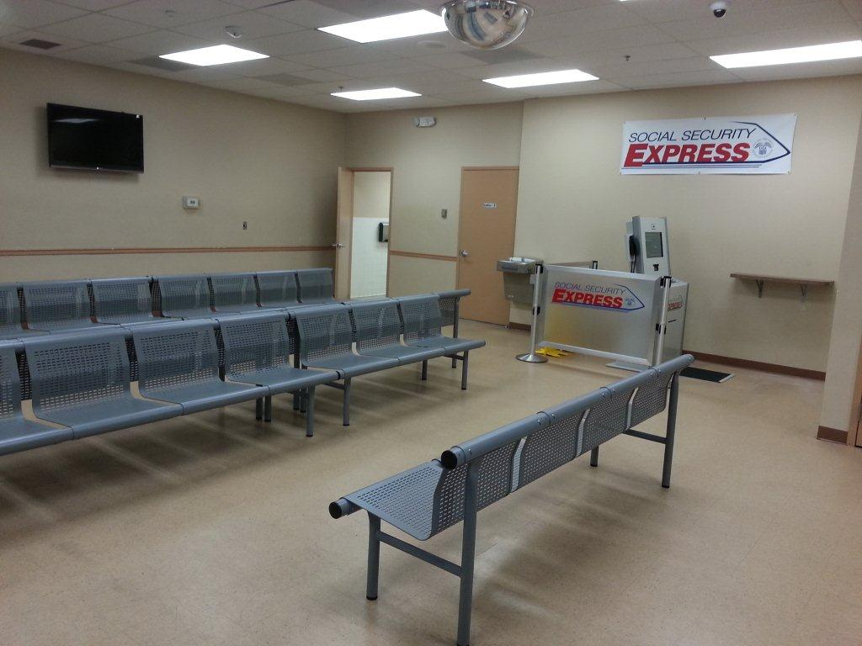
Postal Plaza DC Field Office
Notes:
Here is our Customer Service Station in the Postal Plaza DC Field Office
This is the only Customer Service Station in an SSA Field Office
This Customer Service Station was installed on July 2, 2014 to provide the customers quick, easy access to SSA’s online services.
Customers are able to use the Customer Service Station right away, instead of waiting in line to see a field office representative.

Slide 16
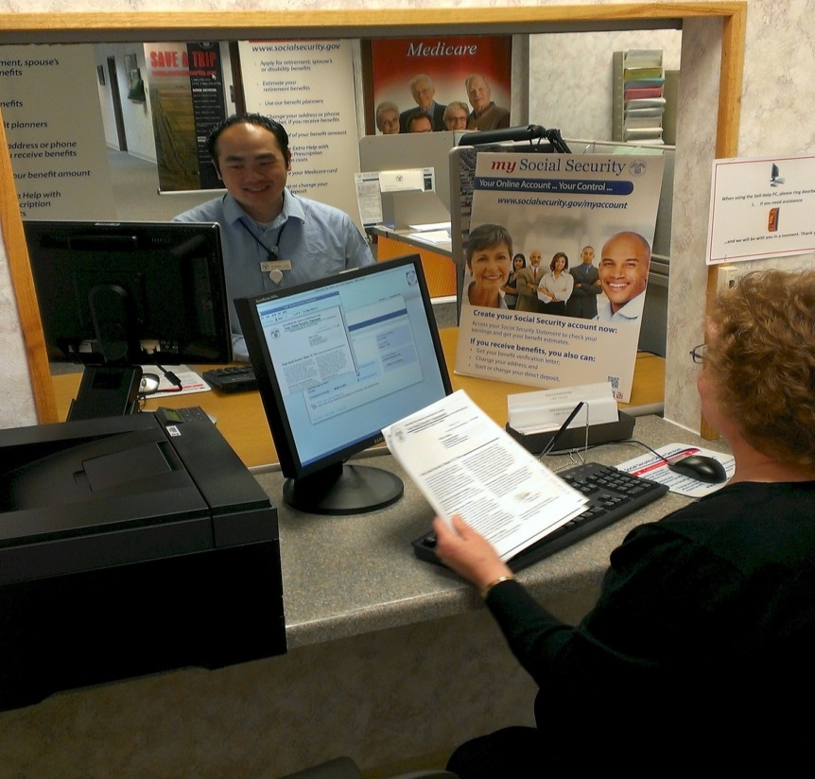
SELF-HELP Computer or PCs
Computers are available in some of our offices for the public to utilize our online services
Don’t have to wait to conduct business with us!
Employees are available if you have questions.
Notes:
Total of 816 SHPC FOs across the country and 1790 SHPCs within these offices
Currently, offices are limited to no more than 4 SHPCs per office
1 SHPC attendant monitors up to 4 SHPCs from a mirror image monitor behind the barrier wall of each SHPC
Offices must have a barrier wall in order to have a SHPC
SHPCs are 508 compliant due to recently added JAWS software (screen reader software for the blind), headphones provided by the offices to customers, and braille/ large print guides available for assistance
Some of the things customers can do on SHPCs...
Create a my Social Security account
Apply for Social Security retirement or spouse’s benefits
Apply for Social Security disability benefits
Apply for Medicare benefits
Apply for Extra Help with Medicare prescription drug plan costs
Appeal a disability decision
Request a replacement Social Security card (iSSNRC)
Estimate your future benefits
Get a replacement Medicare card
View their Social Security Statement
If you receive benefits, you can:
Get your benefit verification letter
Check your benefit and payment information and your earnings record
Change your address and phone number
Start or change your direct deposit

Slide 17

my Social Security
  Your Online Account ... Your Control ... www.socialsecurity.gov/myaccount
my Social Security is an easy-to-access,
easy-to-use portal to view and update some
of your own Social Security information.
Notes:
Who Can Create a my Social Security Account?
You must be at least 18 years old and have:
A valid E-mail address;
A Social Security number; and
A U.S. mailing address.
If you don’t get benefits, you can—
View, save, and print your online
Social Security Statement.
You can still use my Social Security to review:
estimates of your future retirement, disability, and survivor’s benefits;
request a benefit verification letter
showing that you do not receive benefits or haven’t received answer yet
the accuracy of your earnings record;
estimates of the Social Security and Medicare taxes you have paid; and
request a replacement Social Security card if you meet certain requirements
If you do get benefits you can—
Get your benefit verification letter;
Check your benefit and payment
information and your earnings record;
Change your address and phone number; and
Start or change your direct deposit.
my Social Security was released in May 2012.
Initially, the only service available was the online Social Security Statement information.
my Social Security is a convenient way to access your personal Social Security information, whether you have been working and paying Social Security taxes or receiving Social Security benefits.

Slide 18
Click-to-Callback (CTCB)
Notes:
A feature within the my Social Security Dynamic Help widget that provides users with the option to “Talk to an Expert” if they still have a question after they use the “Ask a Question” feature
Available only during my Social Security Help Desk regular business hours
CTCB is most used on the Landing Page, Check Your Benefits, and the Online Statement pages.
Over 130,000 callback requests initiated since implementation
approximately 80% of Callback requests are completed
Fallout reasons include No Answer; Busy signal; Caller unable to take call; Incorrect number
Caller now has the ability to select times to receive callback
Caller can select a topic for the nature of the inquiry using a dropdown menu.
Caller’s phone number prepopulates from ROME with the ability to change that number
Caller can cancel the callback request
Over 20,000 callback requests initiated since enhancements with 23% of users selecting “Account Assistance” as their primary reason of use.

Slide 19
Online Replacement Card
Application Eligibility
Email and Fraud Process
Notes:
iSSNRC—Application Eligibility
The customer must:
Have or register for a mySocialSecurity account,
Be a U.S. Citizens at least 18 years old,
Have a valid U.S., Army Post Office (APO), or Fleet Post Office (FPO), or Diplomatic Post Office (DPO) mailing address,
Possess a valid, unexpired U.S. Driver’s License or State ID, and
Require no change to their replacement card.
In the future we hope to expand the process to include additional types of replacement card requests.
iSSNRC—Email and Fraud Process
Email is our primary contact method with the customer.
We email the customer throughout the application process.
No Personally Identifiable Information (PII) is provided to the customer in emails.
To ensure application security, it is only available to mySocialSecurity account holders.
Application has built-in checks and balances to detect fraud.
In certain cases, individuals are contacted by security experts to ensure an application is legitimate.

Slide 20
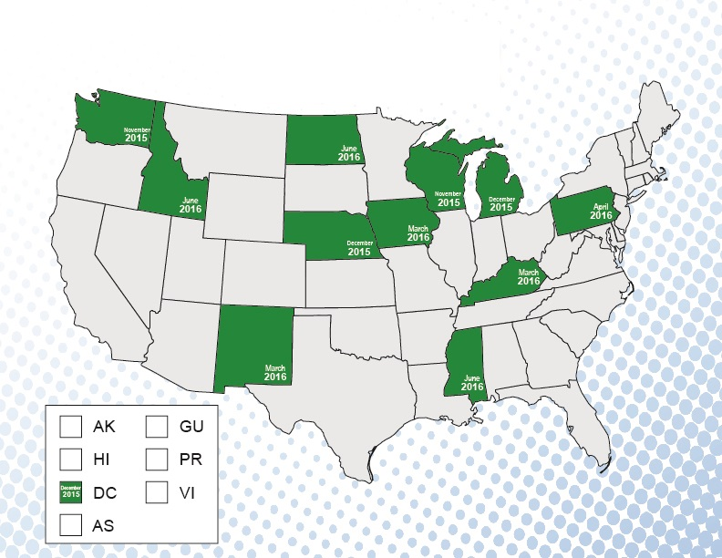
Online Replacement Card
iSSNRC – Participating States
Notes:
iSSNRC Interest and Usage
November 2015 through July 2016:
1 million people have visited the application
120,000 people have attempted the application online
65,000 people have successfully submitted a request and received a replacement card

Slide 21


Click to Chat
Notes:
We are always trying to find ways to communicate with our customers. One method is “Click to Chat.”
This new feature will be coming your way this fall.
This feature will allow you to chat with an SSA representative if you need assistance while utilizing our online services.

Slide 22


