Slide 1


NADE - Mile High Excellence
August 16, 2016
Melissa Spencer
Deputy Associate Commissioner

Slide 2
Agenda
Policy Vision and Goals
Our organization
Policy in Motion
Regulations 101
ODP priorities

Slide 3

Disability Policy’s Vision
Stay in step with changes in medicine, healthcare delivery, technology, and the workplace to improve the lives of individuals with a disability.

Slide 4

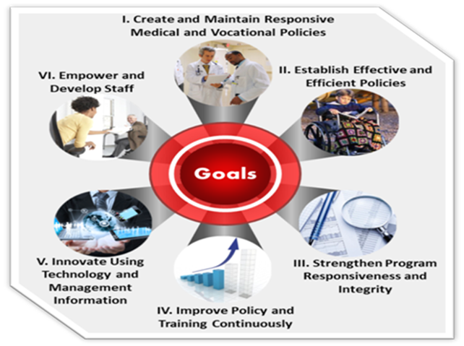

Slide 5
SSA Disability Beneficiaries
14 million people get a Social Security disability benefit
38 million people or 1-in-10 Americans live with severe disabilities
1-in-4 20-year-olds become disabled before retirement
At the age of 55 within five years of the onset of their disabilities:
  1-in-5 men die
  1-in-7 women die

Slide 6

The ODP Team

Slide 7
Office of Disability Policy
Associate Commissioner, Gina Clemons
Deputy Associate Commissioner, Melissa Spencer
Associate Commissioner’s Staff
Training and Policy Support Staff
Office of Medical Policy
Office of Health Information Technology and Electronic Policy
Office of Vocational, Evaluation, and Process Policy
Office of Policy Consultation and Analysis
Office of Medical Assistance
Office of Disability Policy Management Information

Slide 8
Key DDS Participation
Work Group | DDS Representatives
BBA 812 | North Carolina & Montana
Digestive Disorders NPRM | Delaware
Failure to Cooperate | Des Moines, IA & Waterbury, CT
Mental Disorders Final Rule | Vermont, New York, & Texas
Musculoskeletal Disorders NPRM | Kentucky
Neurological Disorders NPRM | Alabama
Query Policy | Carson City, NV, West Virginia, Wisconsin, & Montana
Vocational Regulations Modernization (VRM) | Harrisburg, PA & Springfield, IL
RPC Business Process | DDSs from all 10 regions

Slide 9
Disability Policy Internal SSA Partners
ODP
ODD
DDS
OGC
OQR
ODS
OLCA
ODAR
OACT
OPSOS
ORDES
ORES

Slide 10
The BIGGER Picture - Disability Policy Stakeholders
The American public
Congress and Other Government Agencies
Internal stakeholders
ODP
Claimants, Beneficiaries, Advocates, Representatives, Industry
Research Community

Slide 11
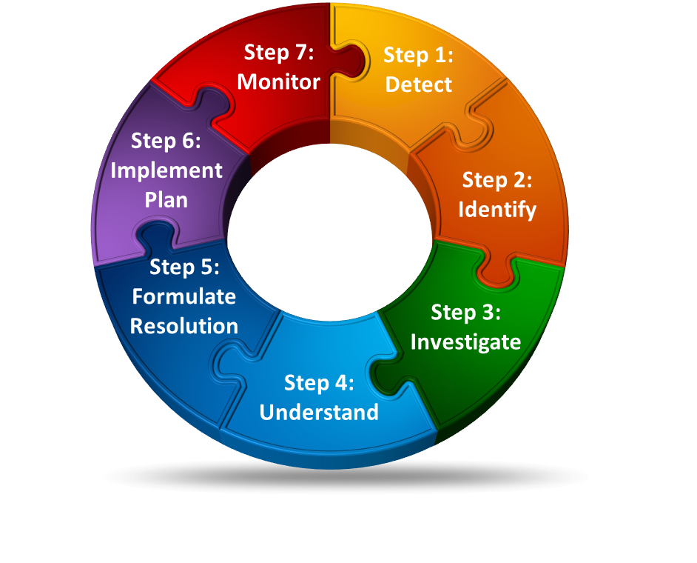
The Regulations Process

Slide 12



Disability Policy in Motion – The Process
Working with Our Internal and External Partners to Keep Pace with the Environment
Step 7: Monitor
We work with our partners and stakeholders to gain feedback and to conduct analysis to ensure desired change occurred.
For example, we conduct case probes and Post Implementation Listing Studies (PILS). We also use front-line eyes on claims, case reviews, Medical Officers/
Consultants, data tools, and stakeholder input.
Step 1: Detect
We constantly scan the internal and external environment for improvement opportunities and incoming claims and data for outliers.
For example, we use research, industry, stakeholder input, front-line eyes on claims, case reviews, Medical Officers/Consultants, and data tools.
Step 7: Monitor
Step 1: Detect
Step 2: Identify
We look to research, our internal partners, and stakeholder input for best practices and to identify internal suspect areas.
For example, we use data analytics with data sources like the Policy Feedback System (PFS), the Electronic Claims Analysis Tool (eCAT), and others to identify statistical variations. We also conduct case studies and research efforts.
Step 6: Implement Plan
We work with our partners to create and implement a plan for program optimization or problem resolution.
For example, we write new policy, deliver training, address irregular behavior, make system enhancements, create new tools, refer to the Office of Inspector General, and embark on larger research efforts.
Step 6: Implement Plan
Step 2: Identify
Step 5: Formulate Resolution
Step 5: Formulate Resolution
We work with our internal partners to
determine what is necessary to
capitalize on the opportunity or
resolve the issue.
For example, our possible actions may include policy change and/or clarification,
training, development of system tools, correction of behavior, referral to the Office of Inspector General, or further research.
Step 3: Investigate
Step 3: Investigate
We work with our internal partners to dig deeper to assess the possibility of capitalizing on opportunity and to pinpoint the root cause of suspect areas.
For example, we conduct research and targeted case reviews, involve Medical and Psychological Consultants, and involve other appropriate partners.
Step 4: Understand
Step 4: Understand
We work with internal partners and stakeholders to develop a holistic understanding and determine if next steps are needed.
For example, we work with internal and external stakeholders including other agency components, federal and state agencies, industry, and advocates.

Slide 13
What laws govern the rulemaking process
Delegation of Legislative Power by Congress
The Administrative Procedure Act (APA)
Social Security Act (P.L. 74-271)

Slide 14
Delegation of Legislative Power by Congress
Under the Constitution, the Delegation doctrine does not authorize giving the power to make law to anyone else but Congress. But Congress may do so on certain occasions.
Congress may create an agency to investigate and regulate certain issues…. “delegate” its authority to make law.
  Why? Congress may not want to legislate on an issue b/c concerned about time, political ramifications, expertise needed.
  Congress may delegate on public issues, people do not expect it to make all decisions.
Where do we look to find limits on delegation?
  The enabling statutory authority of an agency.
  Enabling statute that gave additional power to agency.

Slide 15
The Administrative Procedure Act (APA)
Pub.L. 79–404, 60 Stat. 237, 5 USC § 553, enacted June 11, 1946, is the United States federal law that governs the way in which administrative agencies of the federal government of the United States may propose and establish regulations. The APA also sets up a process for the United States federal courts to directly review agency decisions. It is one of the most important pieces of United States administrative law.

Slide 16
3 Types of Rules
Procedural Rules - These rules do not alter any rights of parties, just alerts them how the agency wants an individual to apply for those rights.
Interpretive Rules - A rule issued by an administrative agency that only clarifies or explains existing laws or regulations. These rules need not meet the requirements set out in the Administrative Procedure Act for notice to the public and opportunity for comment. An interpretive rule does not have the force of law.
Substantive Rules

Slide 17
Substantive Rule
An administrative rule created by a government agency's exercise of delegated quasi-legislative authority. It is adopted by government agencies in accordance with the notice and comment requirements of the APA.
These rules have the force of law.
Substantive rule is also known as legislative rule.

Slide 18
Basic Rulemaking Terminology

Slide 19
Advance Notice of Proposed Rulemaking (ANPRM)
Optional.
Describes the regulatory action an agency is considering and the underlying issues, and solicits public comments.
Agencies frequently use an ANPRM when it is necessary or advisable to obtain a broad spectrum of public comments and information in the initial steps of regulatory action.

Slide 20
Notice of Proposed Rulemaking (NPRM)
Informs the public that the agency is proposing a new rule or a revision to an existing rule
Provides the public with a period of time to comment.
Provides the proposed regulatory text and an explanation of the basis and purpose of the proposed rule and the issues involved.

Slide 21
Interim Final and Direct Final Rules
An Interim Final Rule is a rule adopted without prior public input that is made effective immediately, but then invites post-promulgation comment.
Such rules rely on exceptions —
Direct Final Rules are used in limited circumstances where an agency believes that a rule is noncontroversial and unlikely to receive adverse comments.

Slide 22
Final Rule
A Final Rule is published in the Federal Register to provide public notice, and is generally accompanied by a preamble that explains the basis for the rule, responds to comments received on the NPRM, and contains a variety of analyses required by statutes and executive orders.
The term “Final Rule” includes Direct Final and Interim Final rules. Final rules generally take effect 30 days after publication.

Slide 23
Public Comments
APA requires the public to have an opportunity to participate in rulemaking.
a set period of time is given to submit written comments when a notice is published in the Federal Register.
Executive Order 12866 provides that generally a comment period should be no less than 60 days.
www.regulations.gov is the Federal portal hosting public comments on agency ANPRMs and NPRMs
Enter “social security” in the search bar and you will find a wealth of information about SSA regulations activities.

Slide 24
Subscribing to SSA Federal Register Documents
From any agency page on FederalRegister.gov you can choose to receive email updates of new documents from that agency.
Choices of subscriptions include Documents on Public Inspection, Newly Published Documents, and Documents Deemed Significant.

Slide 25
How the reg process works within SSA
Agency has a regulatory agenda in priority order
Workgroups
OLCA drafts regs with help from the policy owners (exception – we write the listings)
Internal review and approval
Costing out the regs – case studies and OACT
OMB role

Slide 26
Keeping Policy Current
Listings updated on a 3-5 year cycle to keep pace with advances in medicine
Acceptable Medical Sources consistent with modern healthcare delivery
Consistent policy application at DDS, ODAR, and in the Federal Courts
Data driven disability policy
Updated occupational information for vocational decision-making
Vocational rules based on the modern world of work
Leverage technology in disability adjudication process

Slide 27
FY2016 Completed Policy Highlights
Neurological Listings Final Rule (effective 9/29)
Respiratory Listing Final Rule (effective 10/7)
SSR 16-1p Fraud and Similar Fault Redeterminations
SSR 16-2p Evaluation of Claims Involving the Issue of Similar Fault in the Providing of Evidence
SSR 16-3p Evaluation of Symptoms in Disability Claims
SSR 16-4p Using Genetic Test Results to Evaluate Disability
Borderline Age Policy POMS and HALLEX alignment

Slide 28
Next 6-8 months
Implement Neurological and Respiratory Rules
NEW RPC business process
Finalizing Mental Listings
Medical Evidence NPRM
Finalize Immune/HIV Listing
Finalize Evidence from Statutorily Excluded Medical Sources (BBA 812) regulation
Implement medical advisor rule for non-physician/psychologists medical staff (BBA 832)
Failure to Cooperate Policy (POMS) alignment and revision
CDR policy POMS clarification

Slide 29
Update - OIS
The Bureau of Labor Statistics is continuing to collect occupational data for use in our new OIS to replace the DOT
BLS started the second of three years of production data collection; we expect a complete set of data in early 2019
SSA is developing an IT platform to house the BLS data along with information from O*NET and military occupational crosswalks
The new OIS will include descriptors of the mental-cognitive requirements of work – we are still testing and refining these survey questions
Next steps include analysis of the first year of production data and testing the IT platform.

Slide 30

Stay in step with changes in medicine, healthcare delivery, technology,
and the workplace to improve the lives of individuals with a disability.

