Slide 1
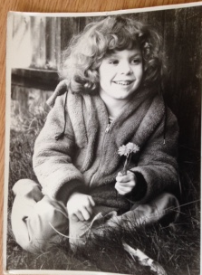
The Worthy Endeavor of Examining Dandelions
PRESENTED FOR: The National Association of Disability Examiners Conference
Mile High Excellence
PRESENTED BY: Joelle Brouner joelle.brouner@state.co.us
SPONSORED BY: The Colorado Association of Disability Examiners
PRESENTED AT: The Radisson Hotel, Aurora, CO
PRESENTED ON: August 15, 2016

Slide 2
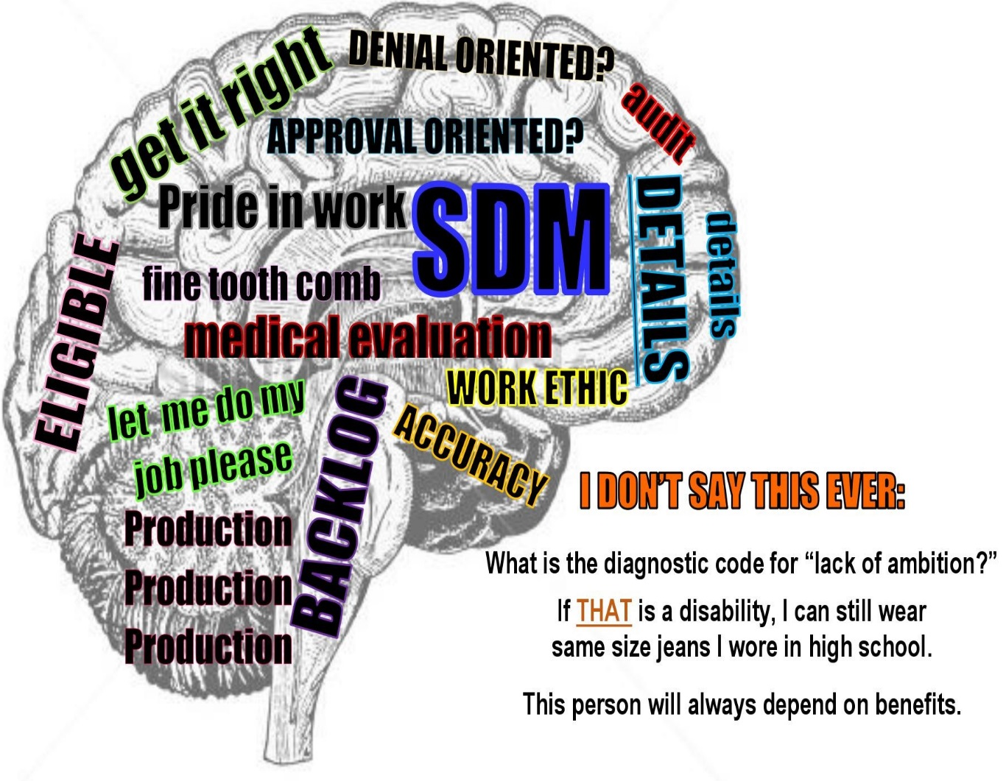
Disability Examiners Are All About the Details
Disability examiner’s are accountable for details
What are the pressures to consider when balancing speed and accuracy?
Why do you do this work?
What matters about what you do?

Slide 3

Conquering the Mountain of Records
How do you manage and balance your workload?
How do you hold on to ALL those details?
How do you guard against cynicism?
What gets lost in translation from paper to the decision?
What are the benefits and drawbacks of considering the lives reflected in those records?

Slide 4
Two Realities: Imagine the Possibilities
Reality One:
Spastic Diplegia Cerebral Palsy
No ambulatory or weight –bearing ability
Complex Post Traumatic Stress Disorder treated with medication and psychotherapy
Full assistance necessary with activities of daily living
Reality Two:
17 years of substantial work history according to SSA
Earned a Bachelor of Arts and Master’s degree while working
Employed for 12 years in the public sector at an executive level
Served as the Director of a state agency before age 40

Slide 5
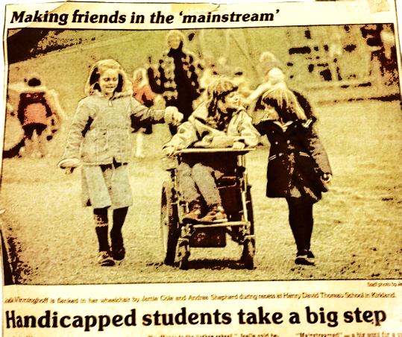
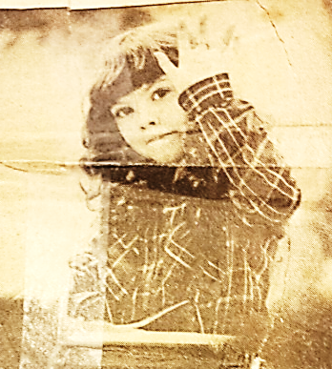



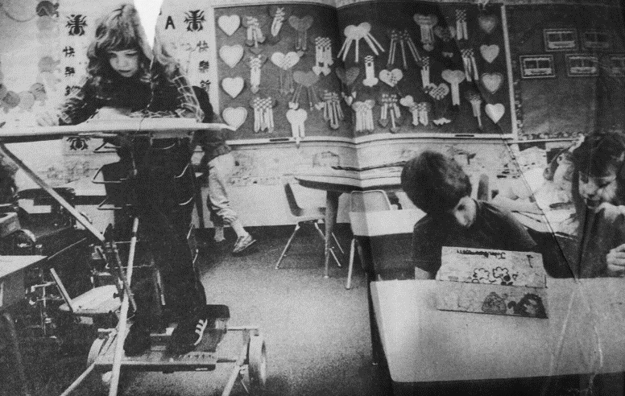
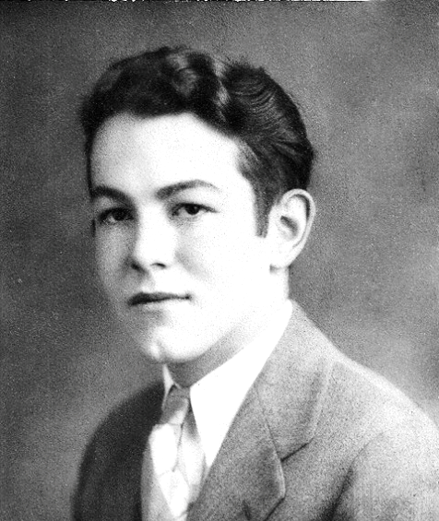

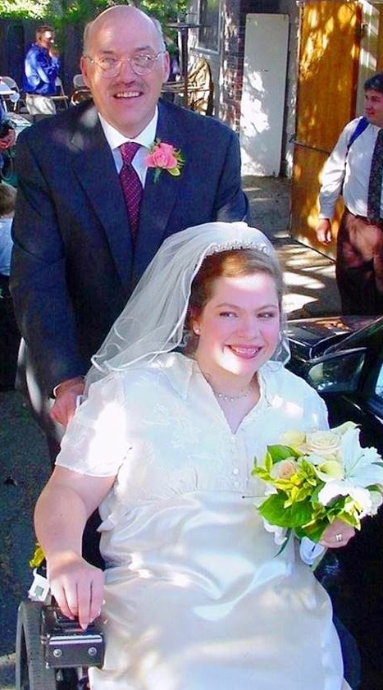




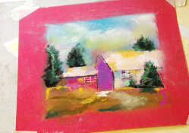
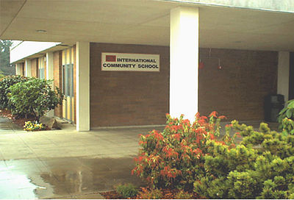
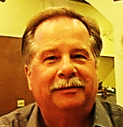




Two Profiles. One Life.
Mine.

Slide 6















The Real World Value of Social Security
Stopping the slide
Increasing stability
Supporting reflection, healing, and restoration
Providing time to distinguish fear from reality
Preserving a shred of confidence
Offering a degree of support for people facing death
Holding oblivion at bay

Slide 7
Disability, Confidence and Sense of Self
How does a sense of helplessness take root?
How does one develop or redevelop a sense of self?
How does one develop and trust his or her skills?
Must believe a future exists before cultivating a vision for it
Confidence is a personal journey

Slide 8

Social Security: A Step on the Road to Work

Slide 9

Examiners: Ambassadors of Possibility
Your work creates a path forward when life unfolds in unexpected ways.
Will someone fall through the cracks or grow out of them?
Some get lost in the weeds
Others discover a resilience and thrive

Slide 10
Thank You!
National Association of Disability Examiners, Sharon Summers, President; Colorado Association of Disability Examiners; Vicki Johnson, Director, Colorado DDS; Wanda Colon-Mollfulldela, SSA Denver Regional Commissioner; Nancy Berryhill, SSA Deputy Commissioner of Operations; Ann Roberts, SSA Associate Commissioner, Office of Disability Determination
Each of You
Enjoy the Conference!

