Slide 1
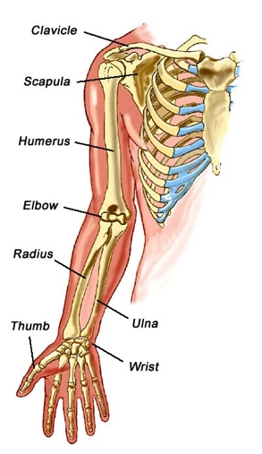
orthopedic problems in the upper extremity
Arm impairments and RFC considerations

Slide 2
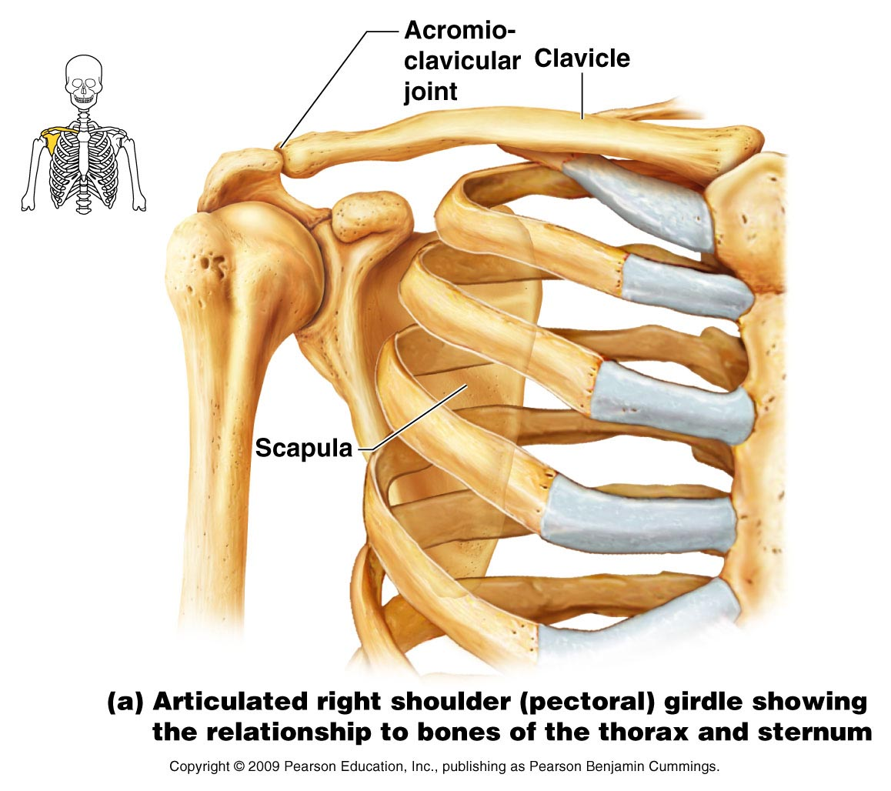
Shoulder anatomy
Joints – glenohumeral (GH), acromioclavicular (AC)

Slide 3
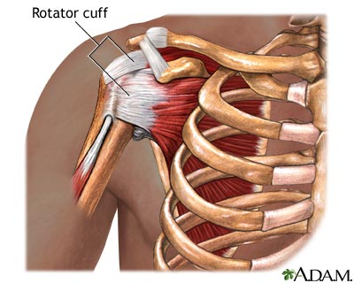
Shoulder anatomy
Rotator cuff muscles

Slide 4
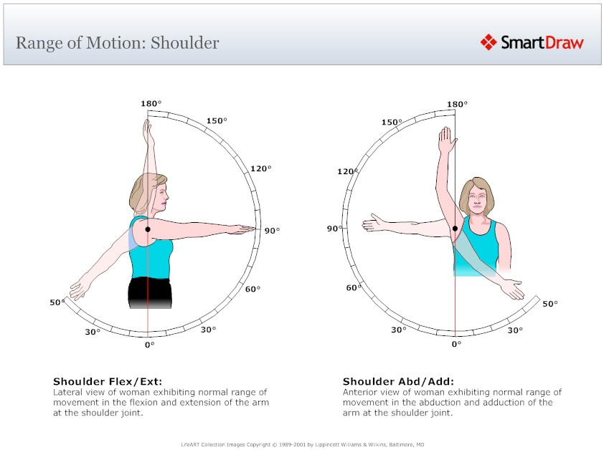
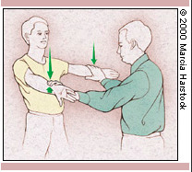
Shoulder ROM
Forward flexion 0-150/180
Abduction 0-150/180
External rotation 0-80/90
Impingement tests

Slide 5
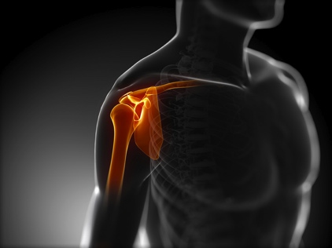
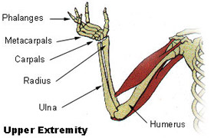
Shoulder problems
Rotator Cuff Problems – Impingement Syndrome, RC tears
Arthritis: GHJ vs ACJ
Fractures/Dislocations
Frozen Shoulder

Slide 6
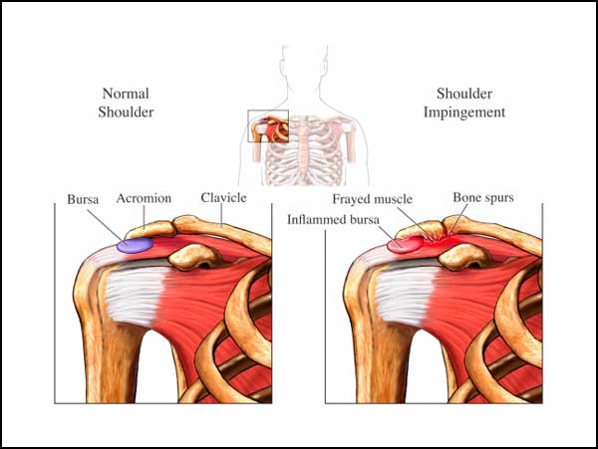
Rotator cuff problems
Impingement Syndrome: RC tendonitis - inflammation of shoulder rotator cuff tendons. Symptoms are pain with arm abduction and overhead activities, and if not treated can lead to rotator cuff tears.

Slide 7
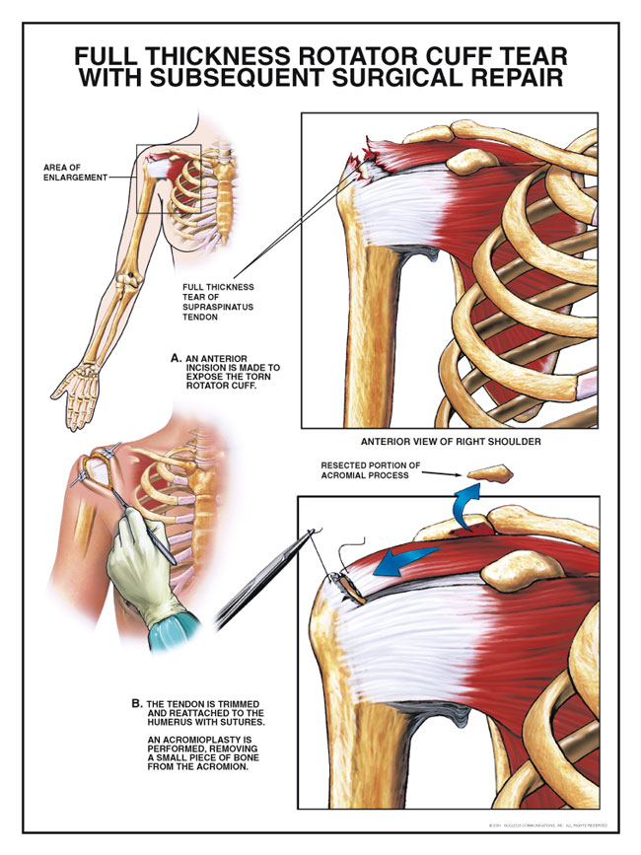
Rotator cuff problems
Rotator Cuff Tear – pain and weakness of shoulder. Results in difficulty lifting arm overhead, reaching, carrying objects and getting dressed.

Slide 8
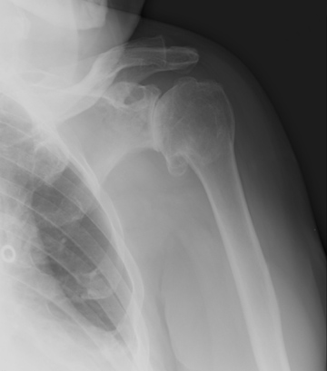
Glenohumeral (GH) arthritis
“shoulder” arthritis – causes pain usually in back of shoulder, decreased ROM, stiffness, swelling and sometimes grinding.
OA, RA, post-traumatic

Slide 9
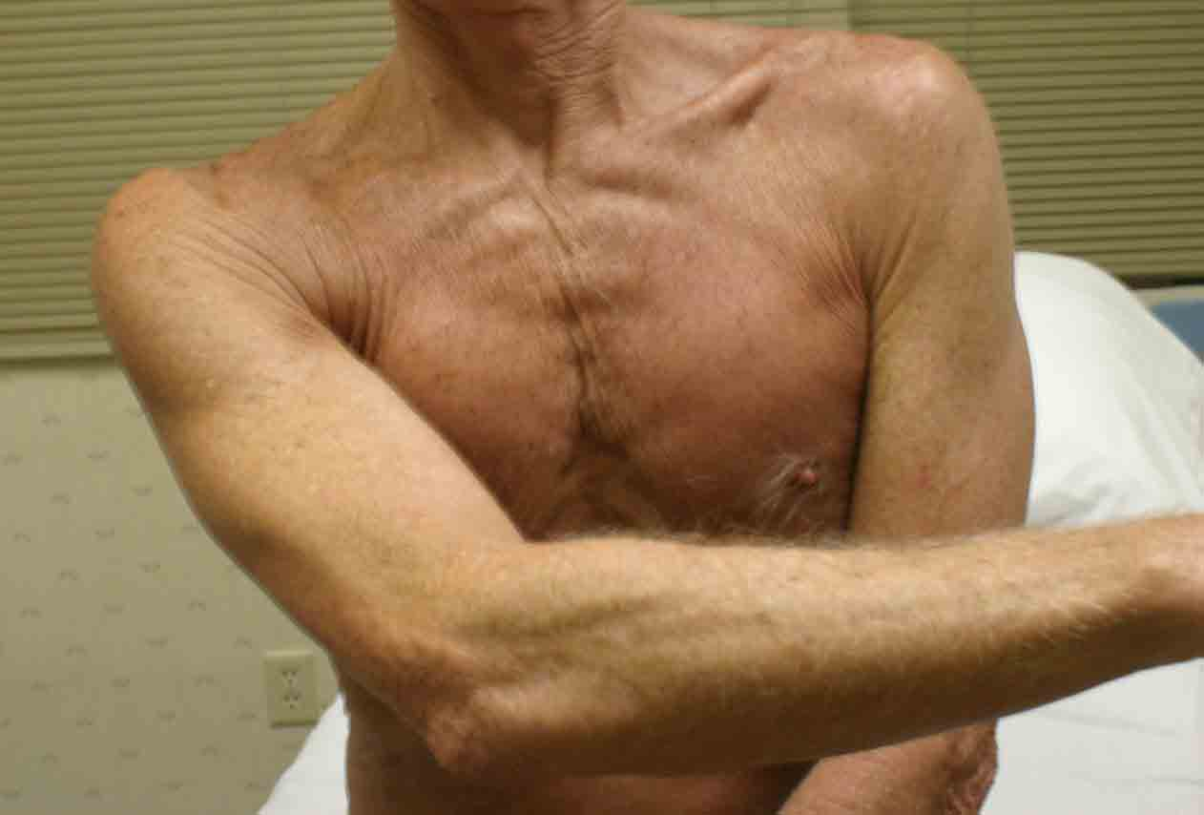
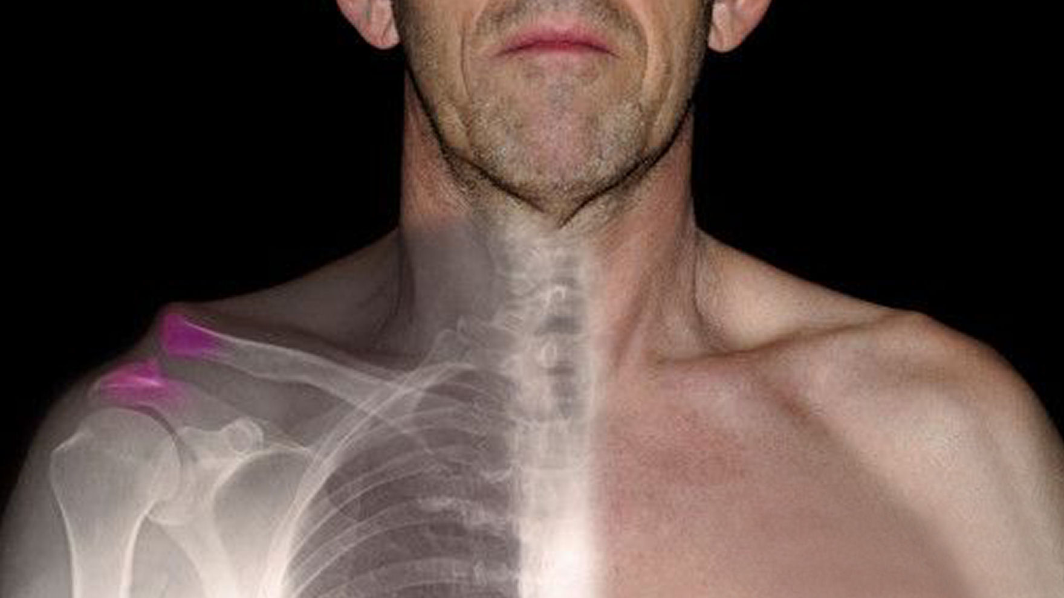
Acromioclavicular (AC) arthritis
Not “shoulder” arthritis
Pain on top of shoulder, usually with certain motions
Cross-arm adduction test – moving arm across chest increases pain by compressing AC joint
Caused by degeneration, repetitive movements or after an injury such as AC separation

Slide 10
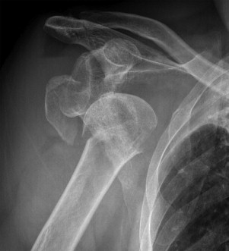
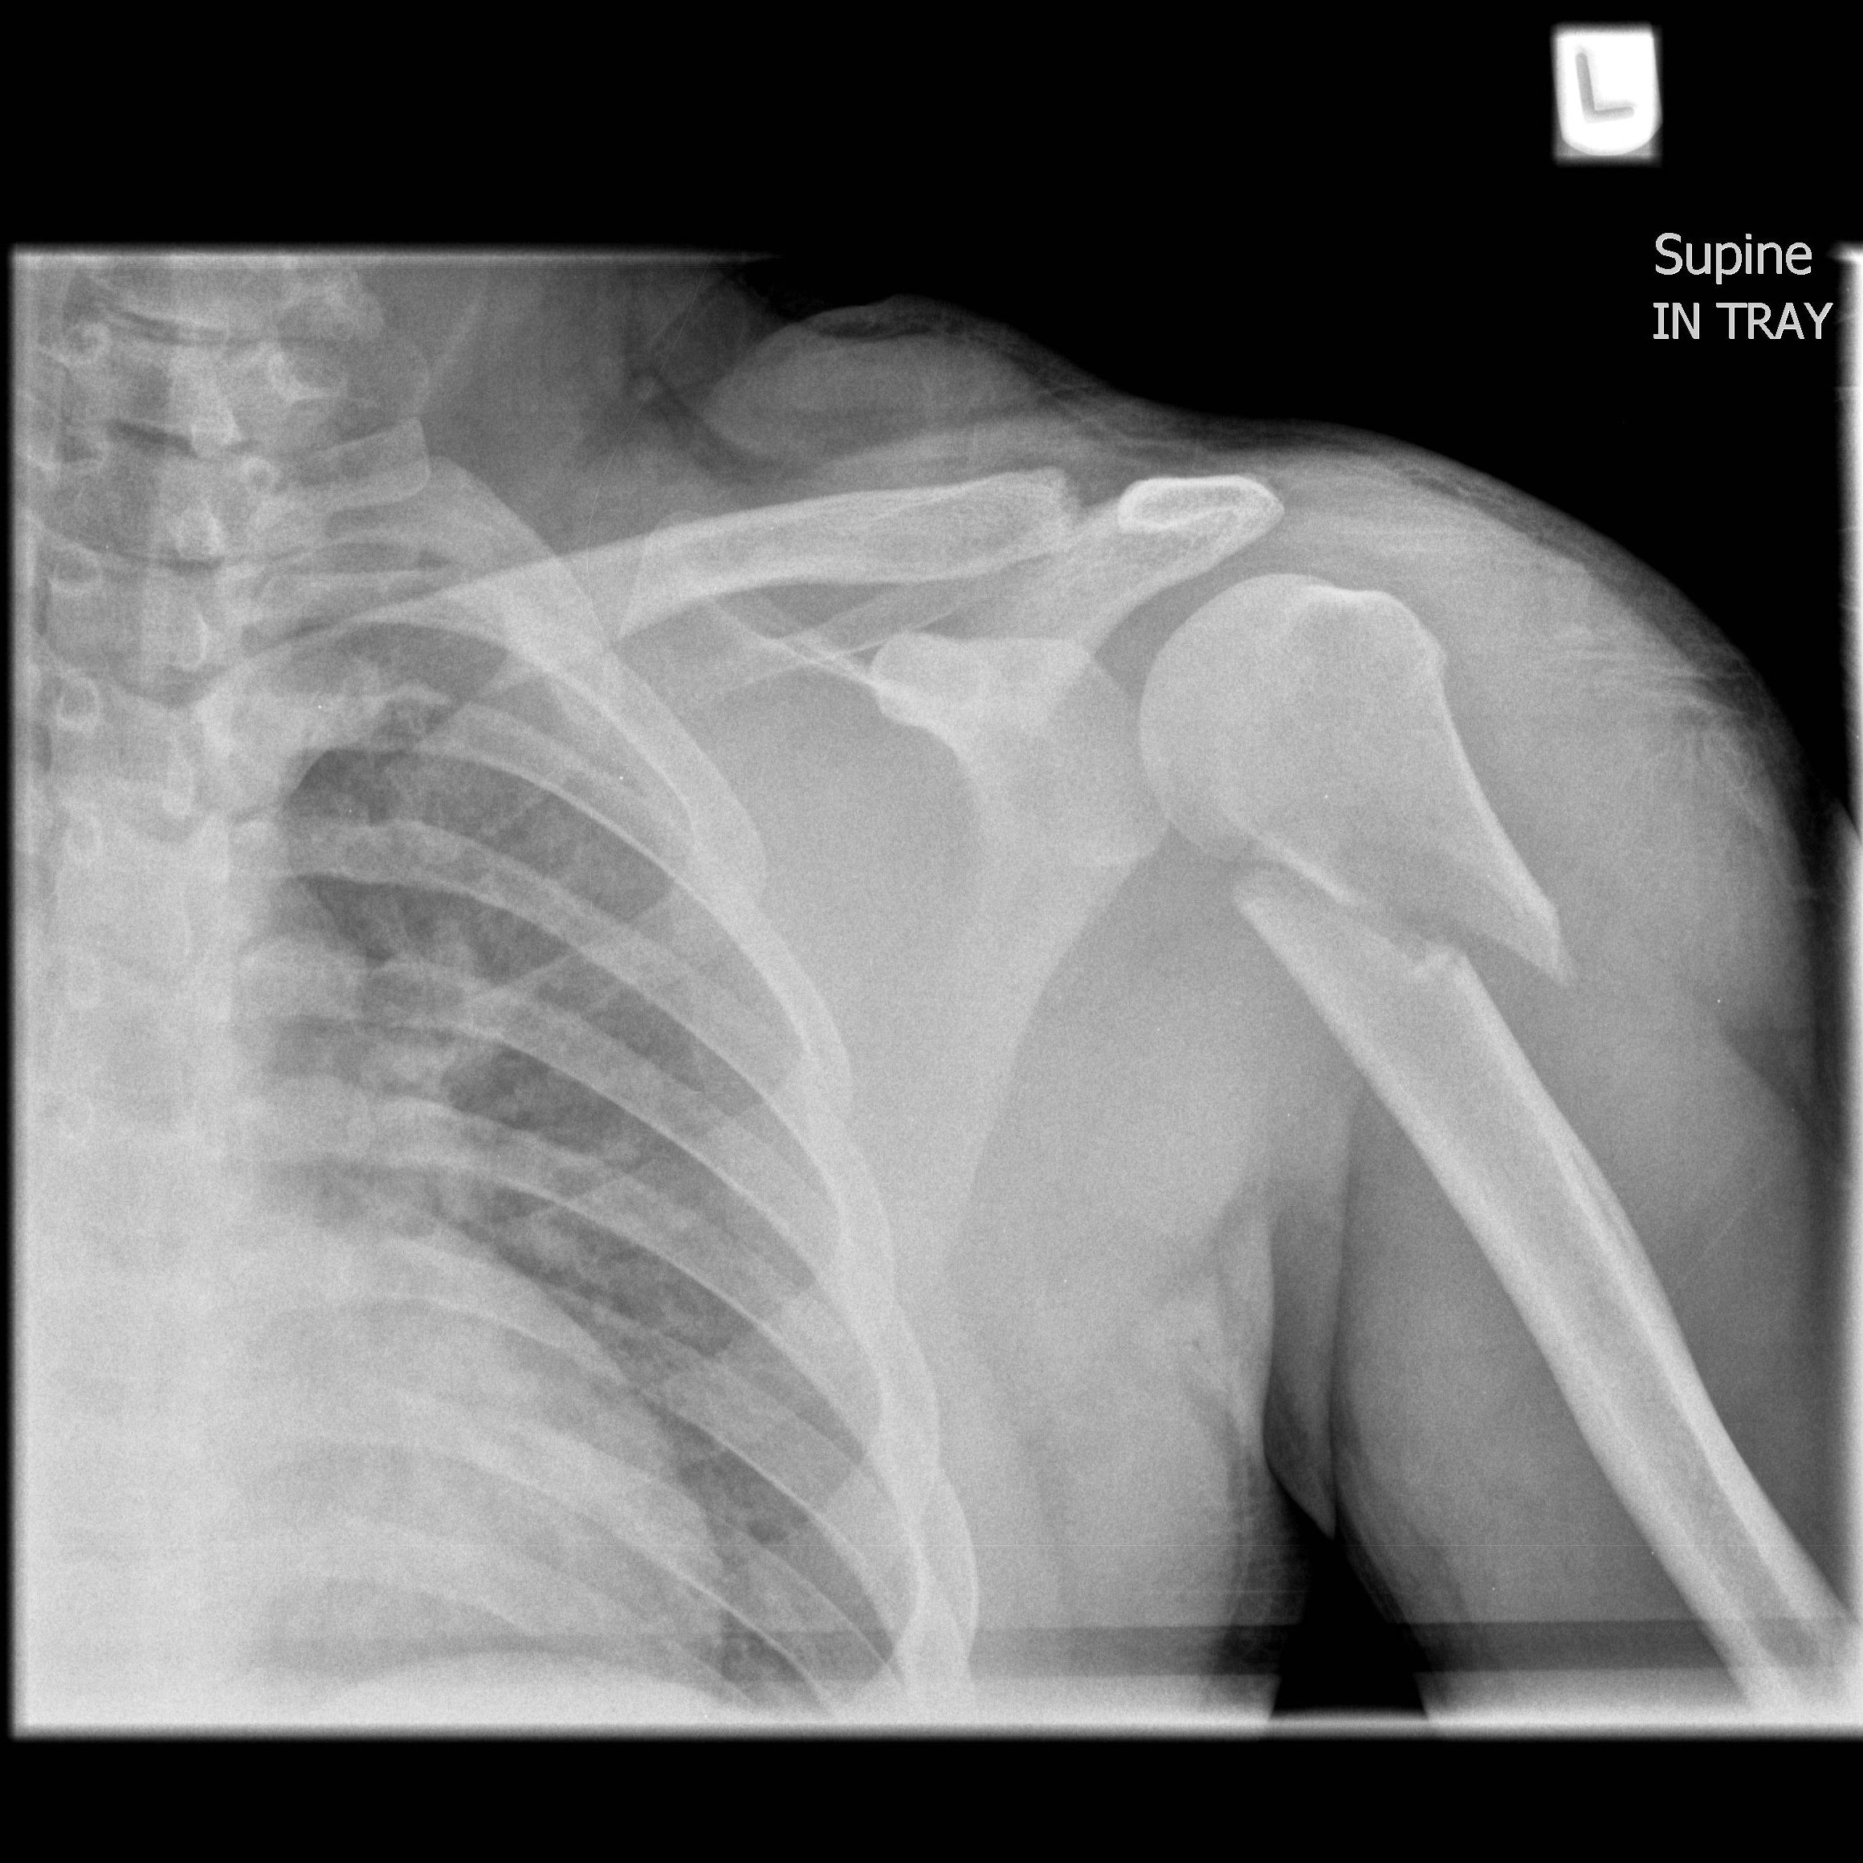
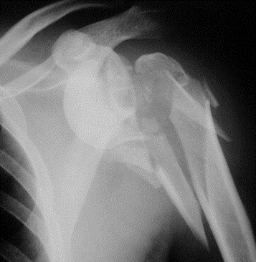
Shoulder injuries
Fractures
Dislocations
AC separations
Can lead to post-traumatic arthritis and frozen shoulder.

Slide 11
Frozen shoulder
Frozen shoulder or “adhesive capsulitis” occurs when capsule around the shoulder joint constricts and forms scar tissue which leads to a stiff and painful shoulder.
Causes: idiopathic (no known cause), post-traumatic with period of immobilization.
More common in 40-60 yo and those with endocrine disorders such as Diabetes and Hypothyroidism.

Slide 12
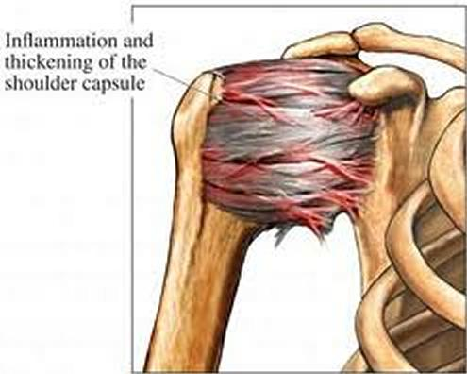
Frozen shoulder
Frozen Shoulder or “Adhesive Capsulitis” – painful with very restricted ROM.

Slide 13
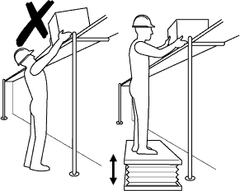
Shoulder RFC considerations
SHOULDER IMPAIRMENTS:
Lift/carry limits
Overhead reaching limits
Possible in front/lateral reaching limits
Possible handling

Slide 14
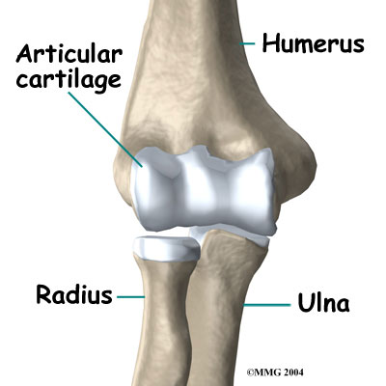
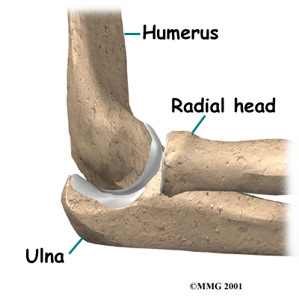
Elbow anatomy
Joints – ulnohumeral (flexion-extension) and radiocapitellar (rotation)

Slide 15
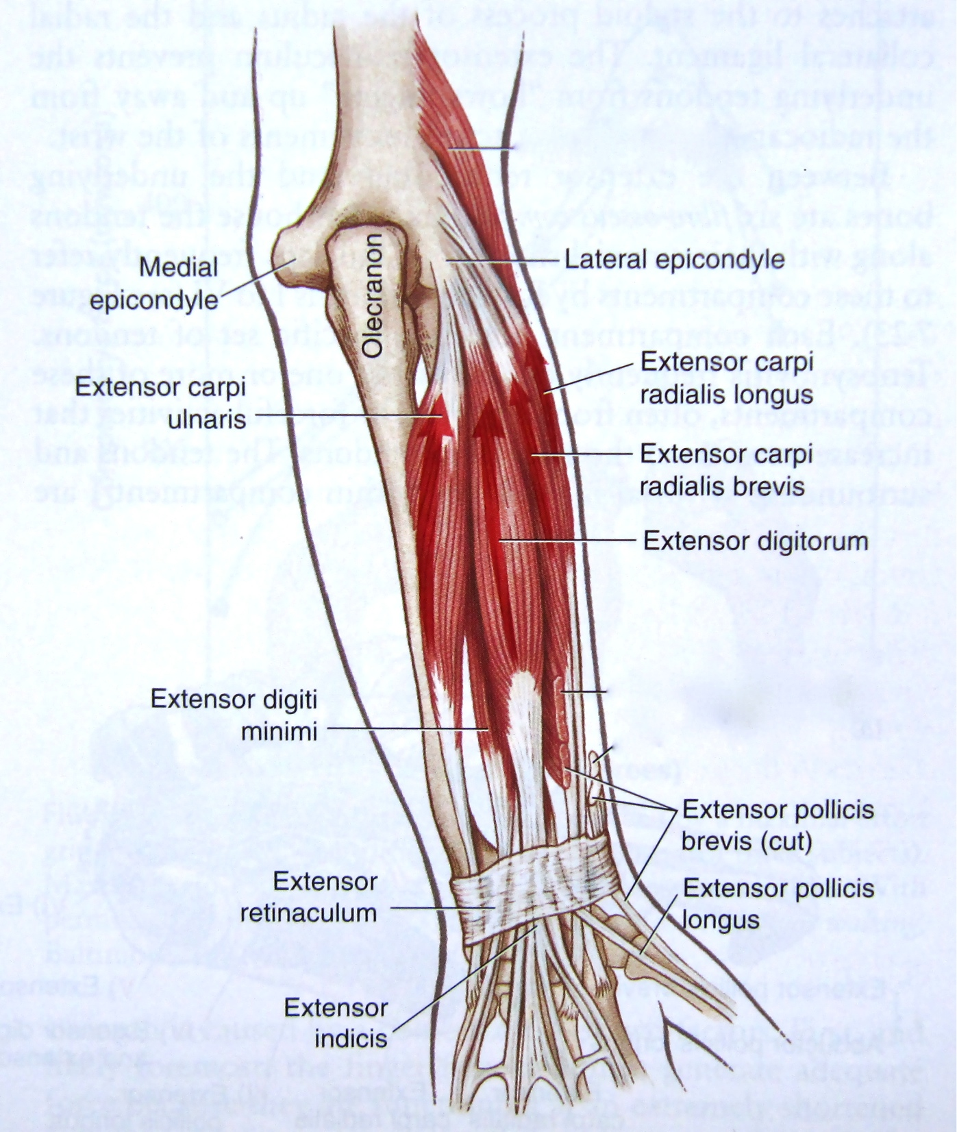
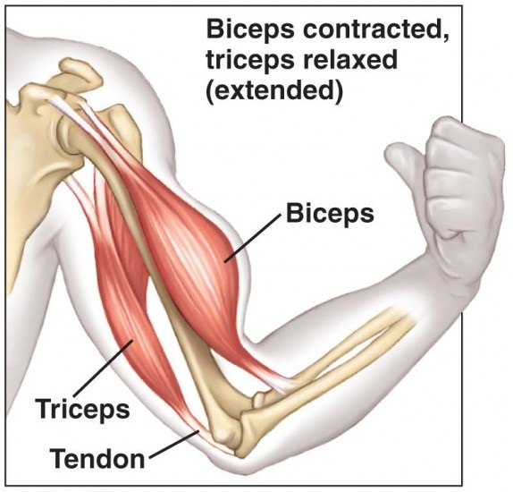
Elbow anatomy
Biceps, triceps
Extensor muscles originate from lateral epicondyle
Flexor muscles originate from medical epicondyle

Slide 16
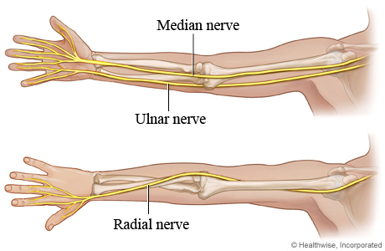
Elbow anatomy
Ulnar Nerve at medial elbow – behind “funny bone”
Median Nerve at anterior elbow
Radial nerve at lateral elbow

Slide 17
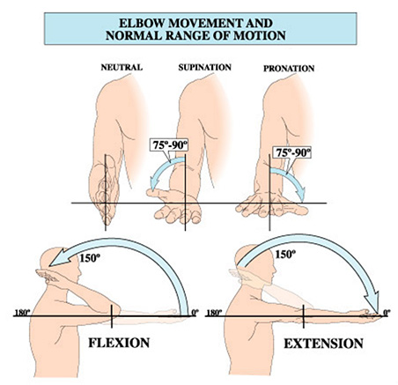
Elbow rom
Flexion/Extension: 0-135/150
Pronation/Supination: 0-80/90
Tinel’s test at cubital tunnel

Slide 18
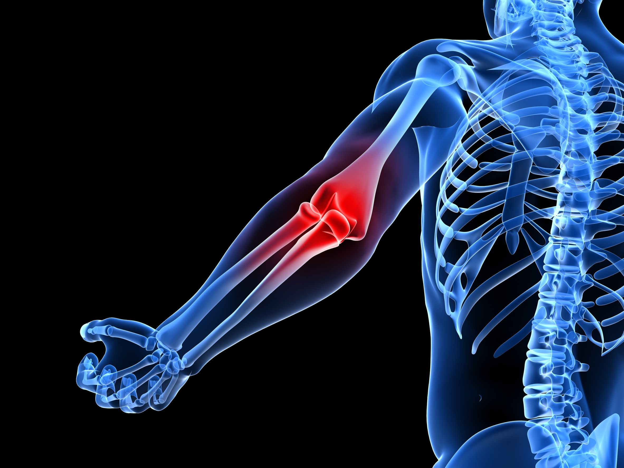
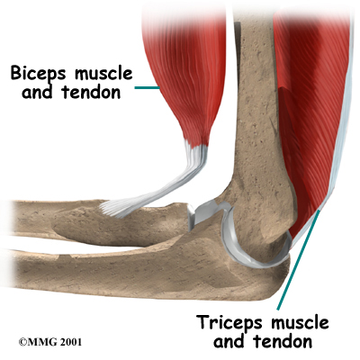
Elbow problems
Lateral Epicondylitis (Tennis Elbow), Medial Epicondylitis
Arthritis
Fractures/dislocations
Cubital Tunnel Syndrome
Radial Tunnel Syndrome

Slide 19
Lateral epicondylitis
Lateral Epicondylitis or “Tennis Elbow” produces pain at lateral side of elbow that can radiate down forearm, made worse by grasping and lifting objects with wrist extended.
Extensor tendons originate from outside of elbow or lateral epicondyle of the distal humerus
Due to inflammation, degeneration and micro tears of the tendon
Occurs in manual laborers (plumbers, painters, carpenters, gardeners) and athletes (esp. in racquet sports including tennis and golf)
(Medial Epicondylitis or “Golfer’s Elbow” –same on medial side)

Slide 20
Lateral epicondylitis

Slide 21
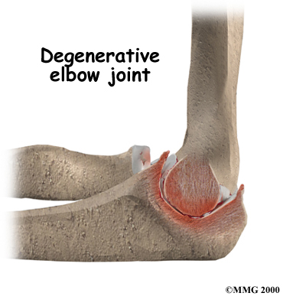
Elbow arthritis
Osteoarthritis
Rheumatoid arthritis
Post-traumatic arthritis
Arthritis can lead to pain, stiffness, and grinding
***Elbow stiffness makes it difficult to lift objects, reach and difficult get your hand to your mouth/face area for hygiene and feeding.***

Slide 22
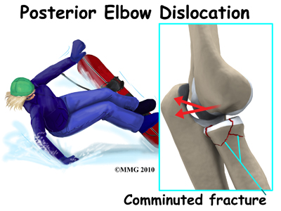
Elbow injuries
Fractures – distal humerus fx, olecranon fx, radial head fx
Dislocations
Ligament injuries
Injuries can result in pain, stiffness, and post-traumatic arthritis

Slide 23
Cubital tunnel syndrome
Cubital Tunnel Syndrome – compression of the ulnar nerve at the elbow.
Results in aching pain from medial elbow to ulnar hand
Numbness and tingling in ring and small fingers
***Decreased strength in hand – decreased grip strength, feeling of clumsiness or “uncoordinated” from decrease in fine motor skills due to intrinsic muscle weakness***
Visible atrophy or wasting of hand muscles at later stages

Slide 24
Cubital tunnel syndrome

Slide 25
Radial tunnel syndrome
Compression of radial nerve (posterior interosseus nerve or PIN) at the lateral elbow
Results in aching pain in lateral elbow and forearm
Called “resistant tennis elbow” – pain is about 4 cm distal to lateral epicondyle
Can lead to weakness of wrist and finger extension
Least common of the peripheral nerve compression neuropathies
Usually no numbness or tingling associated as PIN is a pure motor nerve at elbow level

Slide 26
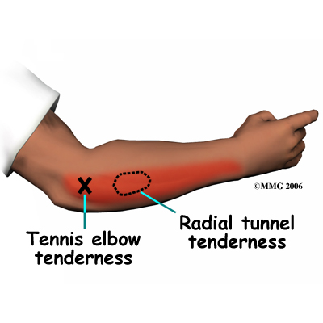
Radial tunnel syndrome

Slide 27
ELBOW RFC CONSIDERATIONS
ELBOW IMPAIRMENTS:
Lift/carry limits
Handling limits
Possible reaching limits
Possible fingering (ulnar nerve)

Slide 28
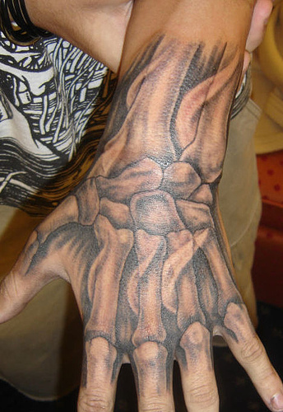
Wrist anatomy
Bones – forearm bones (distal radius and ulna) meet the 8 carpal bones
Joints – radiocarpal , mid carpal, distal radioulnar (DRUJ)
Extensor and Flexor tendons for wrist/hand
Median nerve at carpal tunnel, ulnar nerve at Guyon’s canal, superficial radial sensory nerve

Slide 29
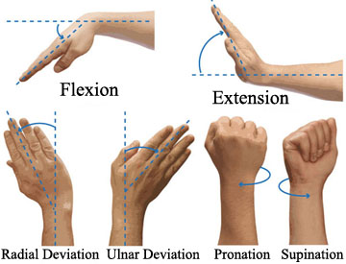
Wrist rom
Flexion 0-80
Extension 0-80
Ulnar deviation 0-30
Radial deviation 0-20
Tinel’s, Phalen’s
Finkelstein’s

Slide 30
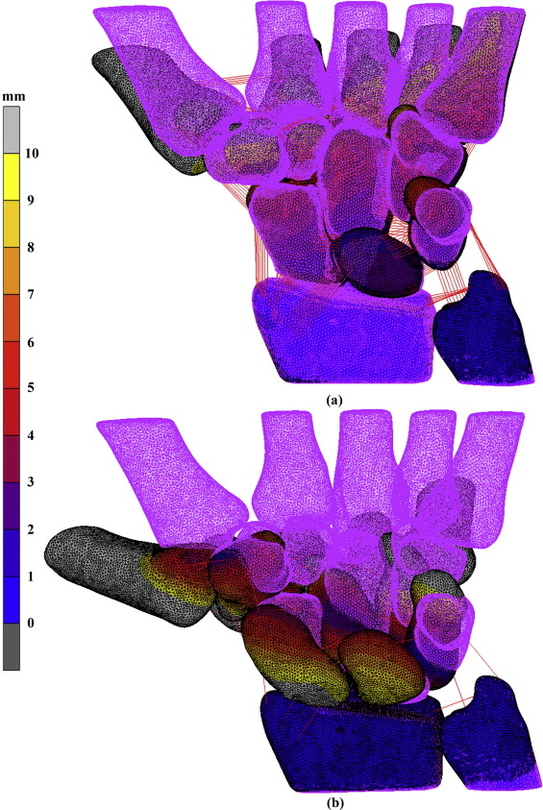
Wrist problems
Tendonitis – DeQuervain’s tendonitis, Extensor tendonitis, Flexor tendonitis
Arthritis – OA, RA, post-traumatic
Injuries – fractures, ligament tears, TFCC injuries

Slide 31
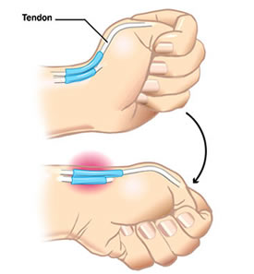
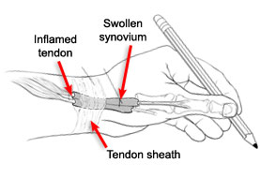
Wrist tendonitis
DeQuervain’s Tendonitis – tendonitis on thumb side of wrist, leads to pain with thumb movement and wrist movement.
+ Finkelstein’s test

Slide 32
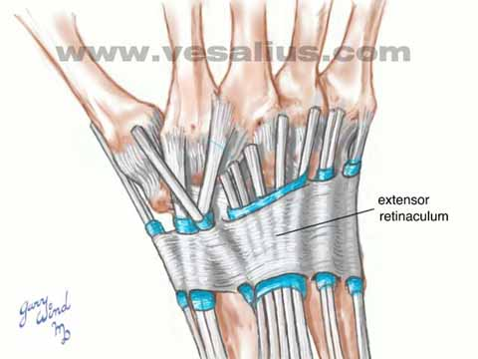
Wrist tendonitis
Extensor Tendonitis – EDC: occurs in RA and can lead to tendon ruptures; ECU: on small finger side of wrist, from repetitive use or trauma, pain in ulnar wrist with rotation of forearm
Flexor Tendonitis: FCR, FCU; repetitive use or trauma

Slide 33
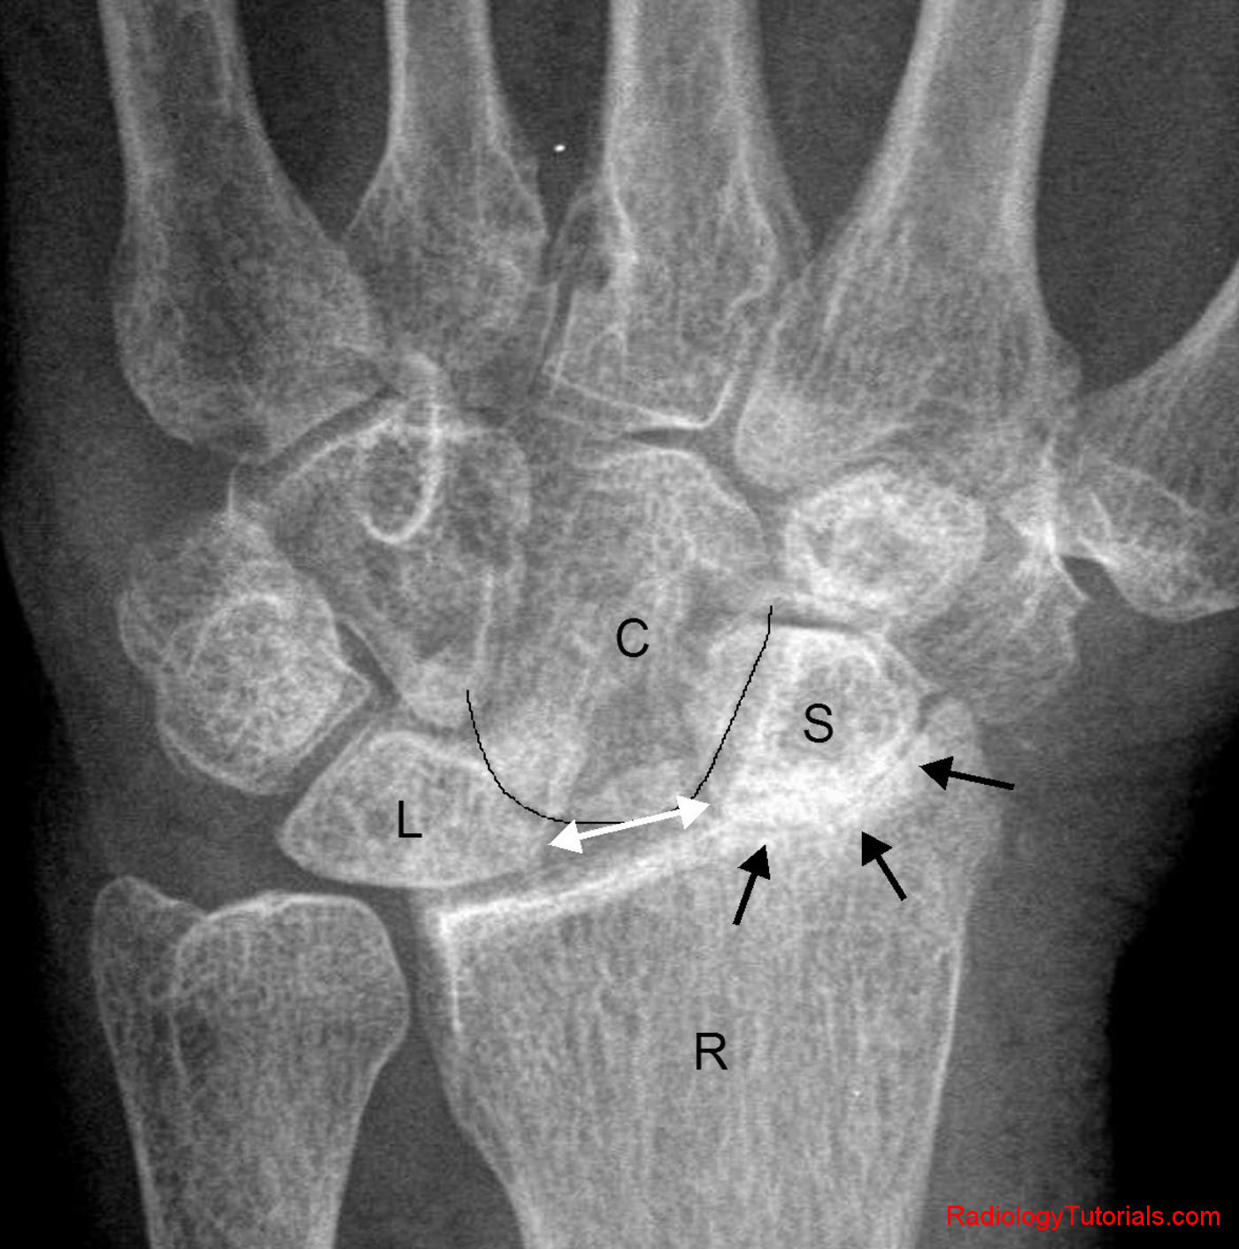
Wrist arthritis
OA
RA
Post-traumatic – common with scaphoid non-unions, or scapholunate ligament tears
Symptoms – pain, swelling, decreased ROM, decreased grip strength, difficulty grasping objects

Slide 34
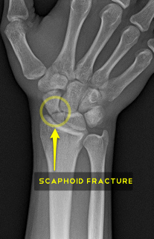
Wrist injuries
Distal radius fractures most common and usually do well
Scaphoid fractures can result in non-union due to delicate blood supply and/or missed diagnosis as wrist “sprain” as initial x-rays are often negative
Scaphoid non-union over time leads to post-traumatic wrist arthritis or SNAC (scaphoid nonunion advanced collapse) wrist
TFCC injuries – cartilage disc on ulnar side of wrist can be injured, like a meniscus in the knee

Slide 35
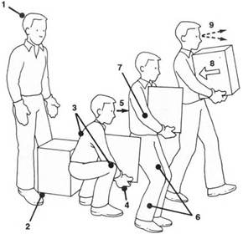
Wrist rfc considerations
WRIST IMPAIRMENTS:
Lift/carry limits
Handling limits
Possible fingering

Slide 36
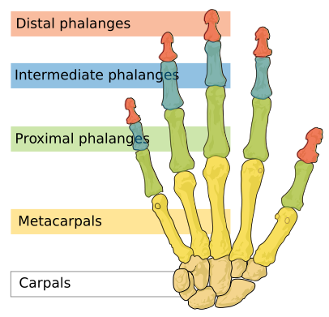
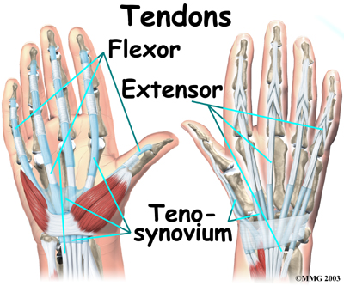
Hand anatomy
Complicated anatomy with many bones, joints, ligaments, nerves and tendons

Slide 37
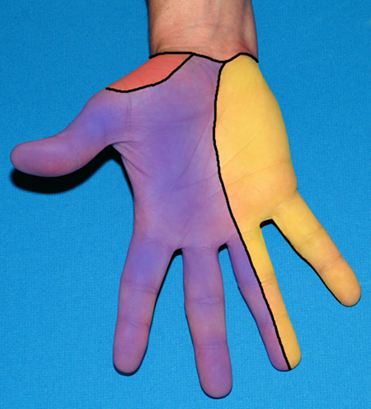
Hand anatomy
Sensory nerve distribution: median, ulnar, radial

Slide 38
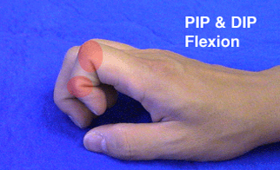
Hand rom
Finger Metacarpophalangeal Joints (MPJ): 0-90
Finger Proximal Interphalangeal Joints (PIPJ): 0-100
Finger Distal Interphalangeal Joints (DIPJ): 0-80
Thumb Metacarpophalangeal Joint (MPJ): 0-50
Thumb Interphalangeal Joint (IPJ): 0-80

Slide 39
Hand problems
CARPAL TUNNEL SYNDROME
CARPAL TUNNEL SYNDROME
CARPAL TUNNEL SYNDROME
Flexor Tendonitis - trigger fingers
CMC arthritis - Arthritis of basal joint of thumb
Finger joint arthritis – OA, RA, Psoriatic
Injuries – fractures, dislocations, ligaments

Slide 40
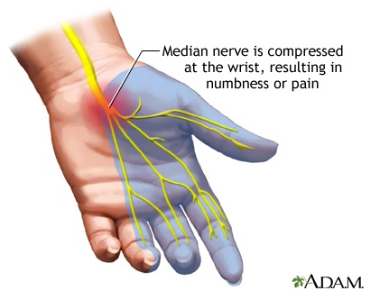
Carpal tunnel syndrome
Very common hand problem
Median nerve compression at wrist/base of palm
Carpal tunnel syndrome – pain, n/t in T/IF/MF/radial RF
Weak opposition of thumb

Slide 41
Carpal tunnel syndrome
CTS – most common compression neuropathy in UE
Increased pressure in carpal tunnel – usually idiopathic, increased in endocrine disorders (diabetes/hypothyroidism), post-traumatic, pregnancy, arthritis
Carpal tunnel is formed by carpal bones on bottom and a tight ligament on top. Median nerve and finger flexor tendons run through tunnel.
Increased pressure leads to nerve pain (often at night), numbness, tingling, and weakness of thumb opposition
+Tinel’s, +Phalen’s tests, +EMG-NCS

Slide 42
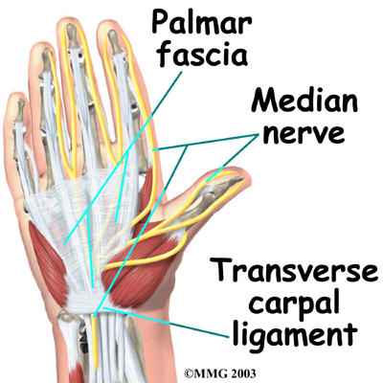
Carpal tunnel syndrome
Usually, there is a very good outcome with surgery (if needed)
Splint treatment/OT/injections in early stages

Slide 43
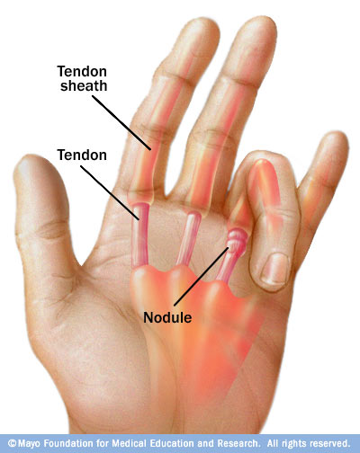
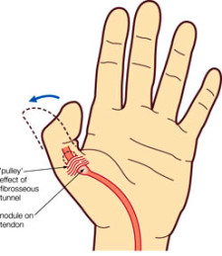
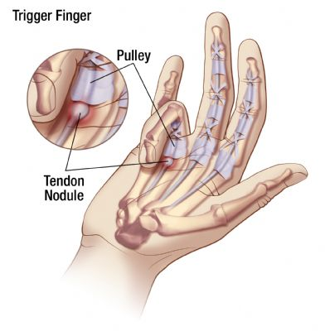
Flexor tendonitis
Trigger Fingers and Trigger Thumb

Slide 44
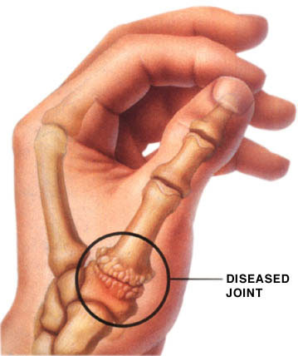
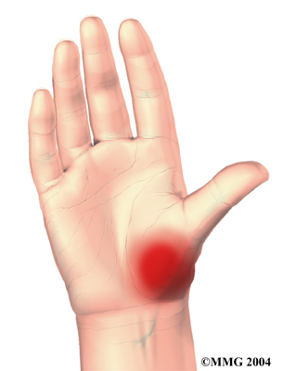
Cmc or basal joint arthritis
CMC (carpometacarpal) joint at base of the thumb
Common place for OA
Pain with thumb movement – grasp, pinch, writing, opening jars & bottles, turning keys, etc.

Slide 45
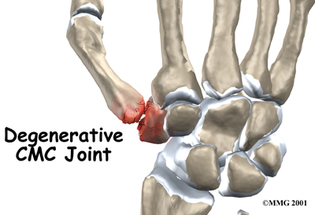
Cmc arthritis
Increased after age 40, women > men
Symptoms – pain, swelling, grinding, limited ROM, deformity, difficulty with hand function since thumb used in most hand activities

Slide 46
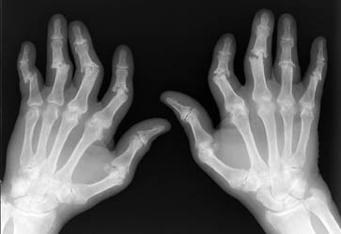
Hand/finger arthritis
OA
RA
Psoriatic Arthritis
Gout

Slide 47
Hand/finger arthritis
Symptoms – pain, swelling, stiffness, deformity, decreased ROM, decreased strength, Heberden’s nodes
***x-ray changes and clinical deformity do not necessarily correlate with pain and hand function***

Slide 48
Finger injuries
Fractures
Dislocations
Ligament Injuries – Skier’s Thumb

Slide 49
Hand rfc considerations
HAND IMPAIRMENTS:
Lift/carry limits
Fingering limits
Possible handling limits
Possible feeling limits

Slide 50
Arm impairments: rfc considerations
SHOULDER: lift/carry, overhead reaching, possible in front/lateral reaching, possible handling
ELBOW: lift/carry, handling, possible reaching, possible fingering
WRIST: lift/carry, handling, possible fingering
HAND: lift/carry, fingering, possible handling, possible feeling

Slide 51
Arm impairments: rfc considerations
If overall lift/carry already decreased, may not need as restrictive manipulative limits depending on type of impairment, severity, etc.
Consider the whole picture: allegations/complaints, pain, ADL’s, established impairments, PE, imaging studies, other tests.

Slide 52
Cracking knuckles
Question: “Does cracking knuckles lead to arthritis?”
Answer: NO!!! (though it may be annoying to others)
Dr. Unger published letter in 1998 Arthritis/Rheum journal after cracking knuckles of L hand daily for 50 years – no difference between his R and L hands.

Slide 53
The end
Thanks for listening!
Any questions?

