Slide 1

Donating Life
Colorado & Wyoming
Tae Stamper, Public Education Coordinator
Notes:
AIDET – Engage people to listen to you – SMILE, MOVE, LOOK AT THE AUDIENCE, TALK SLOWER, ENNUNCIATE, USE PROPER ENGLISH
ACKNOWLEDGE the audience for being there
INTRODUCE yourself
DURATION of speech plus a question and answer time
Explanation and thanks will be during later slides.
Blue slides are call to action slides

Slide 2
Agenda
1
4
Who is Donor Alliance?
Facts About Donation
2
Why Organ & Tissue Donation?
5
Learn More
3
The Donation Process and Need
6
How You Can Help
Notes:
Just paraphrase the agenda – save details for later
CLICK TO uncover each of the 6 AGENDA POINTS

Slide 3
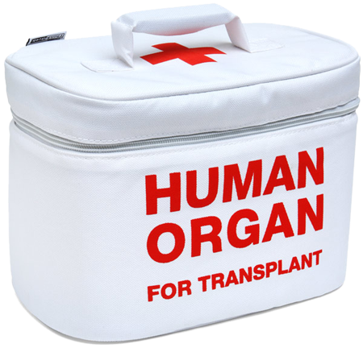
Who is Donor Alliance?
Not-for-profit Organ Procurement Organization (OPO), federally designated by Center for Medicaid
and Medicare Services (CMS)
  Facilitate the recovery of organ, eye
  and tissue donations for
  transplantation in Colorado & Wyoming
  Educate and inspire Coloradans & Wyomingites to register as organ, eye & tissue donors
Notes:
Donor Alliance is 1 of the 58 OPO’s in the U.S. covering Colorado and most of Wyoming
Donor Alliance is also an accredited tissue bank by AATB
Donor Alliance formed in 1997 from the merger of an OPO and a tissue bank already serving Colorado and Wyoming
Donor Alliance currently serves more the 5.5 million residents in the two states and beyond
CLICK Facilitate recovery
CLICK “We are the organ cooler people”
CLICK Educate our service area about the benefits of organ, eye and tissue donation

Slide 4
Facilitate the Donation Process
Medical Maintenance
List Matching
Donor Evaluation
Transplant Center
OR Scheduling
Donor Hospital
Quality Control
Transportation
Notes:
(These should be facilitation description. The process of donation will be described in detail later.) Pose the question, “How does a donor get paired with recipients?”
CLICK Donor Evaluation – TISSUE RECOVRY COORDINATORS or FAMILY SUPPORT COORDINATOR
CLICK Medical Maintenance – ORGAN RECOVERY COORDINATOR
CLICK List Matching – UNOS
CLICK OR Scheduling – in hospital or Recovery Center (Brain Dead ONLY), pediatric always at Children’s and DCD always at hospital
CLICK Transportation – planes or ambulance – we go out or donor comes to Recovery Center
CLICK Quality Control – many individuals are tasked with ensuring the process is safe, beneficial and fair to all in Donor Alliance’s service area

Slide 5
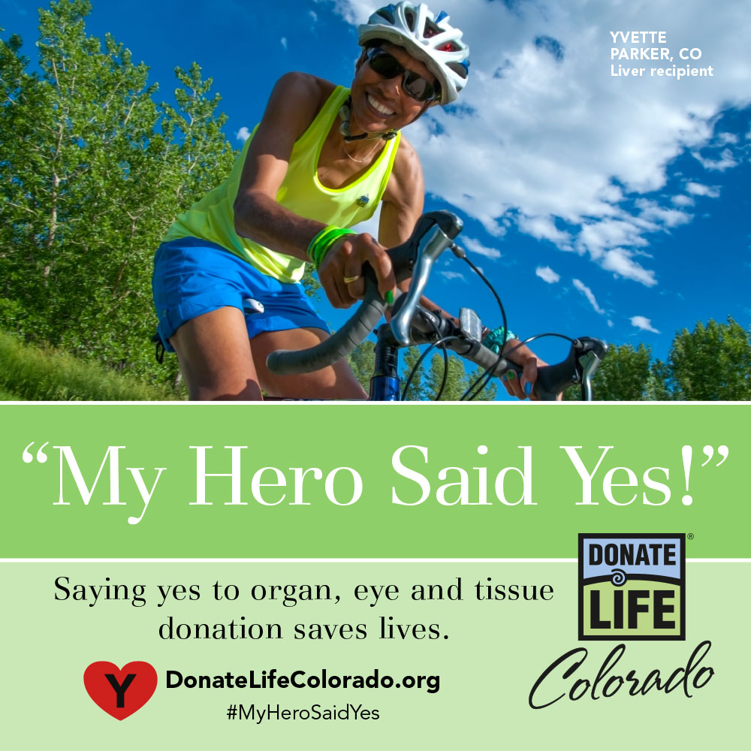

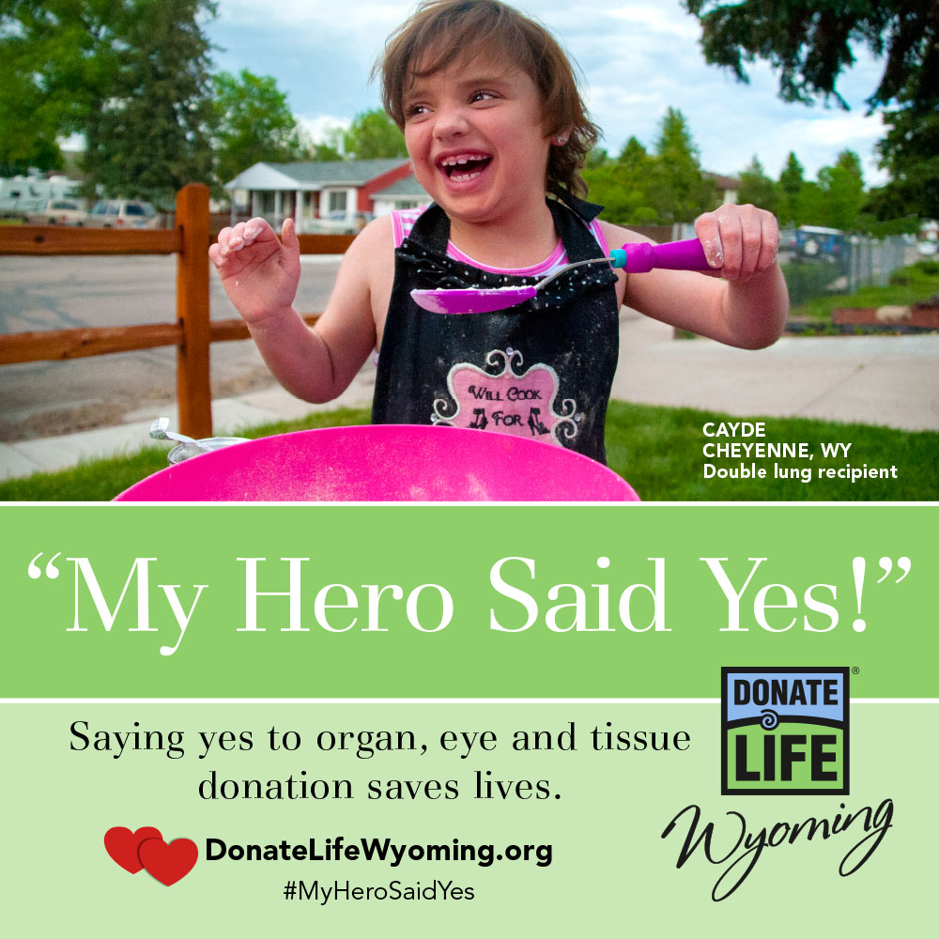
What about Donate Life?
Notes:
Donate Life Colorado or Wyoming is the brand of the donor registry, the Donate Life Colorado and Wyoming Organ & Tissue Donor Registry.
Donor Alliance manages the donor registry, per statute
This largely encapsulates the portion of DA’s duties to educate and inspire the public to register as organ, eye and tissue donors.

Slide 6

Why Do We Do What We Do?
Notes:
This is a question for the audience if manageable, or a moment to lead the audience to think about donation as a public health crises. This should tie into the next slide of DA mission – saving lives through organ & tissue donation
Good probing thought, “Think about a time when you were really sick or hurt. Now, imagine never getting better, being in a constant state of illness unless you get a transplant.”

Slide 7
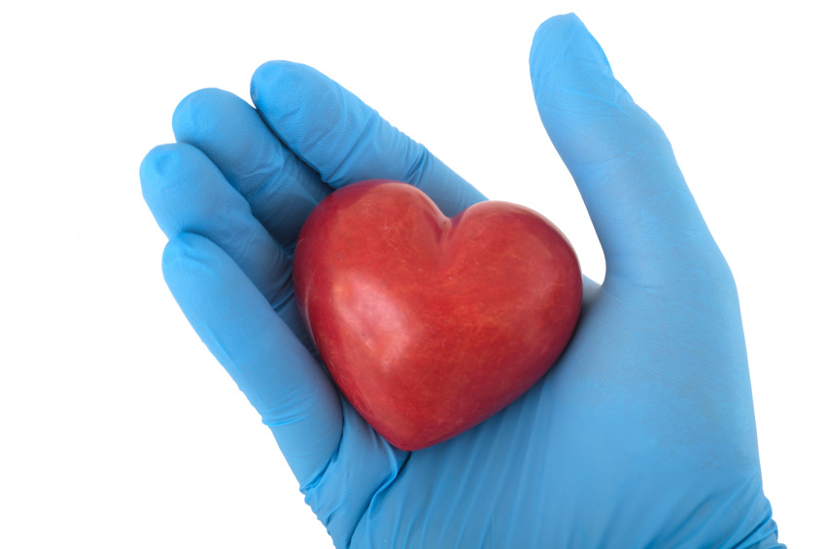
OUR MISSION
SAVING LIVES
THROUGH
ORGAN & TISSUE DONATION
Notes:
Read our mission statement
Don’t expand on the concept – simple and concise is best

Slide 8


Donor Service Area & Partners
DLOs
Transplant Centers
  University of Colorado Hospital
  Presbyterian - St. Luke’s
  Porter Adventist
  Children’s Hospital
20 Counties
24 Hospitals
63 Counties
81 Hospitals
Tissue Processors - Two Local:
  AlloSource
  Rocky Mountain Lions Eye Bank
Numerous Funeral Homes & Coroners
Notes:
There are 4 transplant centers – all located in Denver serving a diverse population
Have done tens of thousands of organ transplants – heart, kidney, pancreas, lung, and liver
There a two local tissue processors creating jobs and biotech innovation in DA’s service area
AlloSource – located in Centennial, south of Denver; world’s largest processor of cellular bone grafts
RMLEB – located on CU – Anschutz Medical campus; one of two eye banks pioneering new corneal transplant technique

Slide 9
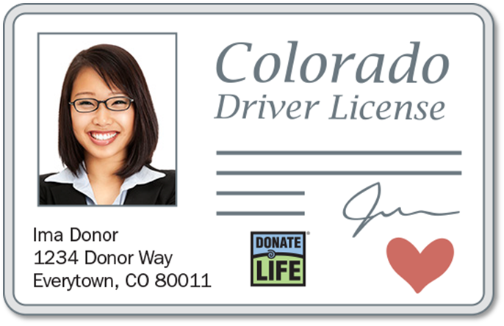
What is the donor registry?
A confidential, electronic database listing every Coloradoan or Wyomingite whom has elected to be an organ and tissue donor after death
Opt-in
Centralized
Confidential
Established by law
1st person consent
Mature
Est. 2001 & 2003
Notes:
CLICK LAW: The Uniform Anatomical Gift Act was passed by the Colorado Legislature in 1998 and Wyoming in 2003, enacting the donor registry. Recognizes the right of adult individuals to choose how they wish to have their bodies utilized without subsequent consultation with their family members.
CLICK MATURE: A registry that has been through at least one renewal cycle so every person has had a chance to obtain a license at least once [5 – 10 year]
CLICK CONFIDENTIAL: State law prohibits registry information from being sold or shared with any company or government agency. Your registry status is only accessed at the time of death by those agencies directly involved in the organ, eye and tissue donation process as outlined by state law.
CLICK CENTRALIZED: one, electronic database that encapsulates both DMV and online registrants
CLICK 1st PERSON CONSENT: makes individual’s intent to be a posthumous organ donor legally binding, much like a living will or advance directive. Donor decision is paramount and should be respected.
CLICK OPT-IN: explicit consent, people must take a concrete action to declare they want to be a donor. (versus opt-out or presumed consent)

Slide 10

Donor Designation Rate
Nearly
68%
Of Coloradans say ‘Yes’ and register as donors
Nearly
60%
Of Wyomingites say ‘Yes’ and register as donors
Donor Designation Rate (DDR) is the percent of people who say “Yes” to organ & tissue donation and get the on their driver’s license.
Notes:
CLICK Colorado second highest rate for DDR in the country.
CLICK Wyoming is in the top ten.
Many factors go into making Colorado successful in DDRs
outreach with our community
relationship with DLOs
Transplantation Science program for middle and high schools
Social media outreach

Slide 11



Generosity of Coloradans and Wyomingites
CO HAS THE
2nd HIGHEST
DDR!
1 Can
Save 8!
Notes:
Colorado is consistently in the top for DDRs, and is currently number 2! Wyoming is usually in the top 10.
CLICK Showed consistent growth until 2011, but hit a plateau, despite nearly 90% of people believing in organ, eye and tissue donation.
This slide sets up the next slide, don’t elaborate

Slide 12
The Gap
Nearly 100,000!
Notes:
Despite our generosity, there is still a need – there is a huge gap between potential organs transplanted
There are several reasons for this gap:
Currently, only 1% of people that pass are able to be donors
Logistics of donation play a role, but are improving at matching donors and recipients to minimize issues
The most important factor is time – having peoples wishes known to the family improves the chance their gift will save a life
One piece of new technology is organ pumps, that help keep an organ viable for a longer period of time
This produces a national gap of nearly 100,000 people waiting for an organ transplant

Slide 13
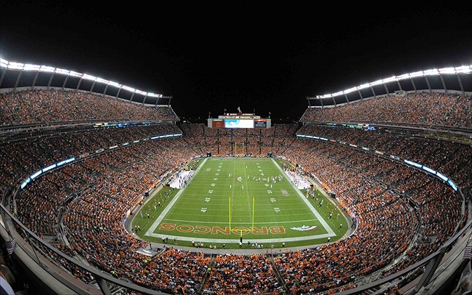
The National Need
In the U.S…
more than
120,000
are waiting for a lifesaving transplant
It would take 1 ½ stadiums the size of
Sports Authority Field at Mile High to seat them all.
Notes:
Organ failure is a public health crises
Every 10 minutes a new person is added to the waiting list
Due to increase medical advancements, patients are living longer, but not always better
Organ and tissue transplantation is important medical procedure to restore health to patients
22 people die each day waiting for a transplant

Slide 14
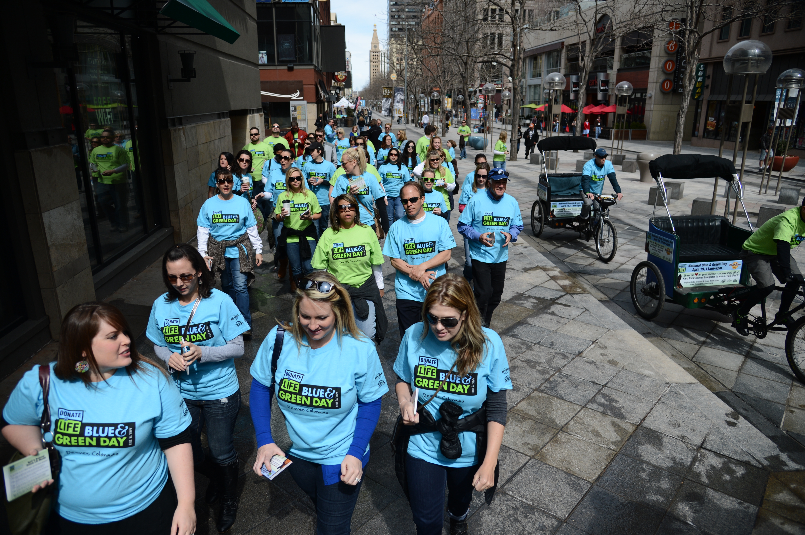
But its not my neighbors, right?
In Colorado…
more than
2,500
are waiting for a lifesaving transplant
400 lives are saved on average each year thanks to donors from Colorado & Wyoming
Notes:
Organ donation is a national health issue, and affects Coloradoans and Wyomingites, too
Colorado and Wyoming would make the third largest state land-wise – behind Texas and Alaska – DA’s service area is large!
The more than 2500 people waiting is the population of Leadville, the highest city in the United States, or would be the 30th largest city in Wyoming
The majority of people wait more than two years for a life saving transplant in Colorado and Wyoming

Slide 15
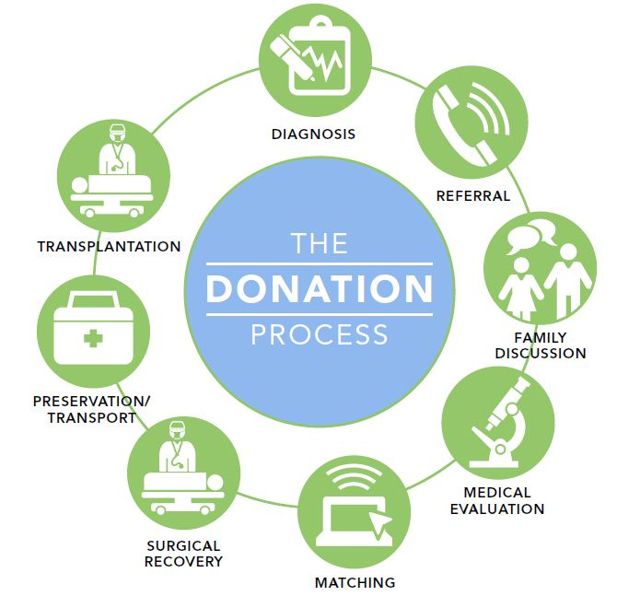
Donation Process Overview
Notes:
Diagnosis
Brain Death: Complete and irreversible cessation of all functions of the brain, including the brain stem. Not the same as coma or vegetative state.
Donation After Circulatory Death: Surgical recovery of organs after the pronouncement of death based on the cessation of cardiopulmonary function
IF time allows (5 minutes) , advance to the next slide and play video
Referal – call from hospital to Donor Alliance with diagnosis
Family Discussion – Family Support Coordinator or Tissue Donor Coordinator contacts family about donation
Medical Evaluation – patient history, medical records reviewed and labs will be taken
Matching – blood typing, patient size and age and other factors are sent to UNOS for donor/recipient matching
Surgical Recovery – donor transported to DA recovery center or performed in hospital OR
Preservation/Transportation – organs are packed to help preserve their function – organ pumps are being used, currently kidneys and soon lungs
Transplantation – the recovered organs are delivered to a transplantation hospital and implanted. Up to 8 patients can be saved by one donor.

Slide 16
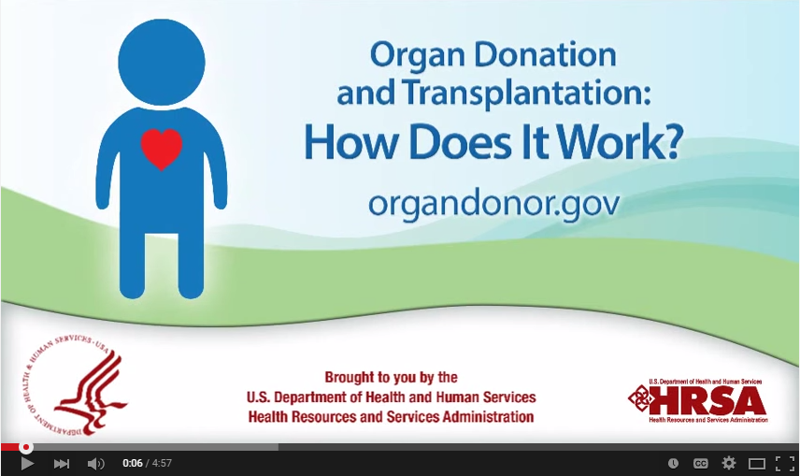
The Donation Process
Notes:
Animated video about donation process. Plays 4:57.
Click anywhere within the video frame to start/stop. Clicking outside the video frame will advance the slide.
HIDE THIS SLIDE IF TIME/TECHNICAL FACTORS ARE AN ISSUE. NEEDS SPEAKERS FOR AUDIO!

Slide 17
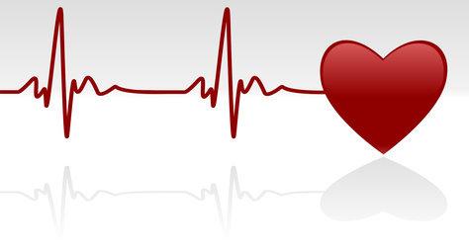


Donor Alliance’s Role in Donation Process
1
Patient care from the hospital is priority #1
2
At patient passing or with certain clinical triggers, the OPO is contacted
3
Two types of death are eligible for organ donation:
  Brain Death
  Cardiac (DCD)
UNOS
4
Registry is checked for consent or family
is approached for organ, eye and tissue donation.

Slide 18

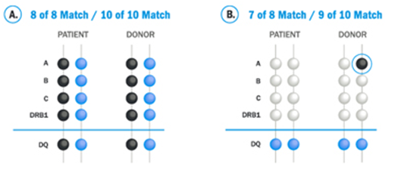




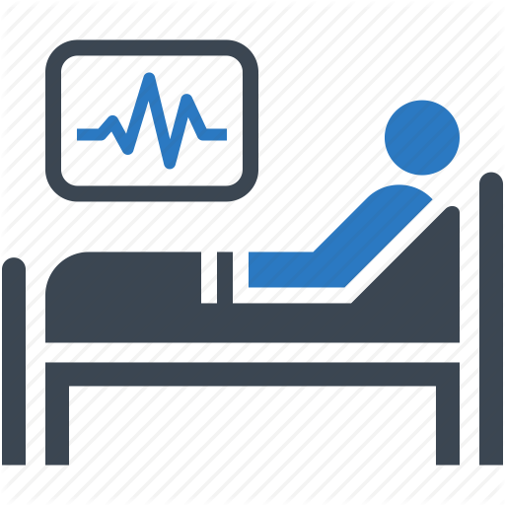
Donor Alliance’s Role in Donation Process
Tissue
Typing
UNOS
Blood Typing
Time on
Waiting List
Height
Severity of
Illness
Distance Between
Donor and Recipient
Notes:
There are many factors that are used to place organs
Blood typing is something most people have heard of – A, AB, B, O and positive or negative rH factor
Height – organs have size, too
Distance – organs must be transplanted within a certain time frame (heart 4 hours, lungs 6 hours, liver 8 – 12 hours, pancreas 12 – 18 hours, kidneys 24 – 36 hours)
Severity of Illness – patients that are most ill are most in need and move to the top of the list
Waiting time – can be long for many organs; but the longer on the list, the more a patient will move up despite medical urgency
Tissue typing – like blood typing, there are many antigens and antibodies at play in the human body, which can cause rejection if there are great variances

Slide 19




Donor Alliance’s Role in Donation Process
Transportation
Recovery Center
Or Hospital
Transplant Center
Or Tissue Bank
Notes:
Donors are taken to surgical suites in Donor Alliance’s recovery center or at a hospital, depending on wishes of family and other needs. Can be done at funeral homes or other places.
CLICK Organs and tissues are transported to ensure time constraints of donation
CLICK A waiting patient will get the life saving organ they need, or tissue will be further made ready and then transplanted

Slide 20
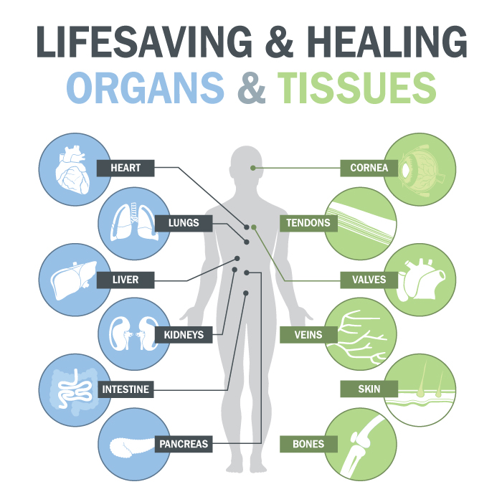
What can be Transplanted?
Notes:
Heart – transplant within 4 hours. Circulates blood to lungs and body. Reasons for transplant – heart failure, congenital defects, cardiomyopathies
Lungs – transplant within 6 hours; can be one or en-bloc. Allows gas exchange. Reasons for transplant – cystic fibrosis, chronic obstructive pulmonary disease (COPD)
Liver - transplant within 12 hours; can be partial liver (living donor) or split liver. Reasons for transplant – hepatitis, cirrhosis, biliary atresia, sclerosing cholangitis
Kidneys – transplant within 72 hours; recipient usually only needs one, can be living donor. Reasons for transplant – diabetes, tumors, hereditary disease (polycystic kidneys)
Intestine – Reasons for transplant - liver dysfunction, repeated episodes of dehydration, life threatening feeding needs
Pancreas – transplant within 18 hours. Produces hormones and insulin and glucagon. Reason for transplant – type 1 diabetes
Cornea – protects the eye and responsible for 75% of focusing. Reason for transplant – damage, infection, Fuchs dystrophy
Tendons – connects bone to bone. Reason for transplant– injury, severe pain or loss of function of joint
Veins – carry blood back to heart. In transplant, are used to carry blood away from heart, like an artery. Reason for transplant – coronary artery disease
Skin – a protective layer. Reason for transplant – burns, skin lesions, decubitus ulcers (bed sores)
Bones – assist with movement; protection. Reason for transplant – fractures, scoliosis, degenerative bone disease

Slide 21
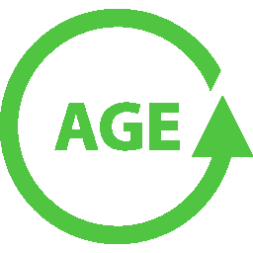

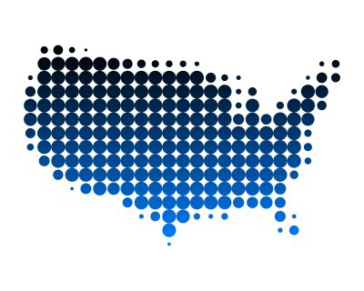



6 Truths about Donation
Open Casket Funeral
Is possible
1
Any
5
or
Medical Care Is
Top Priority
90% - Believe In Donation
2
6
3
7
Quality of Care for
Donors and Family
4
Donation is a Free
Gift
8
All Major
Notes:
1 - Anybody, any age, any medical condition can join the registry. Medical evaluations are done at time of passing. Oldest organ donor – 91(liver); tissue donor – 105 (skin).
2 - Medical care is our primary concern – saving lives is the mission of Donor Alliance
3 - One donor can save 8 lives and heal 100
4 - Donation is an altruistic act – and there is no cost for donation
5 - An open casket funeral is possible – all staff are highly trained surgeons, RN’s, surgical techs and other medical professionals
6 – 90% of Americans believe organ, eye and tissue donation
7 - Donor’s and their families receive the same compassion and high quality care as in the best hospitals
8 - All major religions support organ, eye and tissue donation

Slide 22
Learn More
U.S. Dept. of Health and Human Services
  OrganDonor.gov
Donate Life America
  DonateLifeAmerica.org
National Institute of Health
  NLM.NIH.gov/medlineplus/organdonation
Donate Life Colorado
  DonateLifeColorado.org
Notes:
There are many websites that have organ, eye and tissue donation information
These websites have best practice and current, science based information

Slide 23
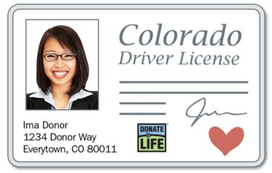
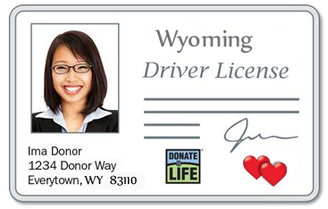

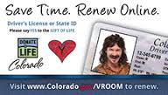
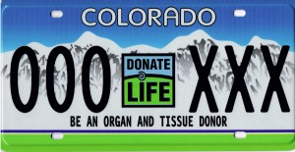
How Can You Help?
Say ‘YES’ at the DMV to becoming an eye, organ and tissue donor.
Notes:
Pose the question: ‘How can you help?’
Click reveals say ‘YES’ at DMV
This is the single best action a person can do – constitutes first person consent for donation

Slide 24

How Can You Help? Find us on:
Notes:
You can find us on the Internet
CLICK Donoralliance.org, donatelifecolorado.org and donatelifewyoming.org
CLICK Facebook and Twitter
CLICK Most importantly – you can register to be a donor at donoralliance.org or Donate Life Colorado or Wyoming .org sites

Slide 25

How Can You Help?
Notes:
Let your family know your decision
This eases your loved ones’ decisions during a difficult time
Increases the chance of finding a match for all your life saving gifts

Slide 26

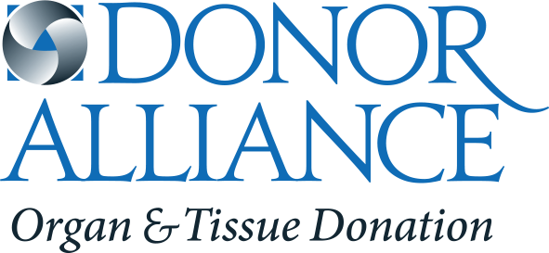
Thank you!
Notes:
Ask for questions if the event is conducive to a Q and A session
Thank the audience

