Slide 1

Disability Evaluation of Vague Neurological Disorders
Amelia Scott Barrett, MD

Slide 2

The Tricky Ones
Migraine
Multiple Sclerosis
Epilepsy

Slide 3
The Easy Ones
Parkinson’s Disease
ALS

Slide 4
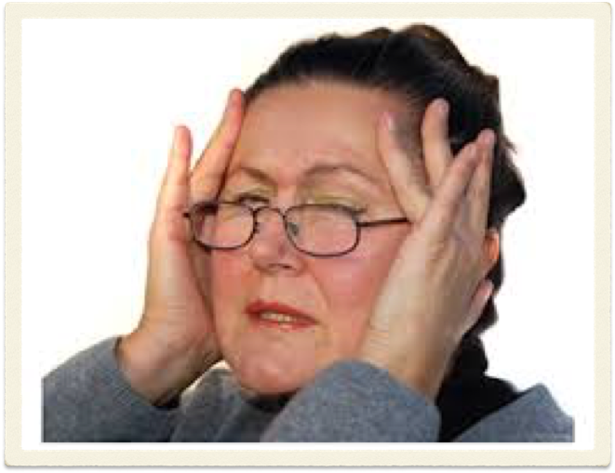
Migraine

Slide 5
11.03 Epilepsy - nonconvulsive epilepsy (petit mal, psychomotor, or focal), documented by detailed description of a typical seizure pattern including all associated phenomena, occurring more frequently than once weekly in spite of at least 3 months of prescribed treatment. With alteration of awareness or loss of consciousness and transient postictal manifestations of unconventional behavior or significant interference with activity during the day.

Slide 6
Proposed guidelines
Disability for migraine should generally be denied
Patient is on an anxiolytic (SSRI such as Prozac, SNRI such as Cymbalta, Tricyclic such as amitriptyline) or in counseling
Patient has had all tests doctor recommends and honestly tries medications
Patient has daily headaches, multiple trips to the ER for non-narcotic medications
Patient reports an impact on personal life as well as ability to work

Slide 7
Anxiety
A meta-analysis of high quality epidemiological study data from 1990-2012 indicates that the incidence of anxiety disorder is nearly four times greater among migraine patients. Headache, 2013, Jan; 53 (1): 23-45.

Slide 8
Clues to anxiety
Insomnia
Multiple symptoms, heart racing, GI problems, reports of stress, eye twitching/muscle twitching

Slide 9
Proposed guidelines
Disability for migraine should generally be denied
Patient is on an anxiolytic (SSRI such as Prozac, SNRI such as Cymbalta, Tricyclic such as amitriptyline) or in counseling
Patient has had all tests doctor recommends and honestly tries medications
Patient has daily headaches, multiple trips to the ER for non-narcotic medications
Patient reports an impact on personal life as well as ability to work

Slide 10
Malingering
Malingering is the intentional exaggeration of symptoms
People malinger for the purpose of obtaining an external reward such as disability

Slide 11
Clues to malingering
Primary Psychiatry 2006;13(1):61-69
Not getting tests done that the doctor ordered
Noncompliance with medications
Frequent side effects from medications
Never has a headache during office visit

Slide 12
Does the type of migraine matter?
No.
Auras are not debilitating for longer than an hour, and are not a cause of chronic disability
There is no significant differences in the severity of migraine provoked by stress, hormonal changes, or any other cause

Slide 13
Should side effects of medications be considered?
No.
People do vary in how their body processes medications, but side effects can be relieved by lowering the dose.
People who are truly in pain are willing to tolerate some level of side effects in order to achieve pain relief.

Slide 14
What should be considered “exhausting all treatment options?”
  Anti epileptic medications: Topamax, Depakote, Gabapentin
  Tricyclic medications: Amitriptyline, Nortritpyline
  Antihypertensives: beta blockers and calcium channel blockers
  Botox
  SSRI (Prozac, Paxil, Zoloft, Lexapro) or SNRI (Cymbalta, venlafaxine)

Slide 15
Proposed guidelines
Disability for migraine should generally be denied
Patient is on an anxiolytic (SSRI such as Prozac, SNRI such as Cymbalta, Tricyclic such as amitriptyline) or in counseling
Patient has had all tests doctor recommends and honestly tries medications
Patient has daily headaches, multiple trips to the ER for non-narcotic medications
Patient reports an impact on personal life as well as ability to work

Slide 16
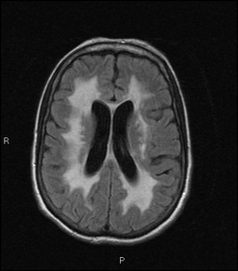
Multiple Sclerosis

Slide 17
Common causes of disability in MS
Physical: Difficulty walking or using hands for fine motor. Check the neuro exam in the notes for:
    Weakness
    Increased tone or spasticity
    Gait aid

Slide 18
Common causes of disability in MS
Cognitive: Check Neuropsych testing for:
  Impaired “executive functioning” or “subcortical dysfunction”
  Exclude treatable conditions such as depression or sleep disorders

Slide 19
Suspicious causes of disability in MS
Fatigue: aren’t we all?!!
Bladder/bowel problems: late in disease
Early disease (first 5-10 years)

Slide 20
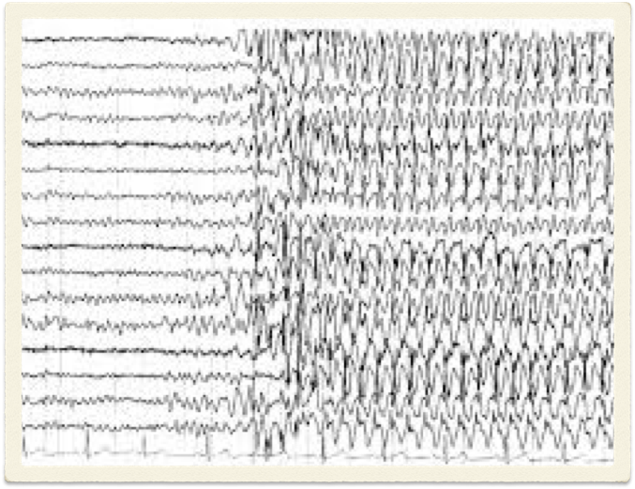
Epilepsy

Slide 21
ADA Amendment Act
An impairment that is episodic or in remission is a disability if it would substantially limit a major life activity when active

Slide 22
Epilepsy
Driving is the key issue to disability in Epilepsy
Colorado standard of care is that patients cannot drive for 3-6 months after a seizure
DOT license (paramedics, firefighters, etc.): no driving for 5-10 years after a seizure

Slide 23
Epilepsy
The vast majority of patients are cognitively normal between seizures
It would be reasonable to require a day off after a grand mal seizure

Slide 24
“Non epileptic seizures”
Confirmed with Ambulatory EEG recording, during which a patient wears EEG electrodes on their head for several days to record brain activity during suspected seizures
If there is normal brain activity during the suspected seizure, then it is called a “nonepileptic seizure.”

Slide 25
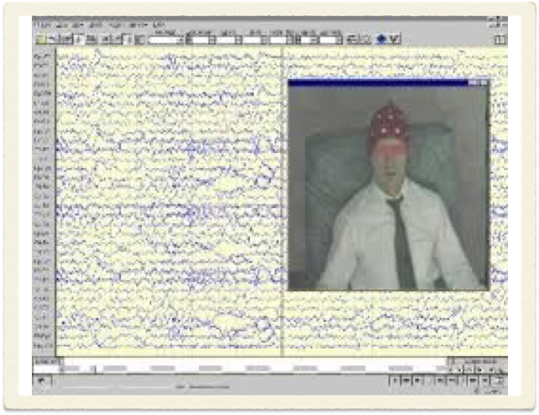

Slide 26
Case studies
45-year-old female with chronic daily migraine. Had a normal MRI, but refused LP. Had MRI, but refused LP Has tried twelve different medications to prevent headaches but does not like antidepressants. Frequent rips to the ER, where she is treated with narcotics about half the time.

Slide 27
Case Studies
52-year-old female who has had MS for ten years, takes Rebif, Baclofen, and Ditropan. Exam shows spasticity of gait with hyperreflexia, and she has started using a cane. Symptoms include fatigue, episodes of incontinence at work, and falls.

Slide 28
Case Studies
62-year-old male with a lifelong history of previously well-controlled seizures, which have recently worsened after a divorce. He is having grand mal seizures approximately once a week, which have not responded to three different medications.

Slide 29
Case Studies
54-year-old teacher diagnosed with ALS six months ago. Exam shows right leg weakness resulting in falls, and history includes occasional choking on food.

Slide 30
Case Studies
20-year-old male with a history of birth trauma and seizures approximately once a month. Graduated from high school, has difficulty holding down a job. Neuropsych testing shows below average IQ and impaired executive functioning.

Slide 31
Case Studies
55-year-old male with MS for the past three years with cognitive impairment so severe that he can longer work. Neuropsych testing shows wildly impaired cognitive performance, depression, and anxiety. Uses a cane to walk, but exam shows no weakness or spasticity.

Slide 32
Case Studies
57-year-old female with Parkinson’s Disease for five years. She has episodes of freezing at work, where she can’t move. She has also been making mistakes on the job, which caused a poor performance review.

Slide 33
Amelia Scott Barrett, MD
Rocky Mountain Neurology
10103 Ridge Gate Parkway, Suite 125
Lone Tree, Colorado 80124
303-790-8899
www.rockymountainneurology.com

